Slide 1
Animal research: a brief overview
These slides have been developed by members of the
American Psychological Association (APA)
Committee on Animal Research and Ethics
March 2024
Notes:
Introduction to slides: This slide deck, developed by members of the American Psychological Association (APA) Committee on Animal Research and Ethics (CARE), provides a brief overview of animal research in the United States. It is intended for educational purposes, and it is free to disseminate with attribution to academic and research institutions, veterinary and medical schools, and companies to raise awareness about the importance of animals in behavioral and biomedical research. The slides include brief explanatory text in the speaker notes.
When using or adapting for use, please acknowledge APA/CARE as the source.
Direct questions to: Science@apa.org

Slide 2
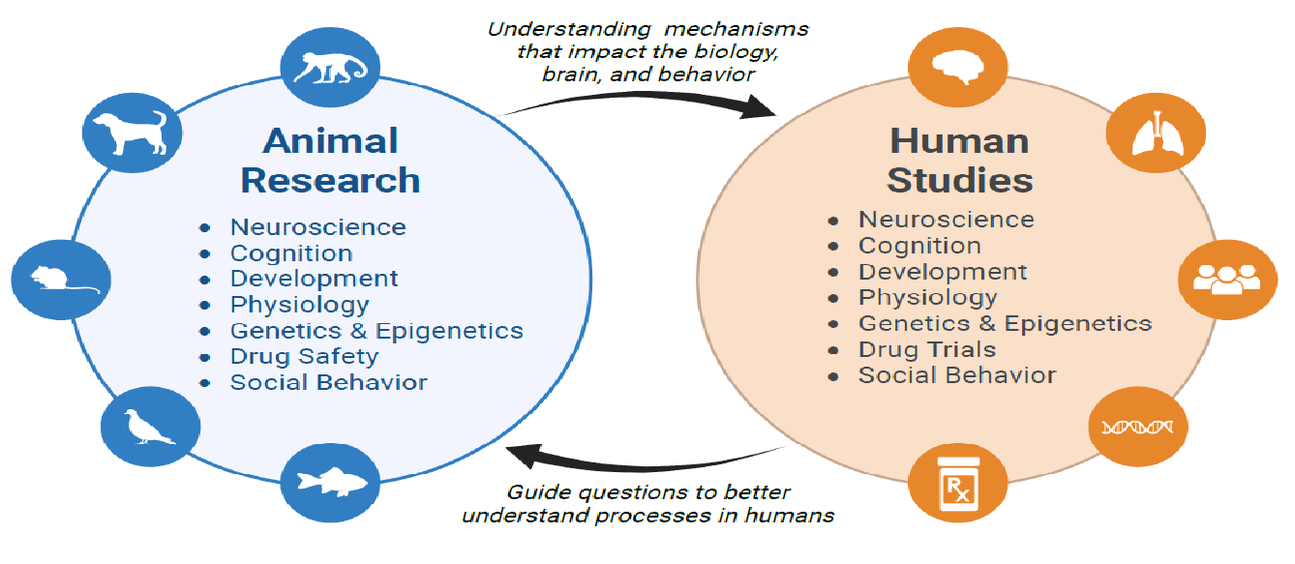
Why animal research?
Animal research is foundational to the discipline of psychology and is fundamental to the advancement of psychological science
Figure Created with Biorender
Modified from Phillips & Roth, 2019
Notes:
Phillips NLH, Roth TL. Animal Models and Their Contribution to Our Understanding of the Relationship Between Environments, Epigenetic Modifications, and Behavior. Genes (Basel). 2019 Jan 15;10(1):47. doi: 10.3390/genes10010047. PMID: 30650619; PMCID: PMC6357183.
Figure Credit: Interactions between animal research and studies in human subjects. Brett Frye; created with Biorender.
Speaker Notes: Animal research is foundational to the discipline of psychology and is fundamental to the advancement of psychological science. Animal research aims to understand the mechanisms that impact biology, the brain, and behavior. Human studies can guide the questions to be investigated using animals to better understand human processes.

Slide 3
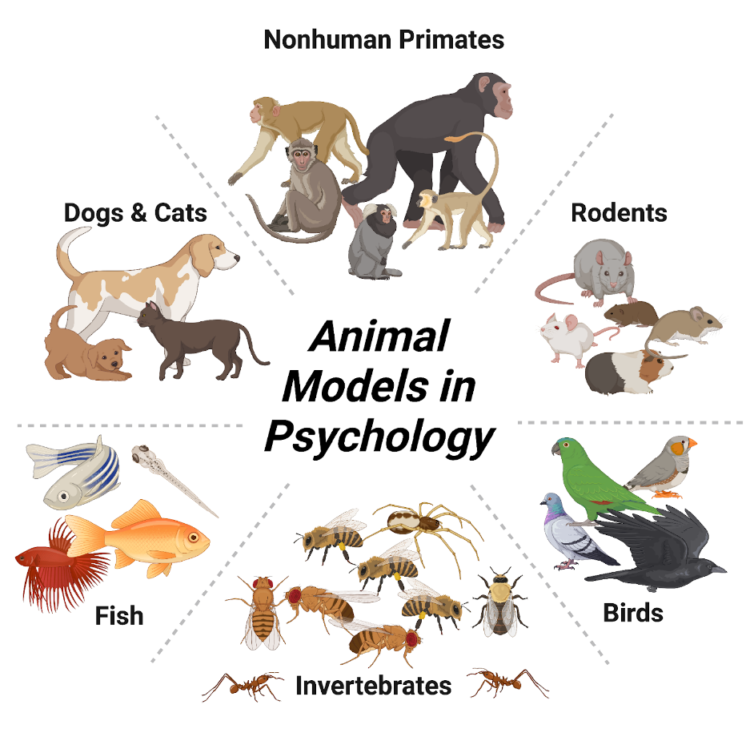
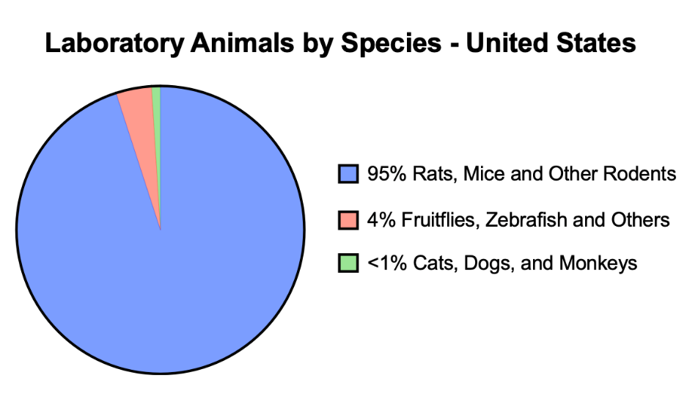
Animal Models in Psychology
Data Source: Love Animals? Support Animal Research.
Foundation for Biomedical Science (2017).
Figure Created with Biorender
Notes:
Figure Credit: ”Animal Models in Psychology” Brett Frye; created with Biorender.
Speaker Notes: Different animal species are chosen for research based on their biological similarities to humans, practical considerations, and specific research objectives.
The vast majority (95%) of animal research is conducted in rodents. Research that uses larger animals, like cats, dogs, and nonhuman primates constitutes <1 % of research conducted in animals

Slide 4
Basic Research
Understanding the causal mechanisms underlying behavior at the genetic, molecular, cellular, circuit or system levels.
Without animals, we often can only identify factors that are associated with behavior.
Notes:
Speaker Notes: Basic research is essential to understand the mechanisms underlying behavior and is not necessarily translational. Translational research aims to generate outcomes that directly impact and improve human health. Its objective is to expedite the transformation of fundamental (i.e., basic) scientific findings into practical applications for the benefit of society.
An example of purely basic research is acquiring new knowledge about brain function, which can be studied at all levels of analysis, from molecular to system levels. More generally, basic research can help discover the set of rules that govern how life functions.

Slide 5
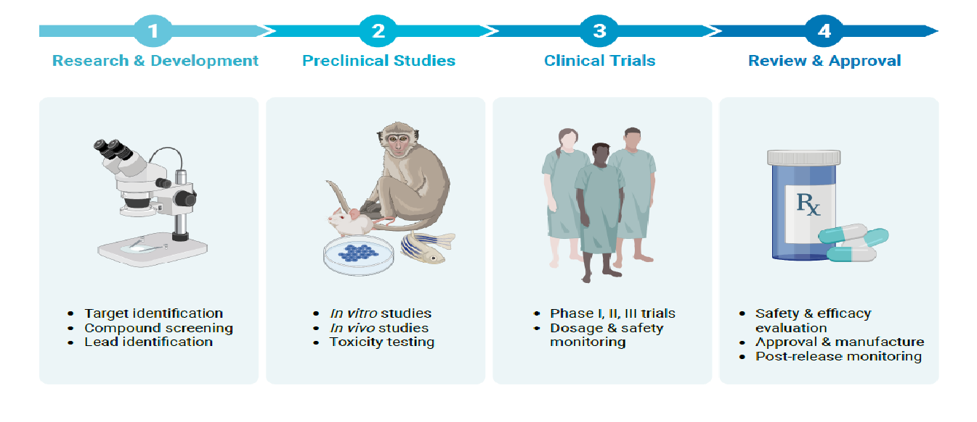
Translational Research
Figure Created with Biorender
Notes:
Figure Credit: Pipeline of ”Translational Research” Brett Frye; created with Biorender.
Speaker Notes: Animal research plays a crucial role in nearly every medical breakthrough. These breakthroughs help to improve the lives of humans AND animals.
In many cases, knowledge gained from animal research can be directly applicable to human health. That is, it is of great translational value. Animals provide valuable insights into disease mechanisms, drug efficacy, and safety, allowing for the development of new treatments and interventions.

Slide 6
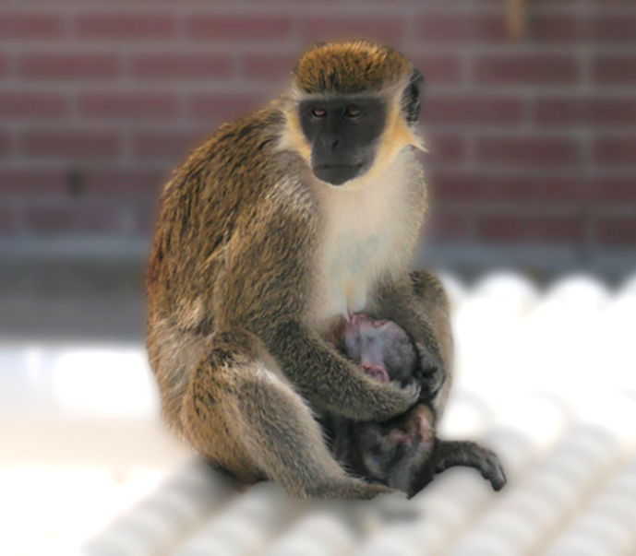
Ethical Considerations
Animal Welfare
Researchers ensure that animals are treated with respect and provided with appropriate care, housing, and conditions that minimizes distress and promotes well-being.
Researchers and ethics committees are required by law to weigh the potential for scientific and medical advancement gained from the research against the potential negative impact on the welfare of animals.
African green monkey (a.k.a. vervet monkey
(Chlorocebus aethiops sabaeus))
Notes:
Speaker Notes: Animal research is conducted by highly trained professionals who adhere to strict standards of care. Training is in place to ensure that researchers possess the necessary skills to handle and work with animals ethically.

Slide 7
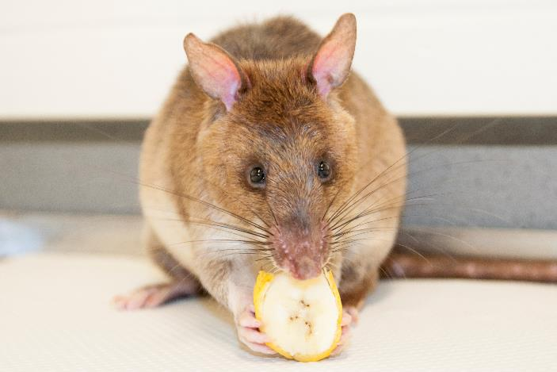
Ethical Considerations
Scientific Justification & Validity
Researchers select the model (organism or alternative) that is best suited to answer their research question.
Ideally, the model has predictive, face and construct validity.
Giant African pouched rat
(Cricetomys gambianus)
Andersen and Rosa (2023) in 2023 E. Valdés, J. A. Lecaros (eds.), Handbook of Bioethical Decisions. Volume I, Collaborative Bioethics 2, https://doi.org/10.1007/978-3-031-29451-8_25
Notes:
Speaker Notes: Researchers select the model (organism or alternative) that are best suited to answer their research question. Ideally, the model has predictive (predicts therapeutic effects), face (reproduces phenotype) and construct (etiology) validity.

Slide 8
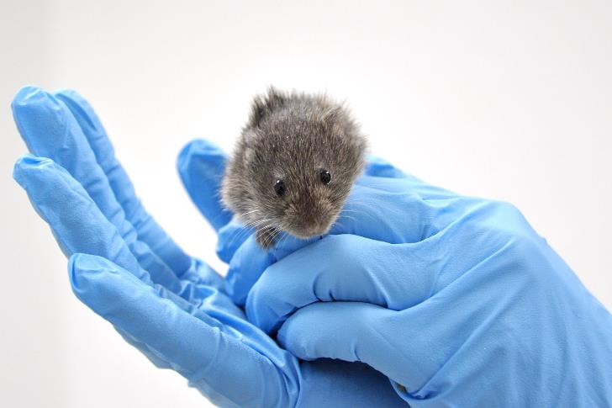
Ethical Considerations
Scientific Justification & Validity
Ethical justification is required before the onset of any research study. This distinguishes research from other ways animals are used in the USA.
Animal use that does not require justification:
In agriculture and food
As pets, show-business
For clothing
Common laboratory mouse
(Mus musculus)
Notes:
Speaker Notes: Scientific justification is required before the onset of a research study. This is unique to research, as other animal use in the US does not require prior justification

Slide 9
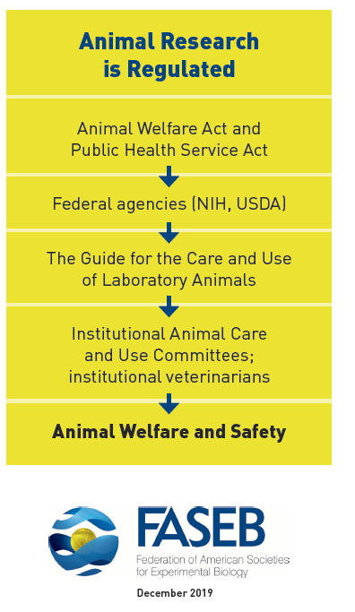
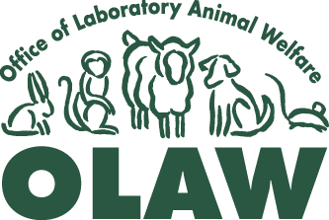

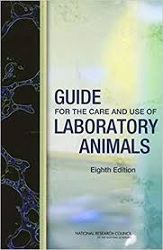
Regulation of Animal Research in the US
AWA and PHS policy require each research institution to appoint an Institutional Animal Care and Use Committee (IACUC)
Implements PHS Policy
Animal procedures in NIH and NSF grants
are evaluated by the NIH
Office of Laboratory Animal Welfare
USDA oversees AWA compliance
Covers only warm-blooded animals except rats, mice, birds bred for research and farm animals
The IACUC reviews all experimental protocols, inspect facilities, and suspends any research practice not in compliance. It is composed of at least 5 members, including a veterinarian, non-affiliated persons, non-scientists, and practicing scientists experienced in animal research.
Notes:
Figure Adapted from Foundation of American Societies for Experimental Biology (FASEB) (2019)
Speaker Notes: Animal research is highly regulated in the US. The Animal Welfare Act (AWA) and Public Health Service Act require research institutions to appoint an Institutional Animal Care and Use Committee (IACUC). The IACUC reviews protocols, inspect facilities and ensures that procedures follow “the Guide”. The IACUC has the ability and responsibility to suspend research not in compliance. Non-compliance with the Public Health Service (PHS)-supported research is reported to Office of Laboratory Animal Welfare (OLAW). The United States Department of Agriculture (USDA) oversees AWA compliance. It provides periodic inspections of facilities that use animals and can impose serious penalties in cases of non-compliance. The reports are publicly available on their website.

Slide 10
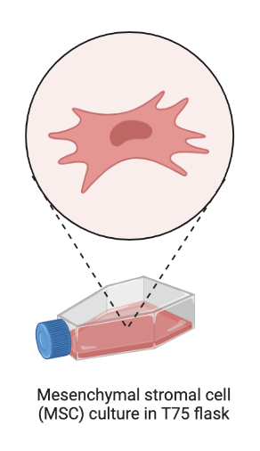
Alternatives to Animal Research
Cell cultures
Computer modeling*
Organs on a chip (“organoids”)
Researchers are obligated to use alternatives for their research when they exist.
*Many alternatives are very early in development
Figure Created with Biorender
Notes:
Speaker Notes: Researchers are continuously working to develop alternative methods that reduce or replace the use of animals in research. This includes the use of computer models, cell cultures, and other innovative techniques that minimize the use of live animals. These methods are very promising and can be used to complement animal research. At present, they have serious limitations and can not replace animal research. For example, it is not currently possible to capture the complexity of brain function and behavior in a dish (in vitro).

Slide 11
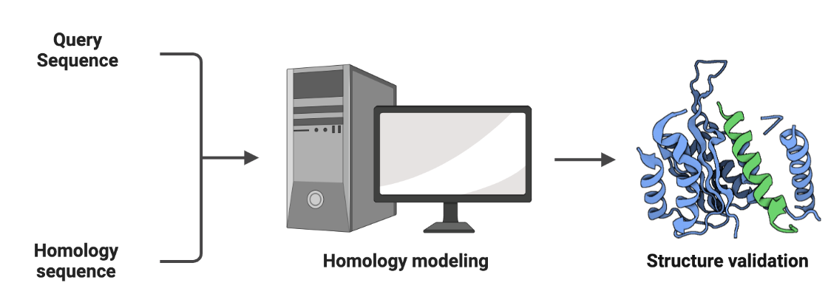
Alternatives to Animal Research
Cell cultures
Computer modelling*
Organs on a chip (“organoids”)
Researchers are obligated to use alternatives for their research when they exist.
*Many alternatives are very early in development
Figure Created with Biorender
Notes:
Speaker Notes: Computer simulation models (in silico) are increasingly being used to test the quality of outcomes from drug trials, and they may reduce the number of animals used in research. These models are still relatively early in development. They, like cell culture alternatives may have difficulty recapitulating complex systems like interactions between the brain and body.

Slide 12
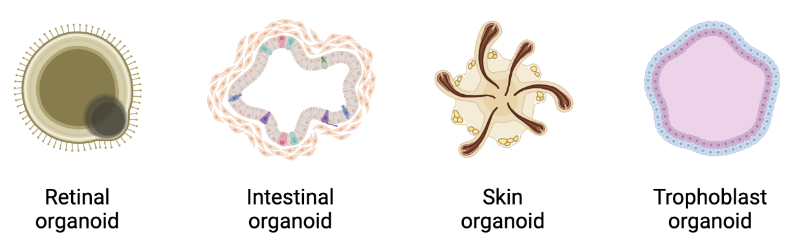
Alternatives to Animal Research
Cell cultures
Computer modelling
Organs on a chip (“organoids”)*
Researchers are obligated to use alternatives for their research when they exist.
*Many alternatives are very early in development
Figure Created with Biorender

Slide 13
Animal research benefits human and animal health
1910s Blood transfusion (dogs, guinea pigs, rabbits)
1920s Insulin (dogs, rabbits, mice)
1930s Modern anesthetics (rats, rabbits, dogs, cats, NHPs)
1940s Penicillin (mice)
1950s Polio vaccine (mice, NHPs), TB vaccine (mice), Kidney transplants (dogs)
1960s Heart transplant (dogs), MMR vaccine (NHPs), antidepressants (rats, guinea pigs, rabbits)
1980s MRI (rabbits, pigs)
1990s Antiretroviral therapy for HIV (mice, NHPs)
2000s DBS for Parkinson’s disease (rodents, NHPs)
2013 CRISPR-Cas9 genome editing (mice)
2018 Gene therapies for human and animals
2019 Ebola vaccine (mice, NHPs)
2020 Covid19 vaccines (mice, hamsters, NHPs)
2023 Drugs for Alzheimer’s (rodents)
RDS: Understanding Animal Research in Medicine and Coalition for Medical Progress
Notes:
Speaker Notes: Animal research has provided numerous medical advancements and improvements in human and animal health.
This includes the development of vaccines, surgical techniques, and treatments for diseases such as diabetes, cancer, and cardiovascular disorders.
Data Source: https://fbresearch.org/medical-advances/animal-research-achievements

Slide 14
Public Perceptions & Misconceptions
MYTH “Animals do not accurately reflect human biology”
FACT Animal models are selected to reflect particular aspects of human biology
MYTH “Most animals used in research are dogs, cats, and monkeys”
FACT More than 95% of animal research is conducted in other species
Notes:
Speaker Notes: Disinformation campaigns from organizations opposed to animal research pose a threat to the continuous progress of biomedical research for improving human and animal health. It is important to educate the public, raise awareness and combat disinformation.

Slide 15
Public Perceptions & Misconceptions
MYTH “Researchers do not care for their animals”
FACT Animal researchers are animal lovers
MYTH "Animal research only benefits humans”
FACT Most research benefits animal’s health, e.g., dog gene therapies, Covid vaccine for chimps and many more
Notes:
Speaker Notes: Disinformation campaigns from organizations opposed to animal research pose a threat to the continuous progress of biomedical research for improving human and animal health. It is important to educate the public, raise awareness and combat disinformation.

Slide 16
Public Perceptions & Misconceptions
MYTH “Research animals suffer”
FACT Research animals are cared for with respect and compassion, provided with enrichment to maximize well-being and given anesthetics and analgesics to minimize pain. Research animals usually receive more frequent veterinary care compared to most household pets.
Notes:
Speaker Notes: Disinformation campaigns from organizations opposed to animal research pose a threat to the continuous progress of biomedical research for improving human and animal health. It is important to educate the public, raise awareness and combat disinformation.

Slide 17
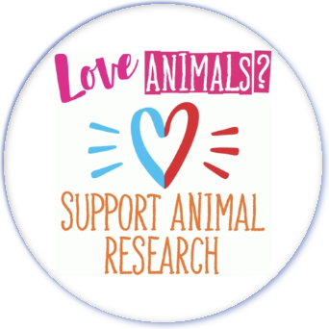

Summary
The role of laboratory animals in promoting scientific and medical progress is undeniable
Animal research is highly regulated to ensure the humane and ethical treatment of laboratory animals
It is crucial to raise awareness of the public and combat increasing disinformation spread by opponents to animal research

Slide 18
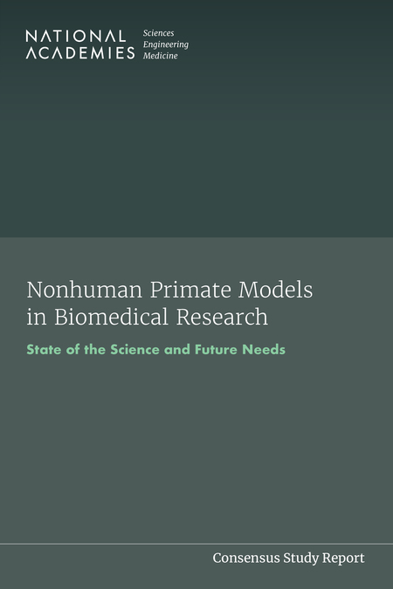


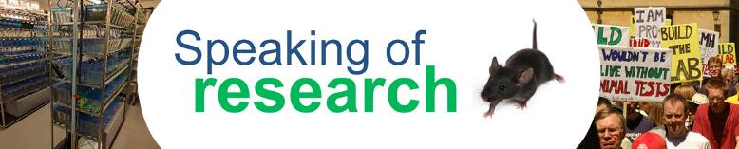


Additional Resources
Click on images for more information

