Slide 1
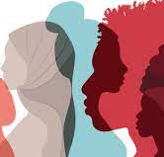
Addressing Mental Health and Wellness Needs of BIPOC Students & Faculty
Beyond Well-Intentioned Efforts
Aleesha N. Young, LPC, Psy.D.

Slide 2
Factors that Impact BIPOC Mental Heath & Wellness
Culturally disenfranchised groups across race/ethnicity are likely to have poorer mental health outcomes, even as they are less likely to receive needed services in the first place.
Reasons for these disparities:
Limited access to quality mental health care,
High cost of that care
Cultural mistrust
Discrimination
Stigma about mental illness
Lack of awareness about mental health problems

Slide 3
Stress and Social Pressures within Academia
Being situated in academia is risky and creates greater hesitancy to share mental health challenges.
Pre-text for questioning their abilities, value to the institution, and worthiness for promotion, tenure scholarships, etc.
Faculty evaluations, especially those about multicultural and diversity issues, may elicit uncomfortable feelings in instructors, making BIPOC students easy targets for retaliation (even if unintended).

Slide 4
Framing the Problem:
Historical Context of Mental Health Interventions
Clinical/Counseling psychology interventions in the U.S. were developed within the historical context of Caucasian, Western, colonial hegemony, and thus cannot be applied to all individuals in the same way.
Thus, psychological theories, treatment modalities, and research protocols were informed by White worldviews, and practiced in this way even by well-intentioned therapists.

Slide 5

Telehealth Prompted by COVID-19 Pandemic
The same structural barriers exist regarding remote service delivery (except for transportation).
Easy to overlook multicultural and diversity issues when patient characteristics and identity markers (i.e., disability status, signals of socioeconomic status/class) may not be as visible through digital technology as it might be the case in the therapy room.

Slide 6
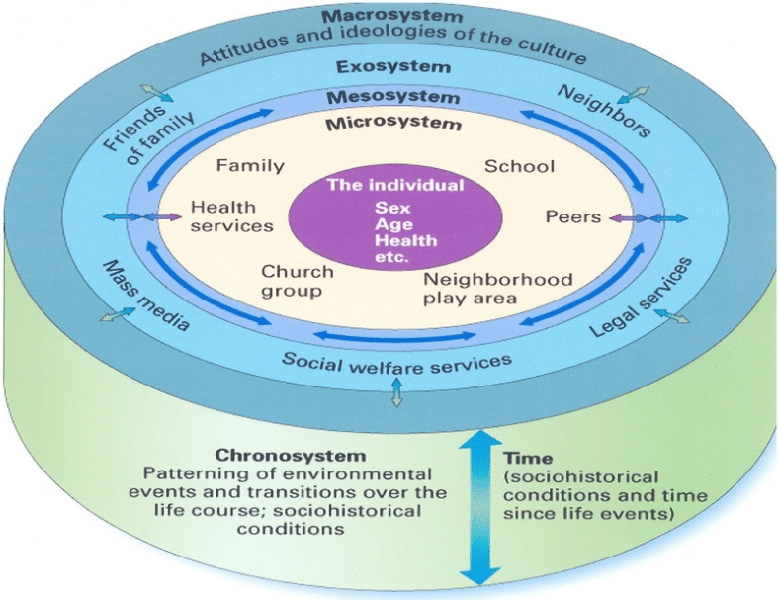
BIPOC individuals affect and are affected by a complex range of social influences and nested environmental interactions.
Socio-Ecological Model

Slide 7
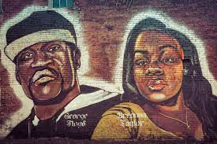
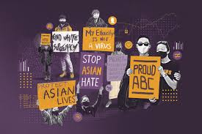
BIPOC individuals affect and are affected by a complex range of social influences and nested environmental interactions.
Social/political climate among the COVID-19 pandemic and police killings exacerbated mental health and wellness of BIPOC folx.
Verbal attacks and false accusations of Asian Pacific Islanders for spreading the disease.
Socio-Ecological Model
Notes:
Cultural and political climate impacts mental health therefore cannot be separated from the therapy room.

Slide 8
If We Know Why the Problem Exists…
Why Are There Still Unmet Mental Health Needs for BIPOC Students & Faculty?
Misguided approached to culturally responsive therapeutic practice.
Even when practitioners intentionally work to disrupt oppressive paradigms, being a part of institutions and organizations that (inadvertently) perpetuate oppression is still part of the learning teaching, and practice of psychology that informs service delivery.
What and whose perspectives are influencing therapeutic practice?

Slide 9
If We Know Why the Problem Exists…
Why Are There Still Unmet Mental Health Needs for BIPOC Students & Faculty?
This requires practitioners to be very explicit in their understanding of environmental blocks and/or stressors.
It also requires an understanding of social justice issues because, without fail, EVERY client is embedded within the overall environment.

Slide 10
Evidence of Culturally Responsive Mental Health Support
Does your provider…
DELIBERATELY identify obstacles/systemic barriers that can interfere with or prevent access to treatment, treatment compliance, or lead to poorer treatment outcomes using an ecological model as shown here.
ALWAYS identify demographic information and your marginalized and privileged identities, and list the resources available to them as a result.
BELIEVE clients when they disclose experiences of oppression from a social justice perspective.

Slide 11
Remember…
Providers should not pathologize culturally-driven cognitions or behavior. Instead, they should focus on ACCURACY and goal-oriented EFFECTIVENESS from your standpoint.
“I don’t fit in.”
“I have to work much harder.”
The problem is not always you…sometimes it’s the oppressive dynamics in the environment!

Slide 12
Telehealth: Considerations for Culturally Responsive Mental Health Services
Does your therapist or provider integrate questions about access to broadband internet into their intake practices?
Multiculturally Friendly “Office Space”
Does your provider display their gender pronouns or tell you what they are?
Provider should consider protections for victims of Intimate Partner Violence
- Vulnerability of women of color, immigrant women, and those from the LGBTQ+ community.

Slide 13
References
Hays, P. A. (2019). Introduction. In Culturally responsive cognitive behavioral therapy: Practice and supervision (2nd ed.) (pp. 5-24). Washington, DC: The American Psychological Association.
Iwamasa, G. Y., & Hays, P. A. (Eds.) (2019). Culturally responsive cognitive behavioral therapy: Practice and supervision (2nd ed.). Washington, DC: The American Psychological Association.
Lee, D. L. & Tracey, T. (2008). General and multicultural case conceptualizations: A cross-sectional analysis of psychotherapy trainees. Psychotherapy Theory, Research, Practice, and Training, 45(4), 507-522. https://doi.org/10.1037/a0014336
Young, A. & McCloskey, K. (2020, October 23-24). Case Conceptualization: When a Multicultural Approach is the Rule, Not the Exception. Workshop presented at the Annual Diversity Challenge (Virtual), Institute for the Promotion of Race and Culture, Boston College.
Young, A.N. (2022). Guide to Providing Culturally Competent Behavioral Health Services via Telehealth. Practice Innovations. https://dx.doi.org/10.1037/pri0000173

