Slide 1
Increasing Mental Health Service Utilization in Black Populations During COVID-19: Clarifying Clinician Responsibility
Race, Culture, and Practice: Centering the Mental Health and Wellness of BIPOC Communities Webinar at Bowie State University
Presented by Tonya D. Armstrong, Ph.D., M.T.S.
Owner, CEO, and Licensed Psychologist
The Armstrong Center for Hope
Durham and Raleigh, North Carolina
February 8, 2023

Slide 2

"Increasing Mental Health Utilization in Black Populations during Covid-19: Clarifying Clinician Responsibility”

Slide 3
Enhancing Black Mental Health
Understanding Historical Cultural Mistrust
Enhancing the Pipeline of Black Psychologists
Integrating Cultural Adaptations into Therapy
Acknowledging the Suicide Crisis
Affirming the Importance of Religiosity/Spirituality
Prioritizing Self-Care

Slide 4
Greater Vulnerability During COVID-19 Among Black Populations
Blacks have been overrepresented among COVID cases
Higher pre-COVID levels of morbidity and mortality
Higher levels of disenfranchisement in terms of social determinants of health
Greater awareness of racial injustice
Other categories of intersectionality—xenophobia, gender identity discrimination, socioeconomic inequity
These and other threats contribute to the polypandemic

Slide 5
Understanding Historic Cultural Mistrust

Slide 6
19th Century “Mental Illnesses”
Ascribed to Black Populations
Drapetomania—a disease among enslaved Blacks who desired to escape plantation life (Umeh, 2019)
Dysaethesia aethiopica—a condition resulting in lethargy or laziness (Umeh, 2019)
These pseudoscientific diagnoses pathologized the normative experiences of human being oppressed under the horrors of chattel slavery (Armstrong et al., 2021).

Slide 7

Mistrust of the
Health Care System
Reproductive Surgeries
Tuskegee Syphilis Study (1932-1972)
NC Sterilization Project (1929-1974)
HIV/AIDS (1960s-present)
Coronavirus Vaccines (2020-??)

Slide 8
Enhancing the Pipeline of Black Psychologists
Only 6.4% of 3,837 psychology doctorates in 2018 were received by Blacks
Shortage of Blacks in psychology
  Insufficient recruitment into psychology programs
  Lower levels of retention among students & clinicians
Proposed solutions
  Begin recruiting efforts earlier and target Black students, particularly at HBCUs
  Provide greater financial support
  Build and sustain mentoring and community-building efforts
  Actively integrate multicultural change into curricula, faculty composition, and program culture

Slide 9
Integrating Cultural Adaptations into Therapy
Communicate with transparency, especially surrounding racial issues
Pursue training in culturally relevant tools
  Strengths-based focus
  Use of cultural socialization messages
  Consultation, supervision, and trainings in culturally sensitive approaches
Use culturally adapted treatments
  Group Cognitive-Behavioral Therapy
  Parent Training
  Relevant language and metaphors in treatment

Slide 10
Acknowledging the Suicide Crisis and the Impact of Adverse Experiences Among Black Children and Youth
Suicide is the second leading cause of death in Black children ages 10-14 & the third leading cause of death among Black adolescents (Bridge et al., 2018)
Suicide risk rises during mid-adolescence for females, in particular
Adverse Childhood Experiences (ACEs) often exacerbate suicide risk:
  Emotional and physical child abuse
  Emotional and physical neglect
  Parental domestic violence
  Parental separation or divorce
  Parental mental health problems
  Substance abuse
  Parental imprisonment
Higher levels of ACES associated with externalizing behaviors and ADHD diagnosis

Slide 11
Affirming the Importance of
Religiosity and Spirituality
Acknowledge the presence of both internal (e.g., prayer, sustaining a positive self image) and external spiritual coping strategies (e.g., seeking social support, directly addressing the source of the problem).
Explore any history and salience of engagement in Black religious institutions.
Recognize spirituality as a protective factor, yet may also contribute to distress.
Assess the spiritual effects of racism.

Slide 12
Prioritizing Self-Care:
An Ethical Necessity
Strongly encouraged by APA’s Ethical Code
Occupational distress is a real threat
  Documentation and record keeping
  Financial pressures
  Client risks
Additional barriers to self-care
  Client care
  Achievement
  Career development
  Desire for upward mobility

Slide 13
Outward and Inward Perspectives from Black Clinicians
Raising self-awareness
Understanding one’s positionality and privilege
Reflect on policies and processes to ensure equitable treatment
Particular considerations for Black therapists in the polypandemic:
  Feeling overwhelmed and afraid
  Facing challenges when holding space for Black clients
  Finding ways to support white clients with differing ideological and sociopolitical viewpoints

Slide 14
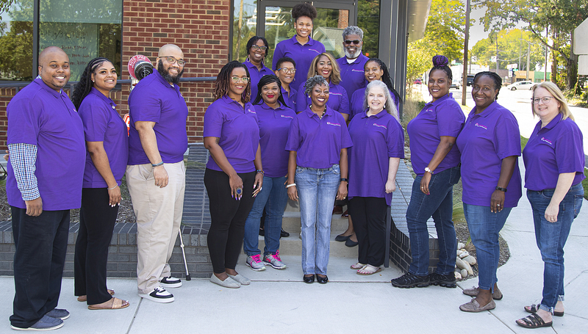

Slide 15
Views on the Polypandemic From Our Staff
Staff (Clinical and administrative)
  70% of our staff are Black
  Ages range from 22 to 65
  85% identifies as female
  Includes professionals in psychology, clinical social work, marriage and family therapy, and clinical mental health counseling
  Combination of formal and informal religious and spiritual preparation
Clients
  85% of our clientele are Black
  Ages range from 2 to 75
  68% identify as female
  23% live in rural settings
  39% utilize public insurance

Slide 16
Views on the Polypandemic From Our Staff, cont.
Data from interval survey
  Reported clients as suffering from social isolation, challenges with work-life balance, and disengagement with traditional forms of funeral arrangements
  64% of staff members reported lower levels of mental health including increased anxiety, social isolation, and sleeping difficulties
    Disrupted social engagement
    Experiencing challenges with remote work
    Witnessing more social injustice
    Managing child(ren)’s virtual learning
    Feeling the pain of grief and loss

Slide 17
Self-Care Strategies Most Commonly Endorsed by ACFH Staff
Exercise
Spending quality time with loved ones
Meditation
Prayer
Music
Deep breathing
Enjoying the outdoors
Engaging humor

Slide 18

Blossoming Hope Book & Audio Experience
Available on Amazon and Kindle
Audiobook available on GooglePlay & AppleMusic

Slide 19

Contact Information
The Armstrong Center for Hope
1502 W. NC Highway 54, Suite 403
Durham, NC 27707
805 Spring Forest Rd., Suite 800
Raleigh, NC 27609
919-418-1718
acfhinfo@armstrongcfh.com
www.armstrongcfh.com
Twitter: @DrTDArmstrong, @ACFHope
LinkedIn, Facebook & Instagram:
@ArmstrongCenterforHope, @drtonyaarmstrong

