Slide 1
Chapter 9
Theories of Reinforcement
Thorndike and the Law of Effect
Hull and Drive Reduction Theory
The Premack Principle
The Response-Deprivation Hypothesis
Response Allocation and Behavioral Economics

Slide 2
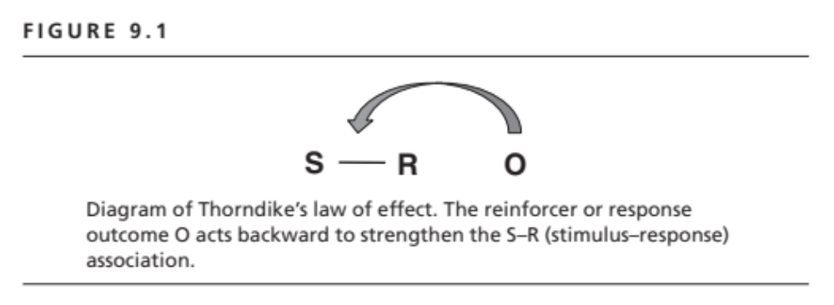

Slide 3
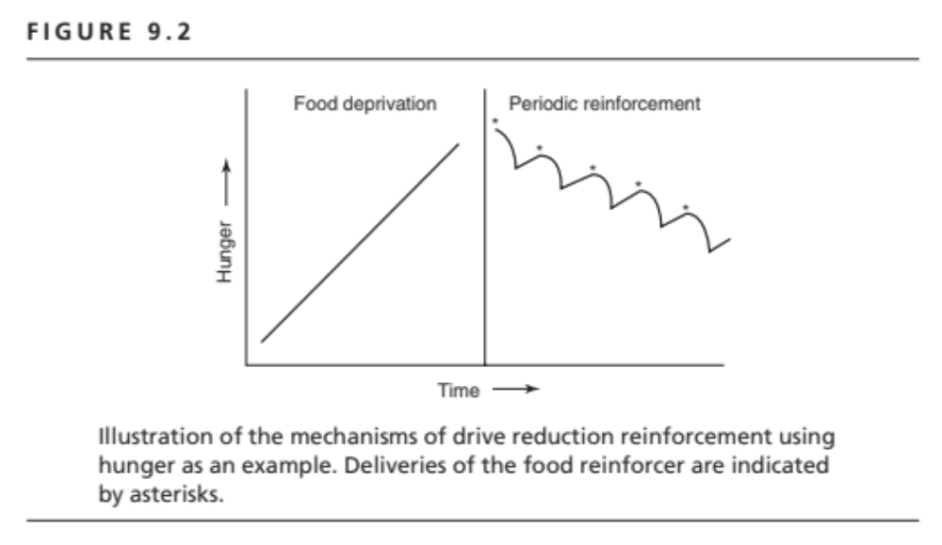

Slide 4
Reinforcers as Stimuli
Primary reinforcers and biological drives
Secondary reinforcers and acquired drives
Sensory reinforcers

Slide 5
The Premack Principle
Reinforcers as responses
Differential Probability: A high(er) probability response will reinforcer a lowe(er) probability response

Slide 6
The Response-Deprivation Hypothesis
Restricting access to an activity below its baseline rate makes that response a reinforcer.
Instrumental conditioning procedures typically involve restricting access to the reinforcer response.
Reinforcers are created by the restrictions inherent in an instrumental conditioning procedure.

Slide 7
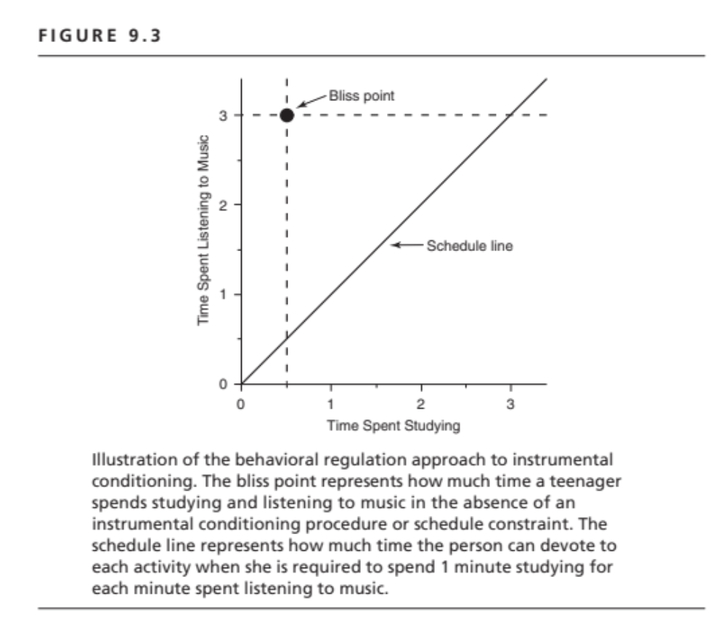

Slide 8
Response Allocation & Behavioral Economics
Individuals have a behavioral bliss point.
The bliss point is defended in the face of constraints on response options.
An instrumental contingency constrains response options and causes deviation from the bliss point.
Adjustments to the constraint determine whether a response shows (or does not show) a reinforcement effect.
Behavioral adjustments to schedule constraints are a function of the elasticity of demand and the availability of substitutes for the reinforcer activity.

Slide 9
Key Concepts in Response Allocation
Reinforcers not special kinds of stimuli.
Instrumental conditioning is a constraint on the free flow of behavior.
Reinforcement effects represent response reallocation, not the strengthening behavior.
Effects of a particular instrumental contingency depend on all behavioral options.
Response reallocation involves a process of optimization characterized by economic concepts.

