Slide 1
Chapter 8
Schedules of Reinforcement
The Cumulative Record
Simple Schedules of Reinforcement
Mechanisms of Schedule Performance
Concurrent Schedules
Concurrent-Chain Schedules and Self Control

Slide 2
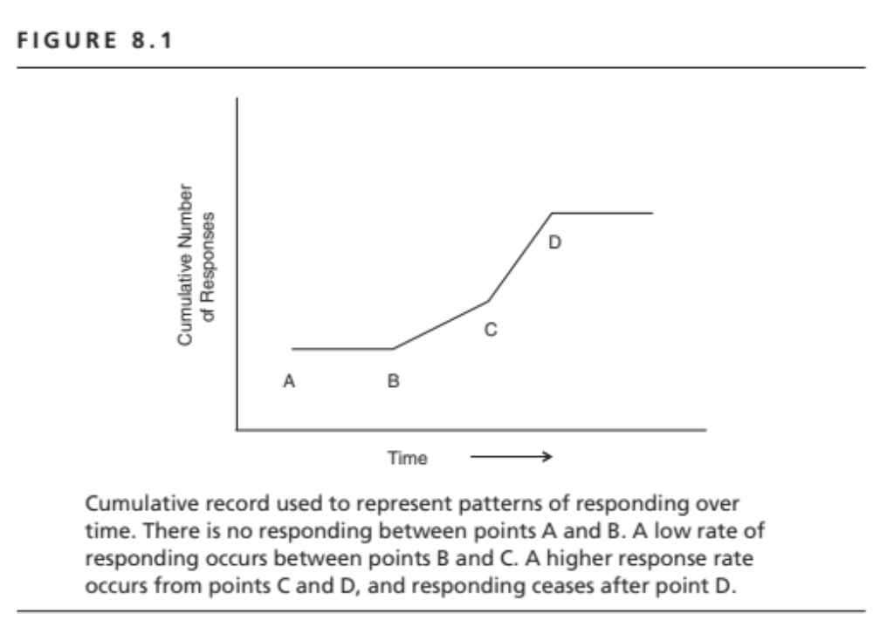

Slide 3
Simple Ratio Schedules
  Continuous Reinforcement (CRF)
  Fixed Ratio (FR)
  Variable Ratio (VR)

Slide 4
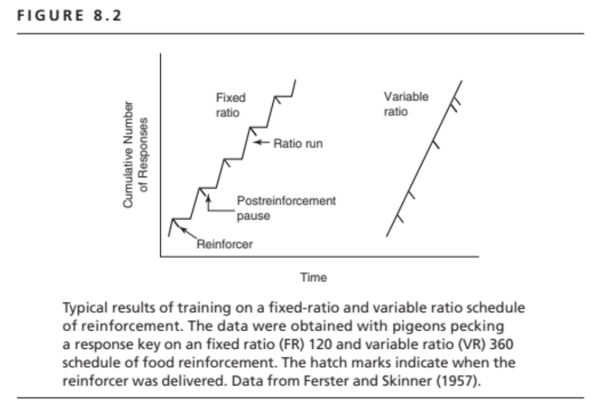

Slide 5
Simple Interval Schedules
Interval = Set-up time for reinforcer
Set-up time = Time required to “prepare” the reinforcer.
Once the reinforcer is set up, a response is required to obtain it.
Interval measured from last reinforcer or start of trial.

Slide 6
Interval Schedules
Set-up Time
Responses
Start of Cycle
Delivery of Reinforcer

Slide 7
Simple Interval Schedules
Fixed Interval = Set-up time is always the same (e.g., FI 3 min)
Variable Interval = Set-up time varies from one trial to the next (e.g., VI 3 min)

Slide 8
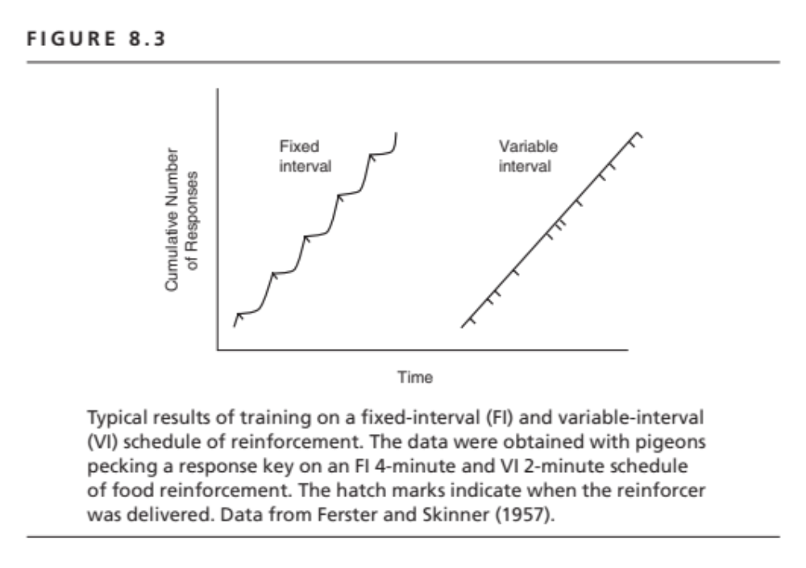

Slide 9
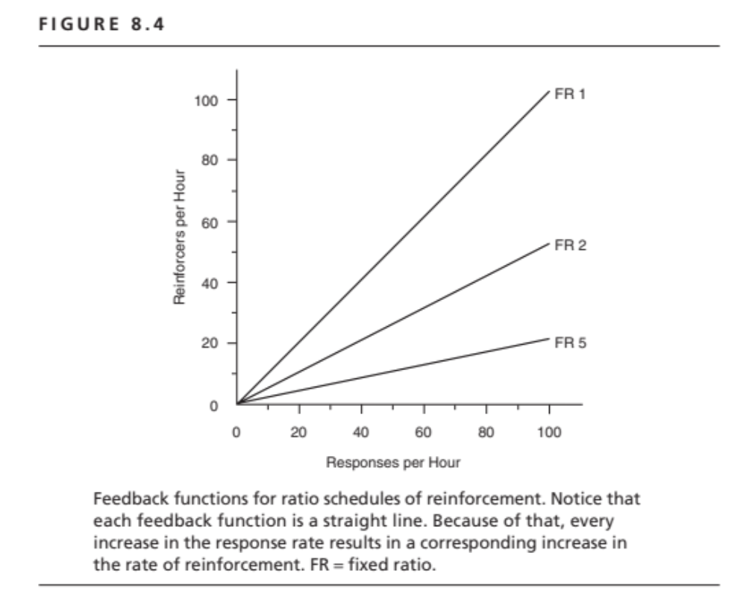

Slide 10
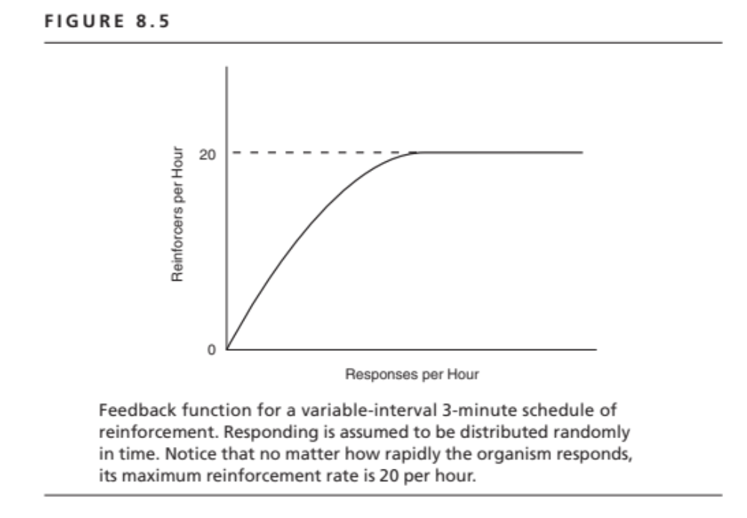

Slide 11
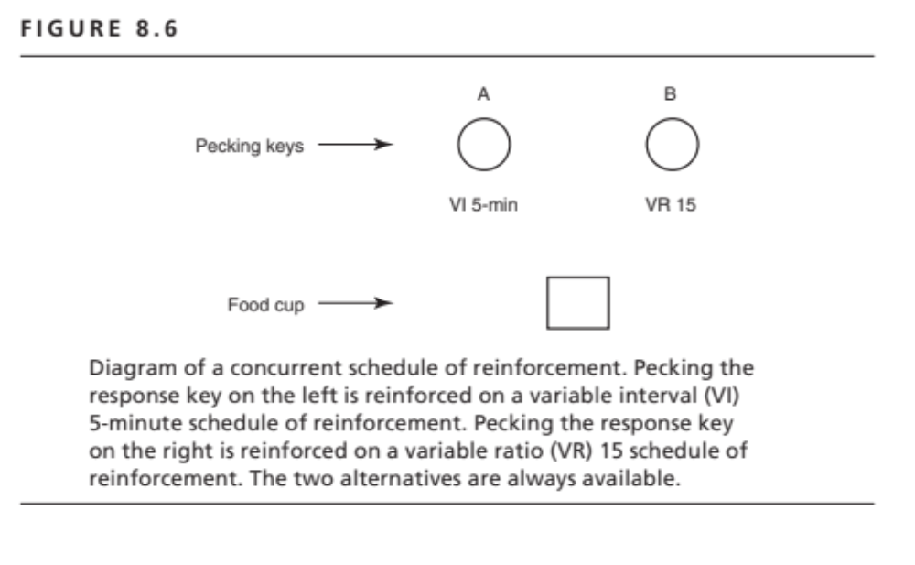

Slide 12
