Slide 1
Chapter 7
Instrumental or Operant Conditioning
The Traditions of Thorndike and Skinner
The Initial Learning of an Instrumental or Operant Response
The Importance of Immediate Reinforcement
Associative Mechanisms in Instrumental Conditioning
Implications for Biological Constraints on Instrumental Conditioning
Implications for Neural Mechanisms of Instrumental Conditioning

Slide 2
Contrasts
Instrumental Conditioning
Response required for presentation of the US
No discrete antecedent to the US
US is called the reinforcer
Pavlovian Conditioning
No response requirement
US preceded by the CS

Slide 3
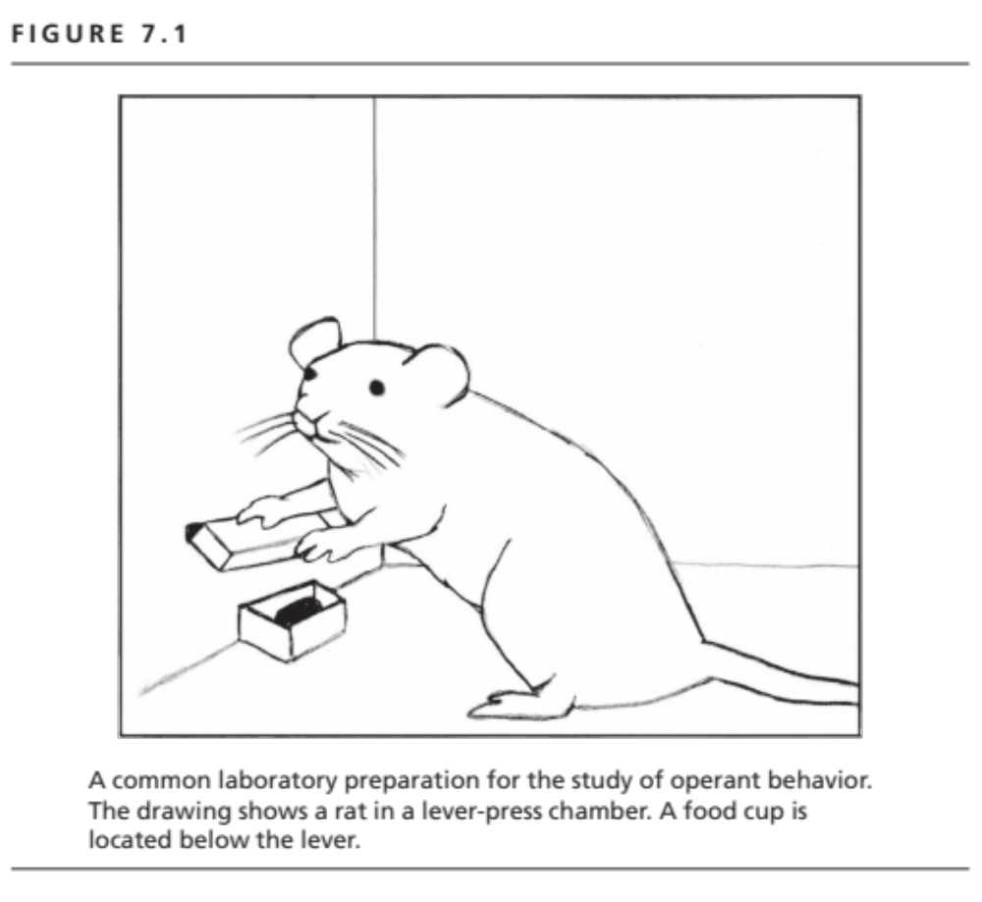

Slide 4
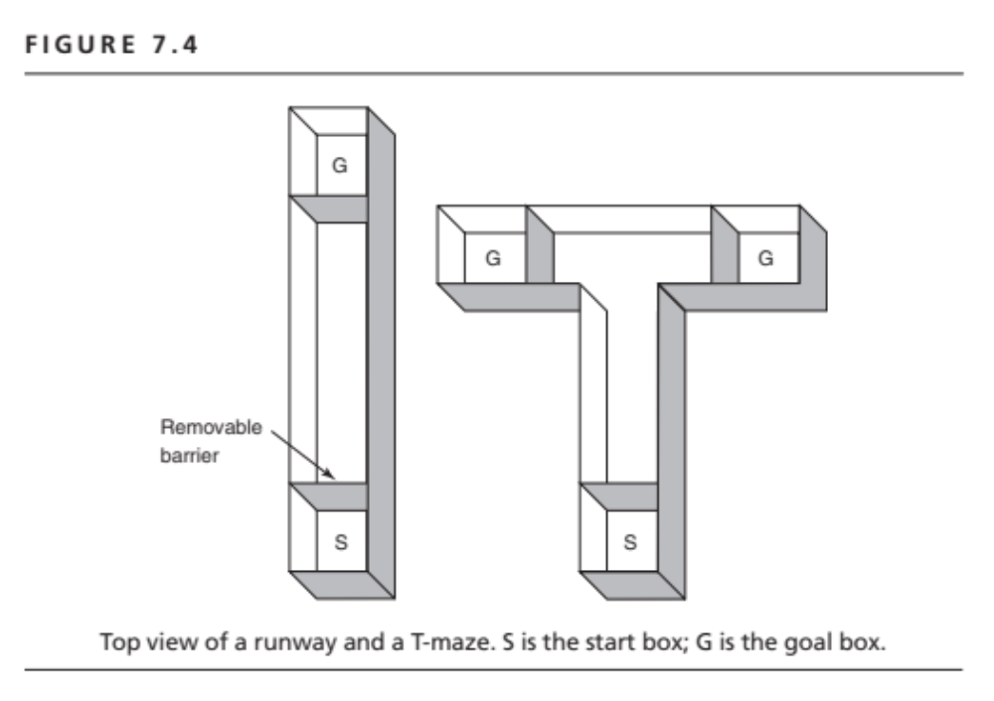

Slide 5
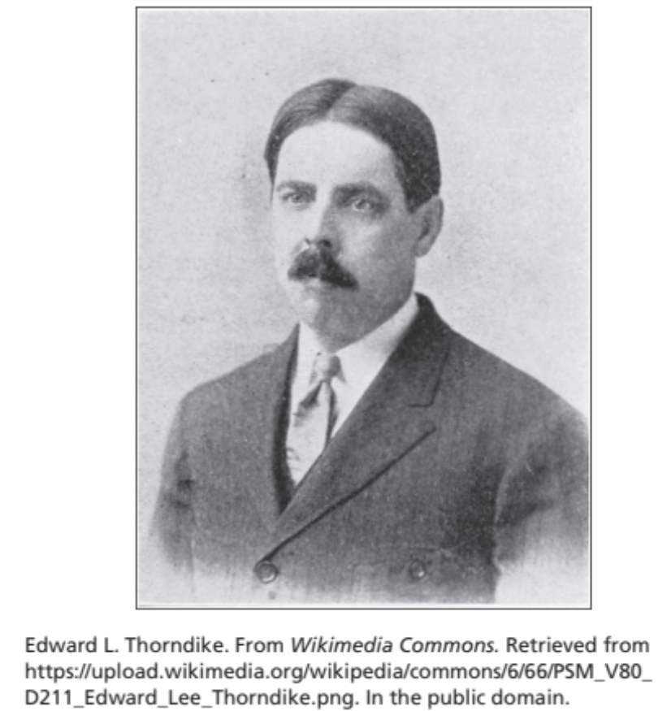
Discrete Trial Method
Thorndike’s Puzzle Boxes
Discrete trials
Paced by the experimenter
Not ideal for the study of motivation

Slide 6
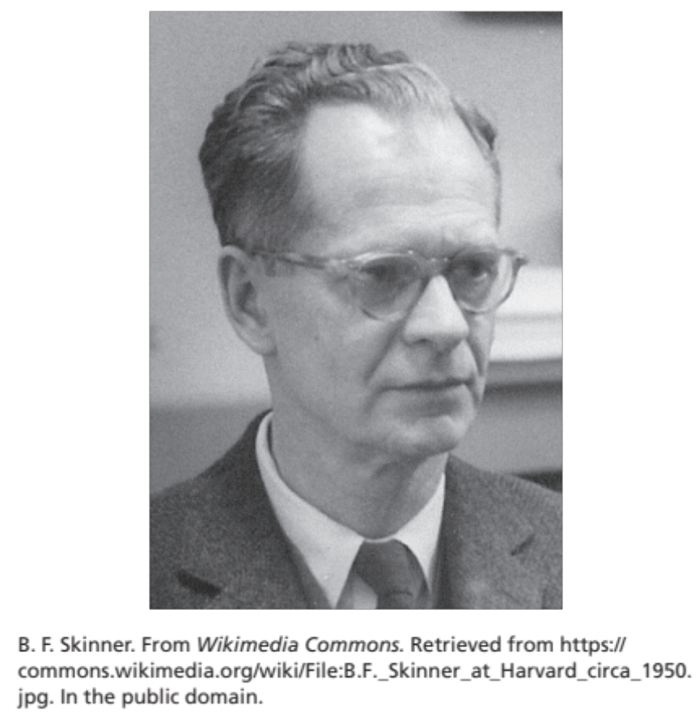
Free Operant Method
B. F. Skinner
Subject schedules its own trials
Good for measuring motivation
Response rate as the
basic measure of behavior
Responses/hour

Slide 7
What Is Learned?
New Responses
New Response Units
Familiar response components organized into a novel behavioral unit

Slide 8
Shaping
Reinforcement of Successive Approximations
Identify starting point of behavior
Identify terminal goal
Divide the difference into shaping steps

Slide 9
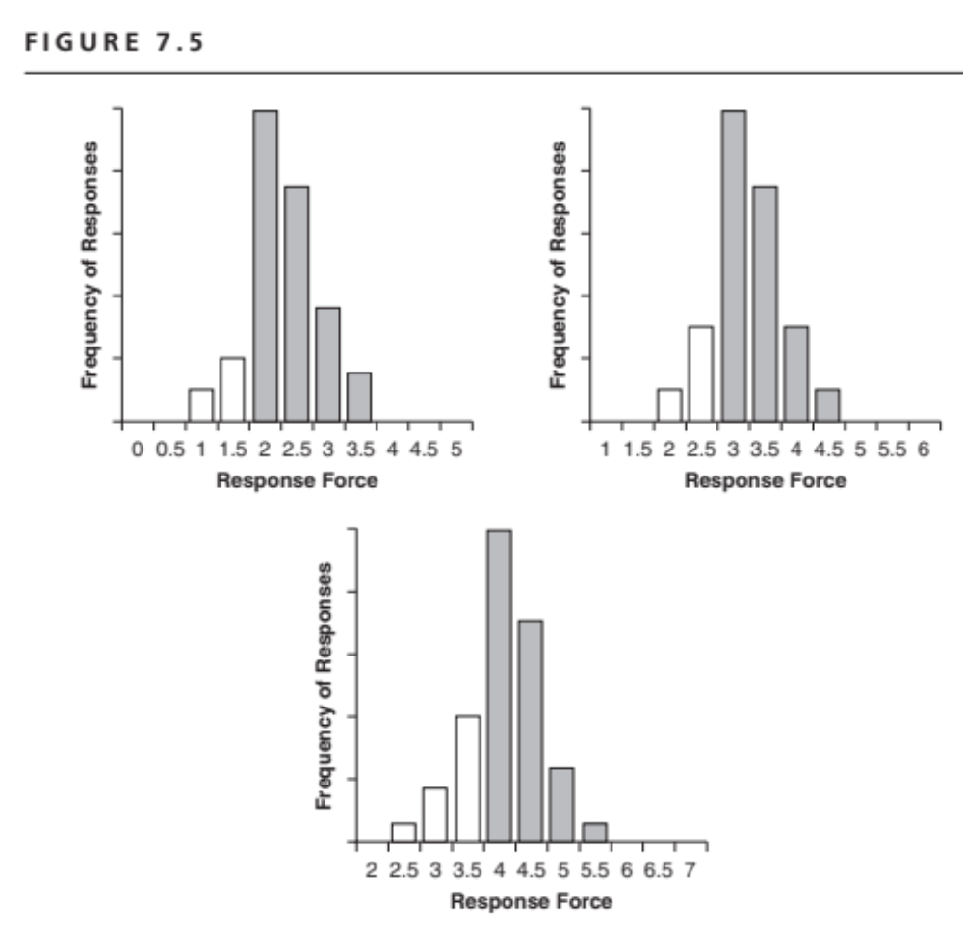
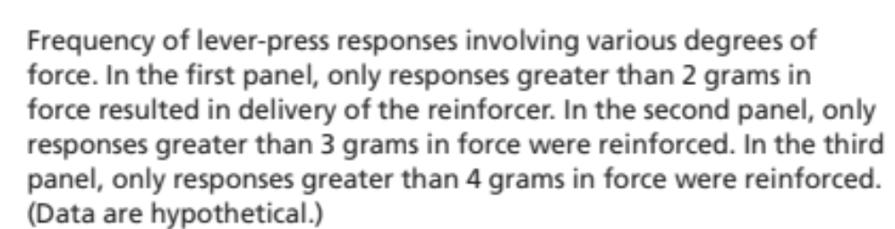

Slide 10
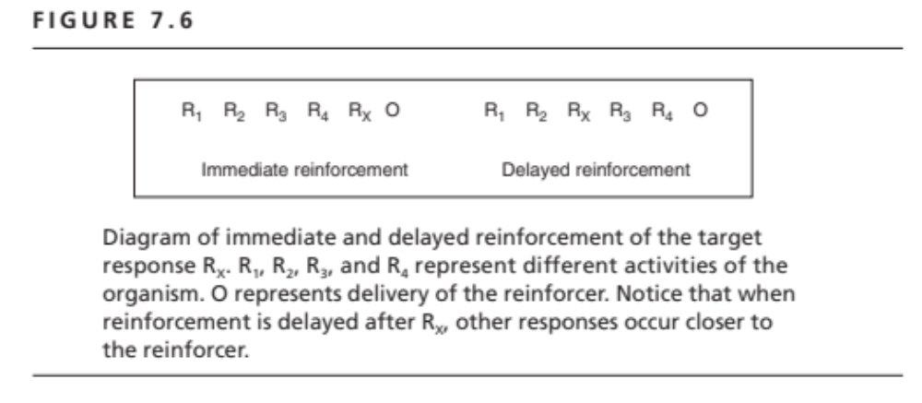

Slide 11
Overcoming Delayed Reinforcement
Secondary or conditioned reinforcement
Marking
Rx
S_{M}
R1
R2
R3
R4
R5
Reinforcer

Slide 12
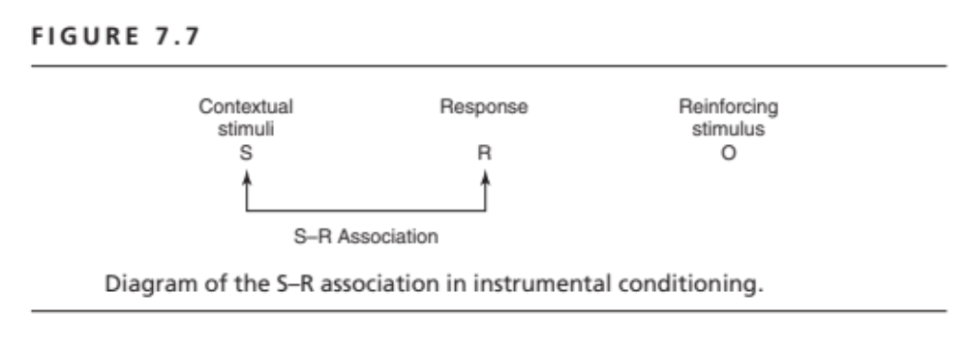

Slide 13
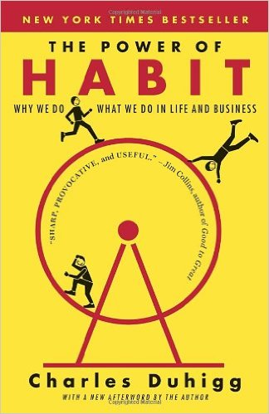
S-R Associations and Habits
Why We Do What We Do in Life and Business
2014

Slide 14
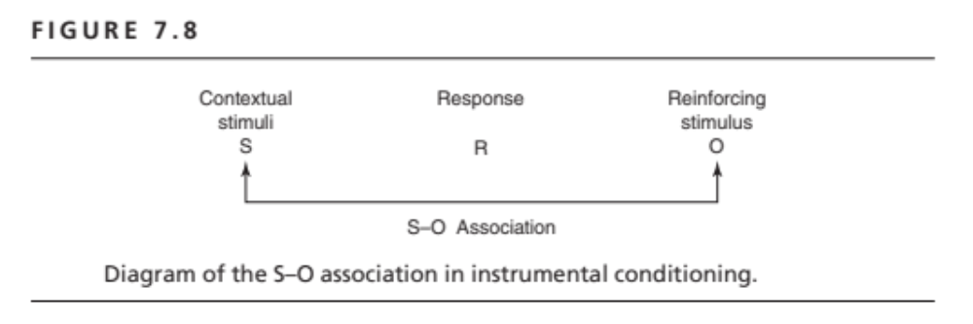

Slide 15
Tests of S-O Associations or Reward Expectancy
Emergence of Pavlovian CRs during instrumental conditioning
Pavlovian-Instrumental Transfer Experiments

Slide 16
Pavlovian-Instrumental
Transfer Experiments
Phase of Classical Conditioning
CS comes to elicit a reward expectancy
Phase of Instrumental Conditioning
Transfer Phase: Test of CS effects on rate of instrumental behavior

Slide 17
