Slide 1
Chapter 6
Pavlovian Conditioning: Mechanisms and Theories
What is Learned in Pavlovian Conditioning?
S-R versus S-S learning
How are Pavlovian Associations Learned?
The Rescorla-Wagner model
Attentional models of conditioning
Temporal factors and conditioned responding
The comparator hypothesis

Slide 2
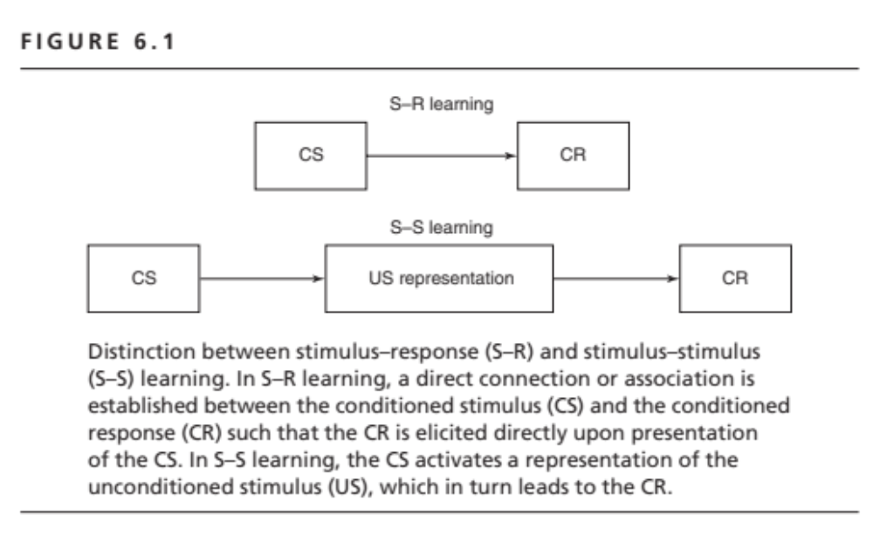

Slide 3
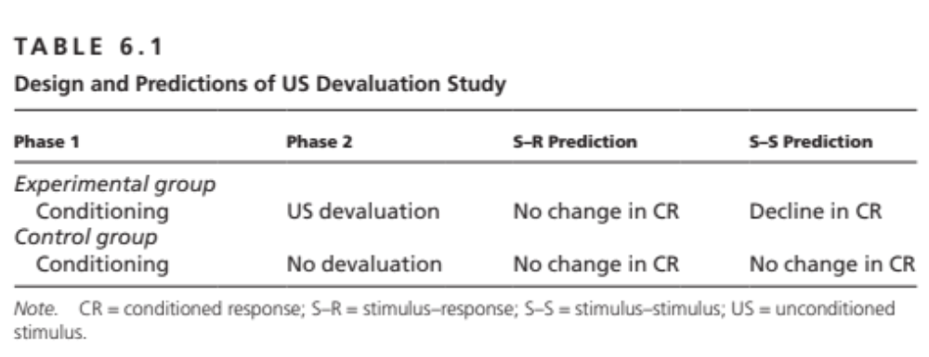

Slide 4
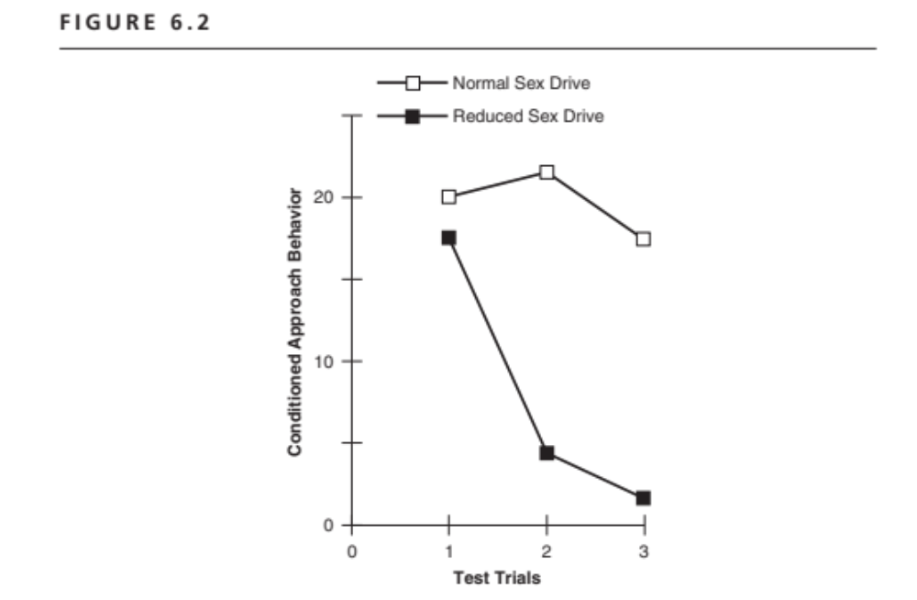
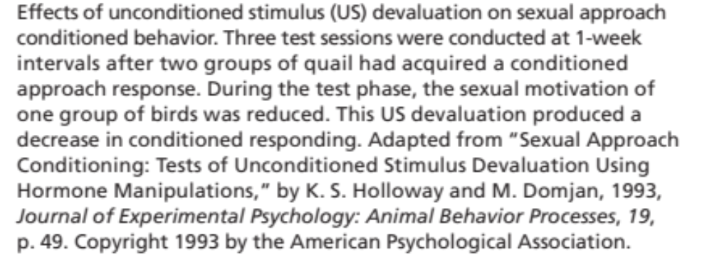

Slide 5
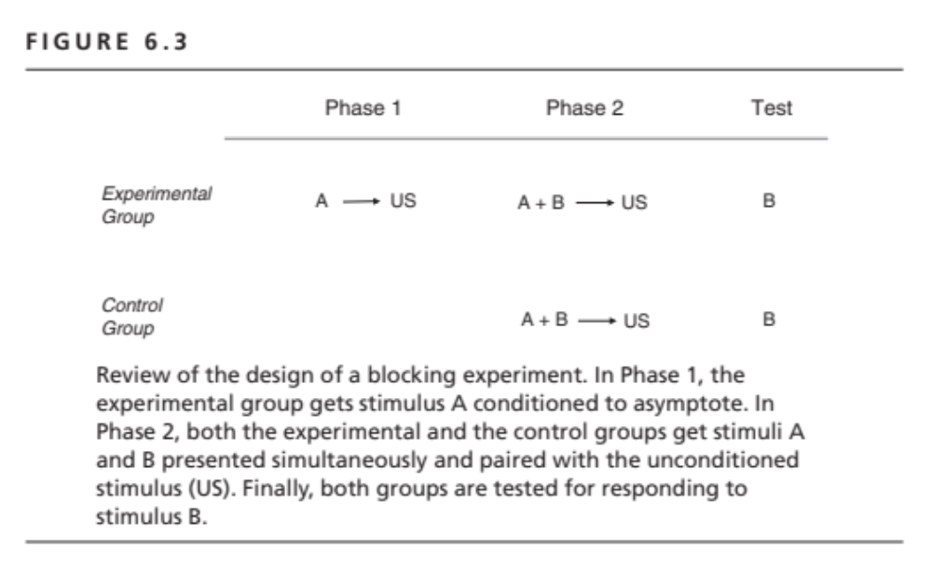

Slide 6
Rescorla-Wagner Model
Conditioning is a function of US effectiveness.
US surprisingness determines its effectiveness.
US surprise calculated based on all of the predictive cues in the situation.
Quantitative model.

Slide 7
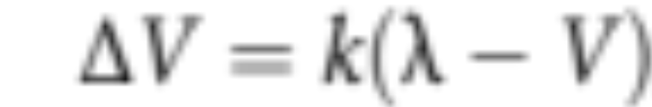
Rescorla-Wagner Model
Learning as error correction.
Error is difference between what is predicted and what occurs.
Error calculation:

Slide 8
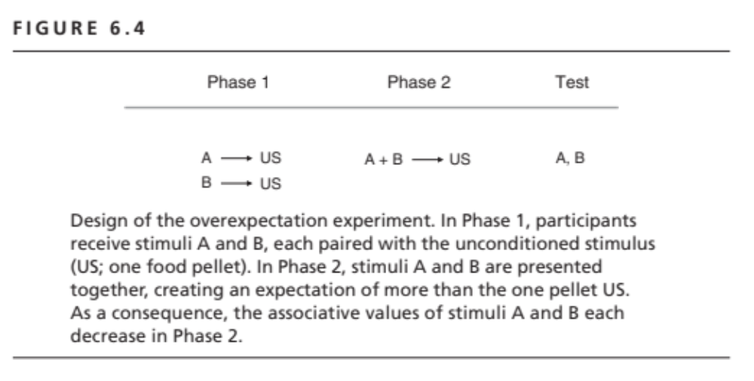

Slide 9
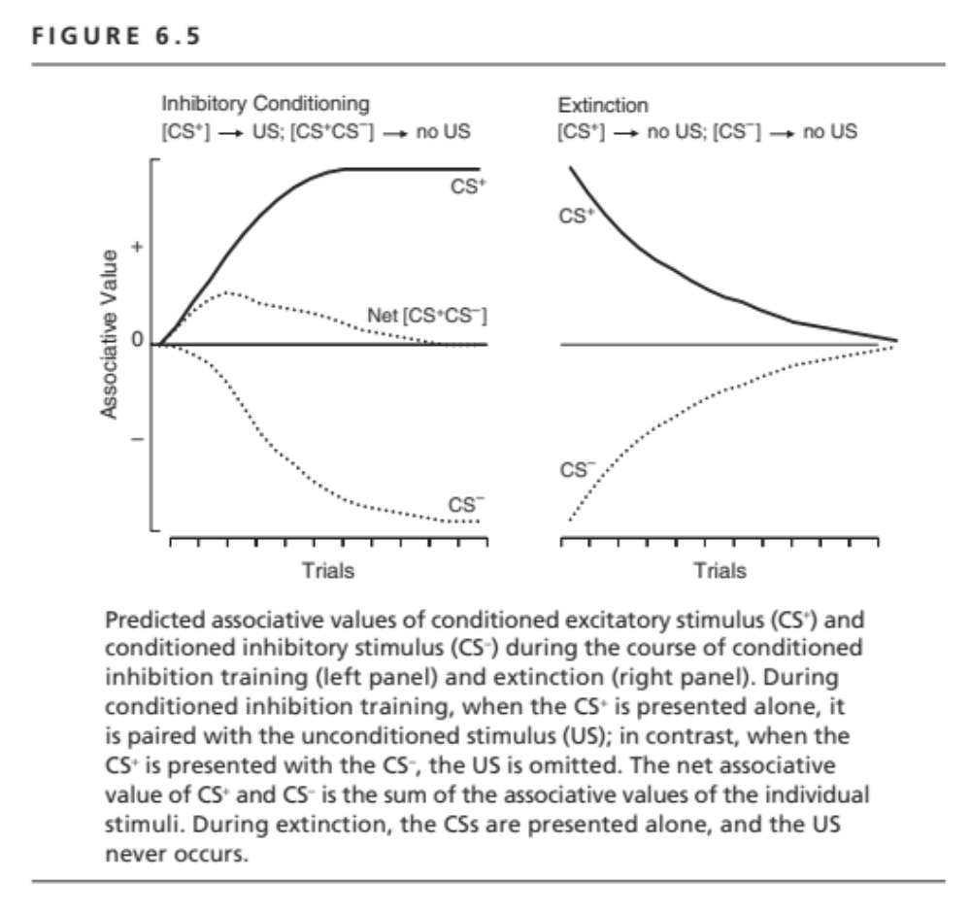

Slide 10
Attentional Models
Pearce & Hall: Surprisingness of US on trial N increases attention to the CS on trial N+1.
–Prospective effect
–Cannot explain 1-trial blocking

Slide 11
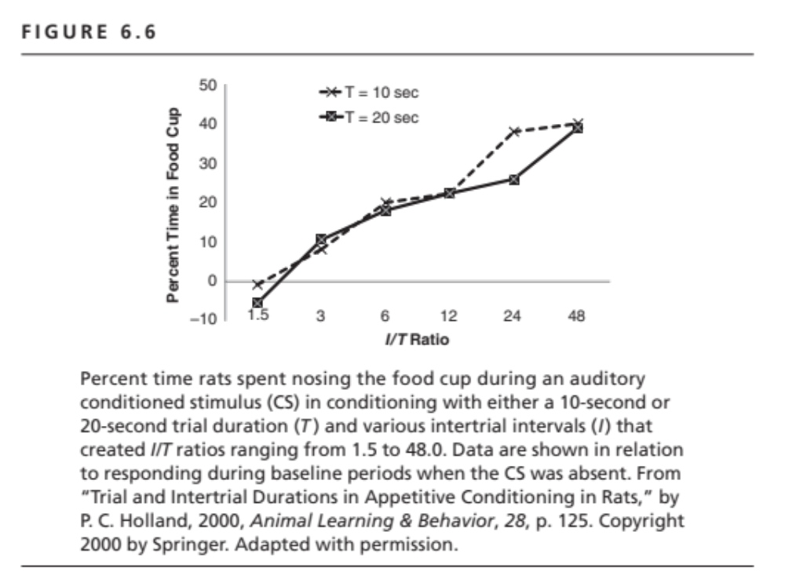

Slide 12
Comparator Hypothesis
Theory of performance, not learning.
Assumes only excitatory associations
Predicts that changes in the value of the “comparator” stimulus will change level of responding
  Conditioned inhibition is lost with extinction of excitatory comparator.

Slide 13
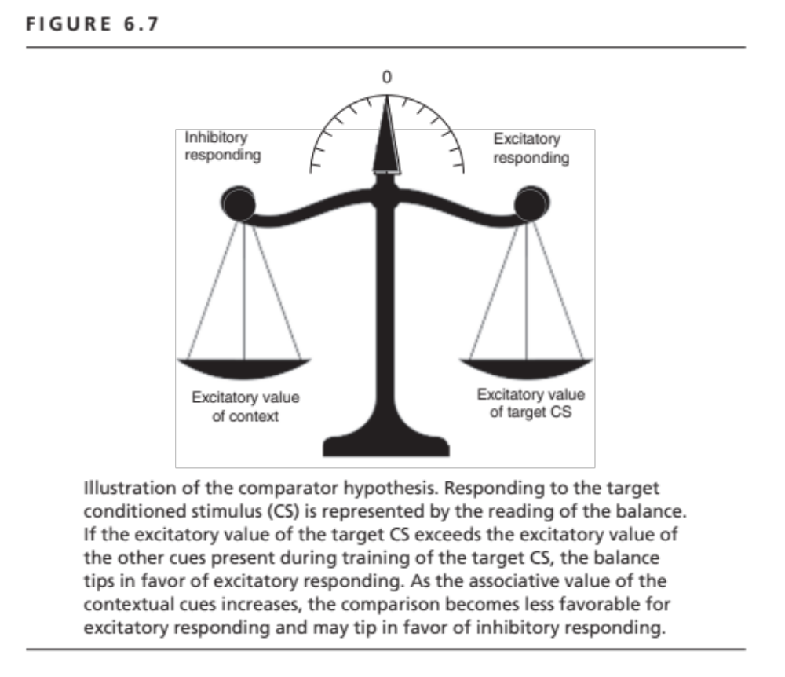

Slide 14
