Slide 1
Chapter 5
Stimulus Relations in Pavlovian Conditioning
Temporal Relation Between CS and US
Signal Relation Between CS and US
Higher-Order Relations in Pavlovian Conditioning: Conditioned Inhibition
Higher-Order Relations in Pavlovian Conditioning: Conditioned Facilitation

Slide 2
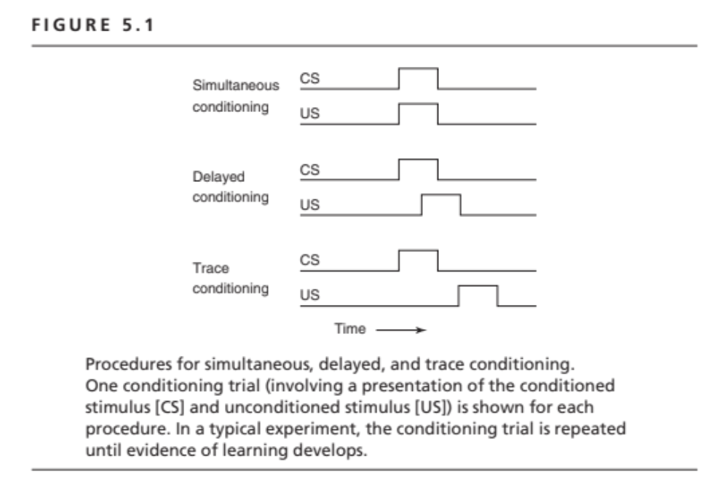

Slide 3
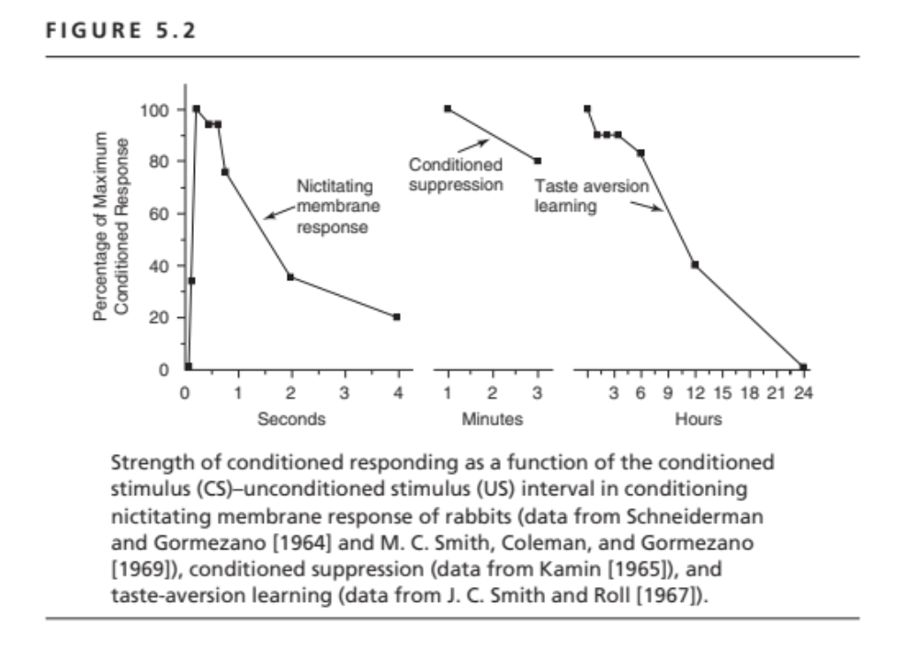

Slide 4
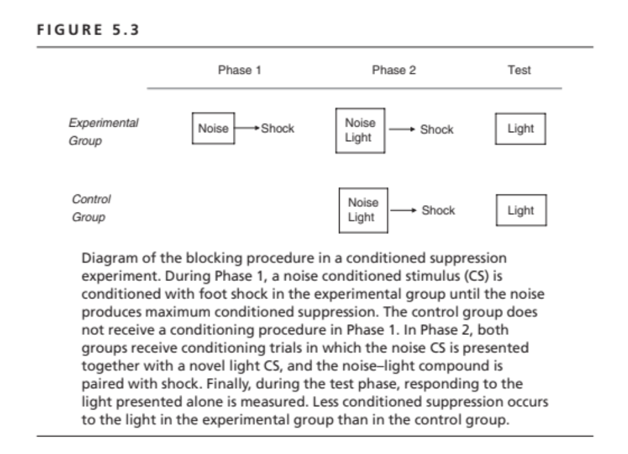

Slide 5
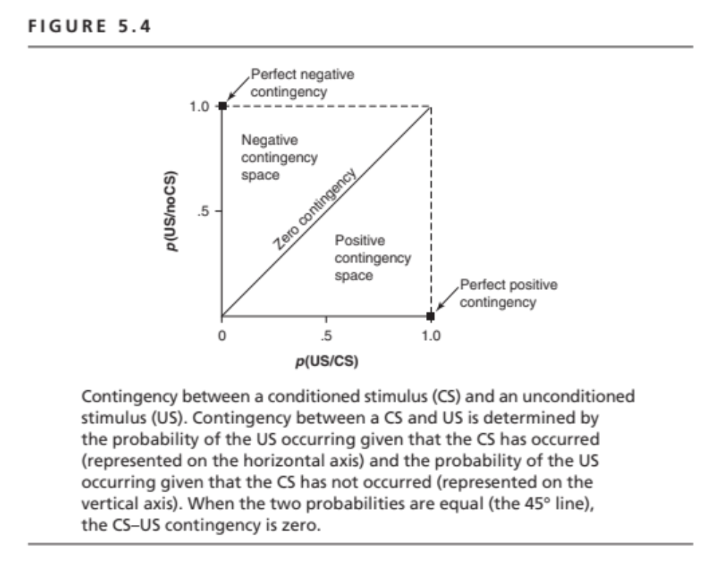

Slide 6
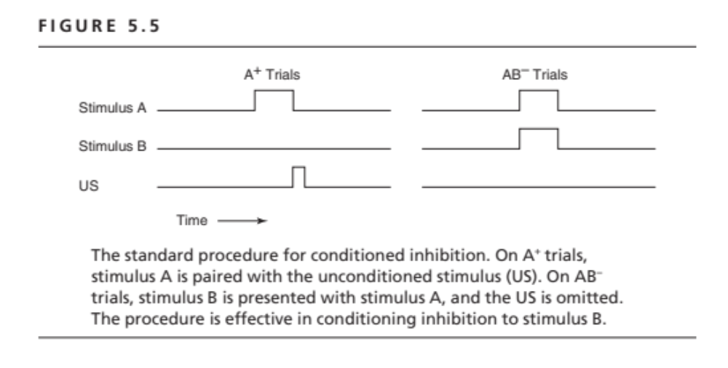

Slide 7
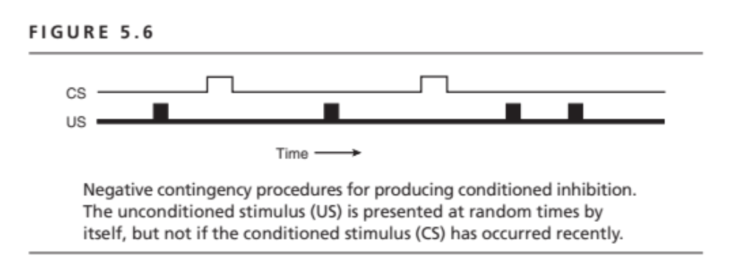

Slide 8
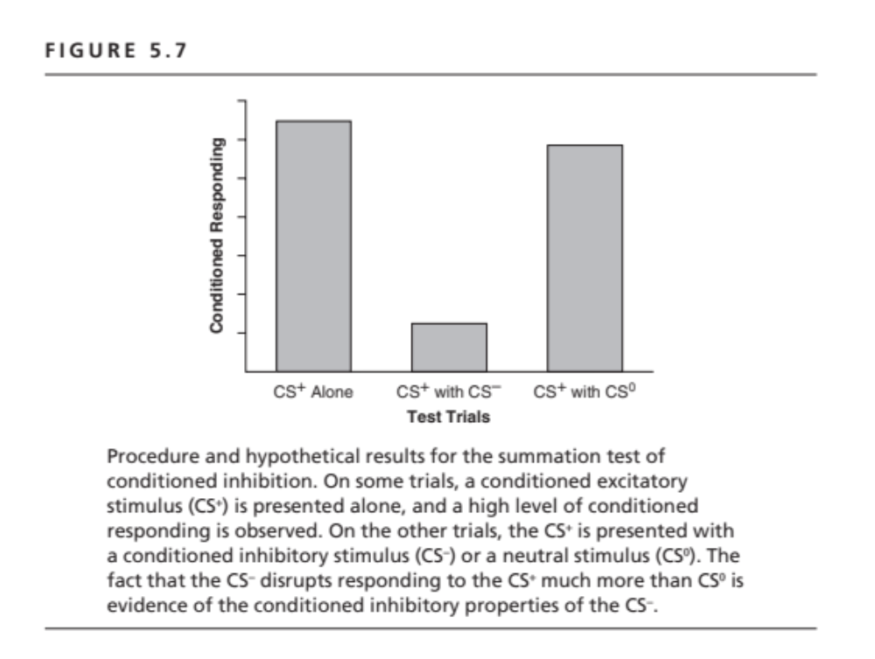

Slide 9
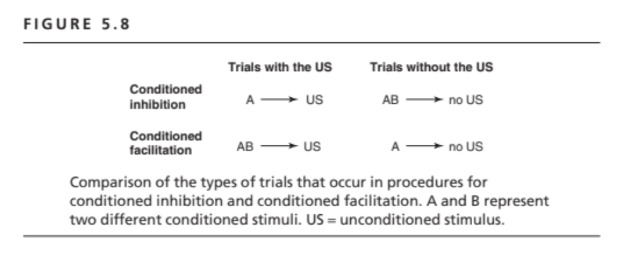

Slide 10
