Slide 1
Chapter 4
Pavlovian Conditioning: Basic Concepts
Pavlov’s Proverbial Bell
Contemporary Conditioning Situations
The Nature of the Conditioned Response
Conditioned Modifications of the Unconditioned Response
Stimulus Factors in Conditioning
The control Problem in Pavlovian Conditioning
Prevalence of Pavlovian Conditioning

Slide 2
Basic Terminology
Unconditioned Stimulus or US
Unconditioned Response or UR
Conditioned Stimulus or CS
Conditioned Response or CR

Slide 3
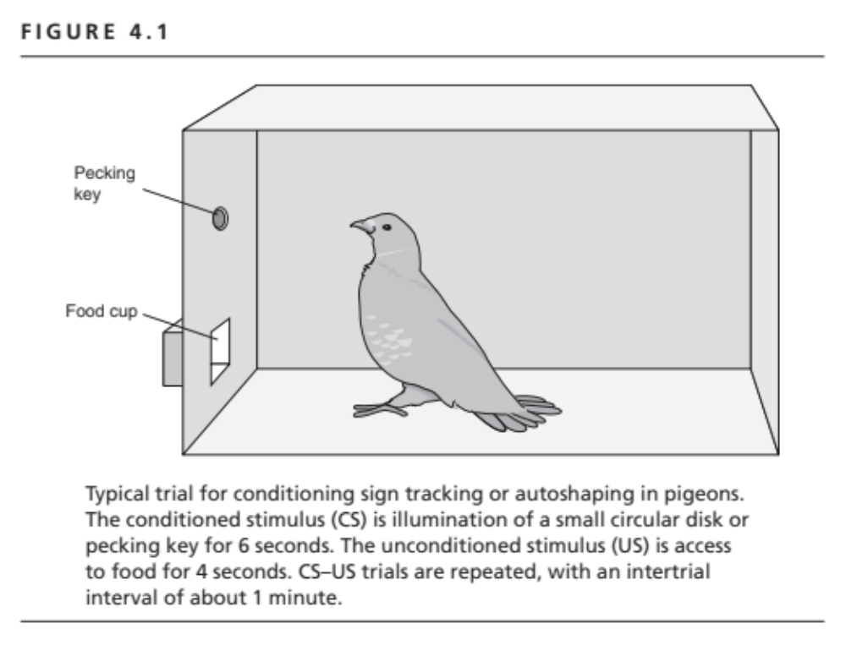

Slide 4
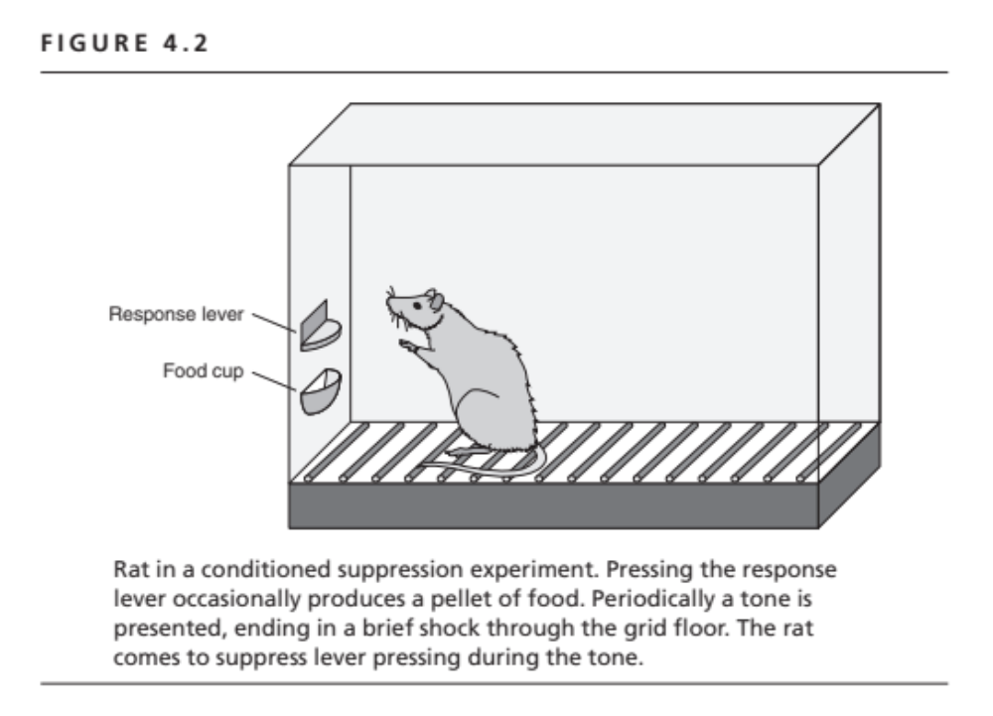

Slide 5
Measures of Conditioning
Magnitude of the CR to the CS
Latency of the CR to the CS
CS alone test trial procedure
Modifications of responding to the US
  Presence of the CS modifies the UR

Slide 6
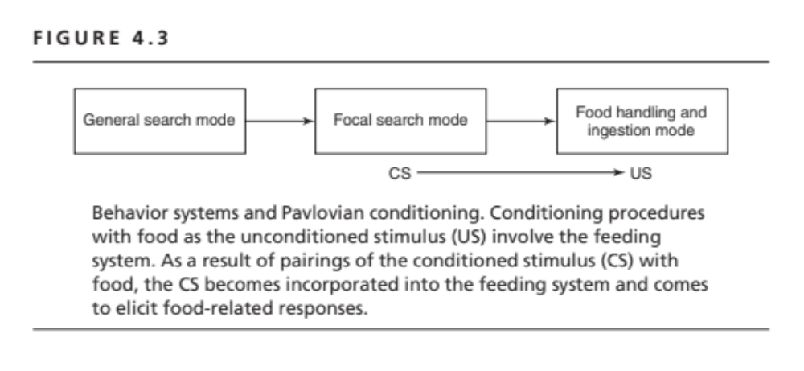

Slide 7
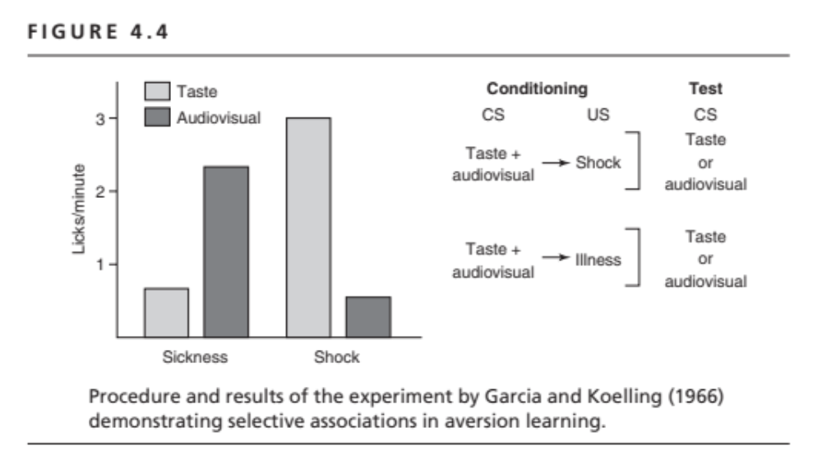

Slide 8
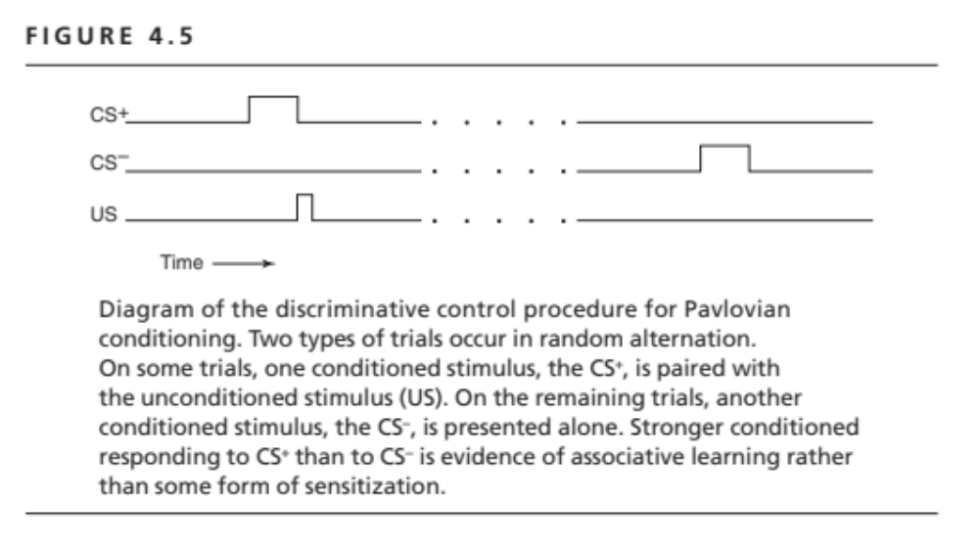

Slide 9
Prevalence of Classical Conditioning
Digestive secretions
Human causal judgments
Fear and defensive behavior
Drug conditioning
Infant suckling and maternal behavior
Sexual behavior

