Slide 1
Chapter 3
Habituation and Sensitization
Effects of Repeated Presentation of an Eliciting Stimulus
Characteristics of habituation effects
Characteristics of sensitization effects
The Dual-Process Theory of Habituation and Sensitization
The S-R system and the state system
Implications of the dual-process theory

Slide 2
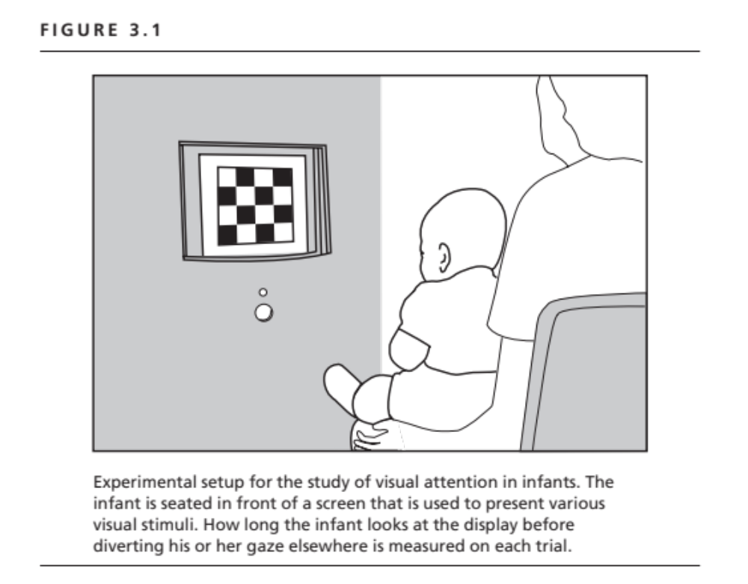

Slide 3
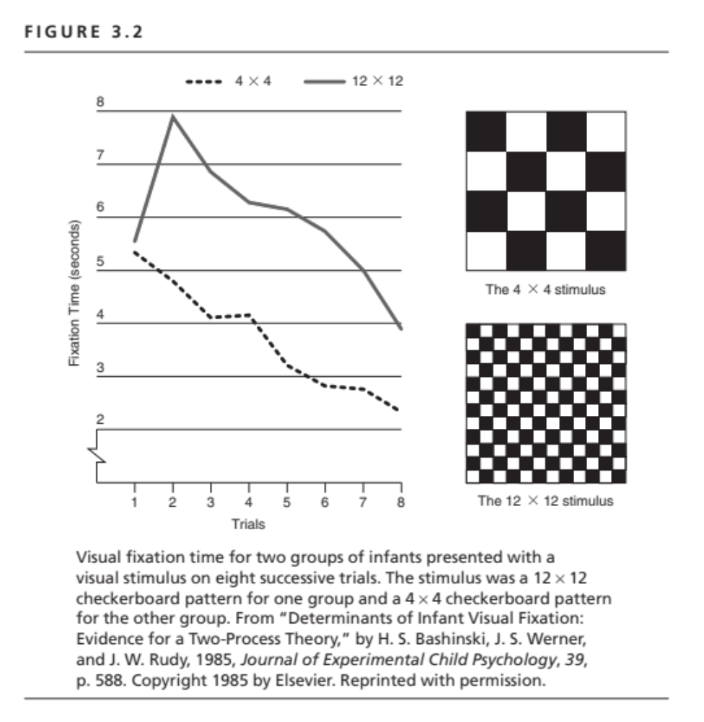

Slide 4
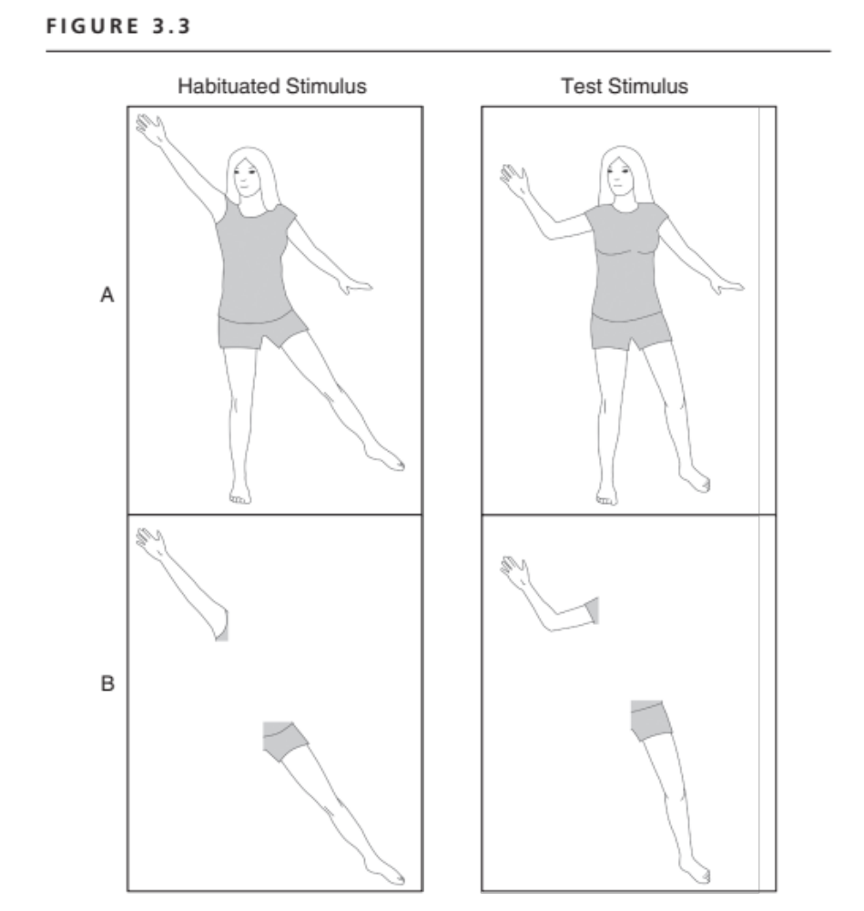
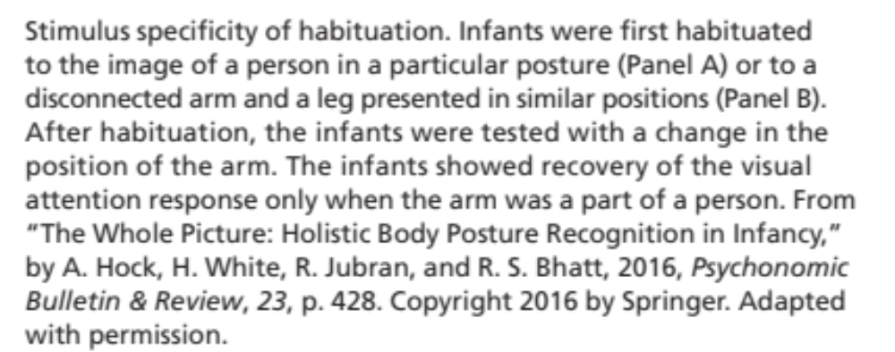

Slide 5
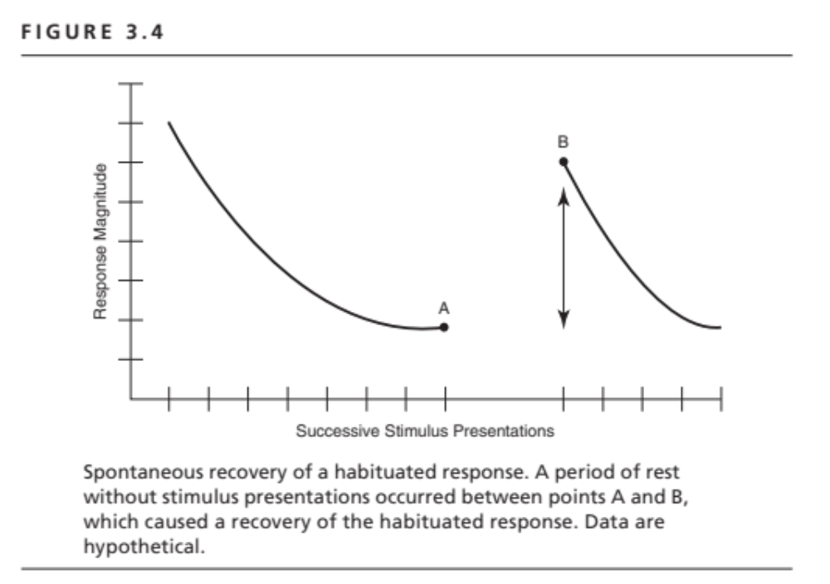

Slide 6
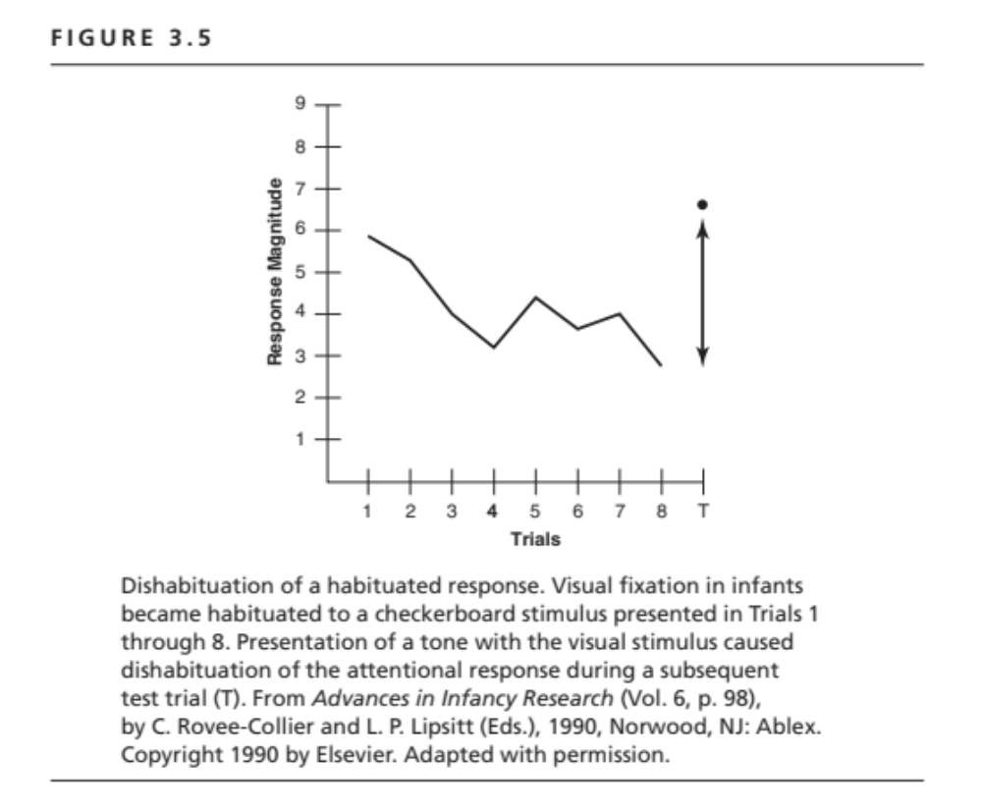

Slide 7
Characteristics of Habituation and Sensitization
Function of repeated trials
Function of stimulus intensity or complexity
Habituation: Stimulus specific
Sensitization: Not stimulus specific
Dishabituation: Not stimulus specific
Habituation dissipates with rest, resulting in spontaneous recovery
Sensitization also dissipates with rest
Short-term vs. long-term habituation

Slide 8
Dual-Process Theory
S-R System
  Shortest neural path from sensory input to response output
  Site of underlying habituation process
State System
  All other neural influences on S-R pathway
  Site of underlying sensitization process
Additivity of habituation & sensitization processes

Slide 9
