Slide 1
Chapter 2
The Structure of Unconditioned Behavior
Homogeneous versus Heterogeneous Substrates of Behavior
The Concept of the Reflex
Complex Forms of Elicited Behavior
Modal action patterns
Sign stimuli
The organization of Elicited Behavior
Motivational factors
Appetitive and consummatory behavior
Behavior systems

Slide 2
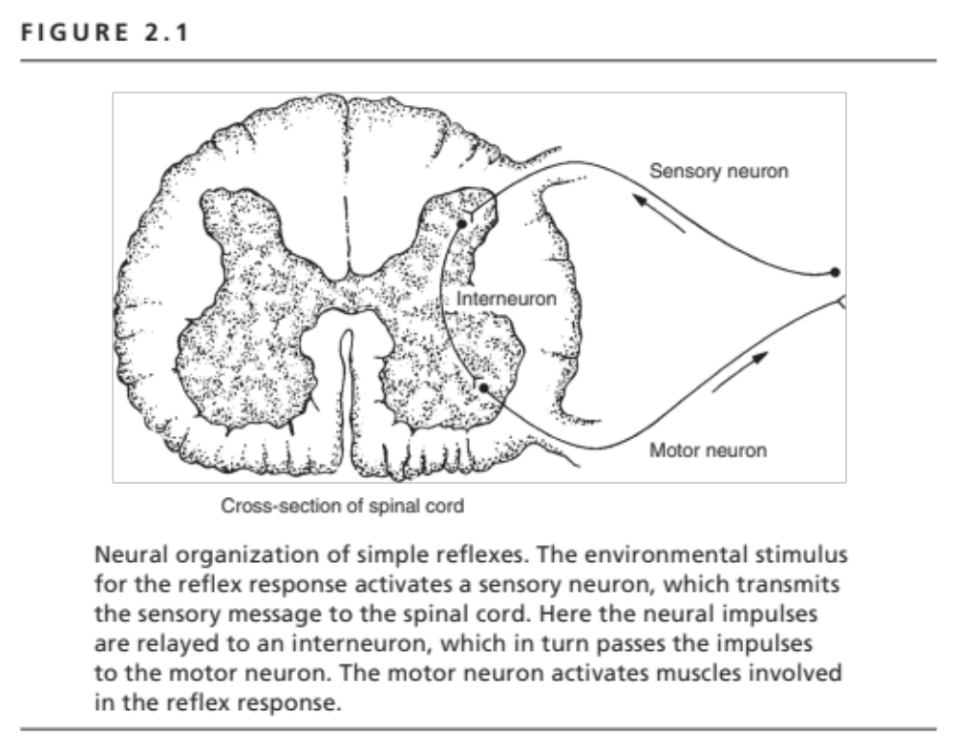

Slide 3
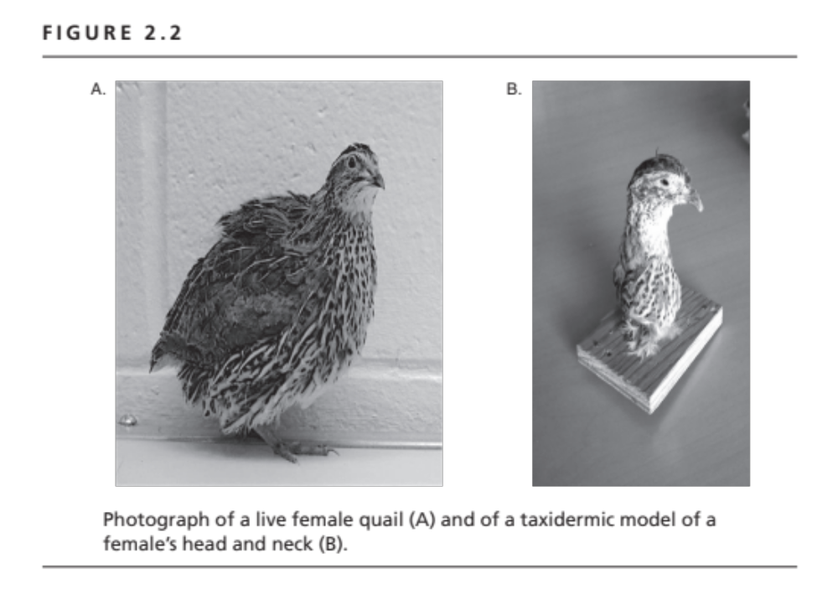

Slide 4
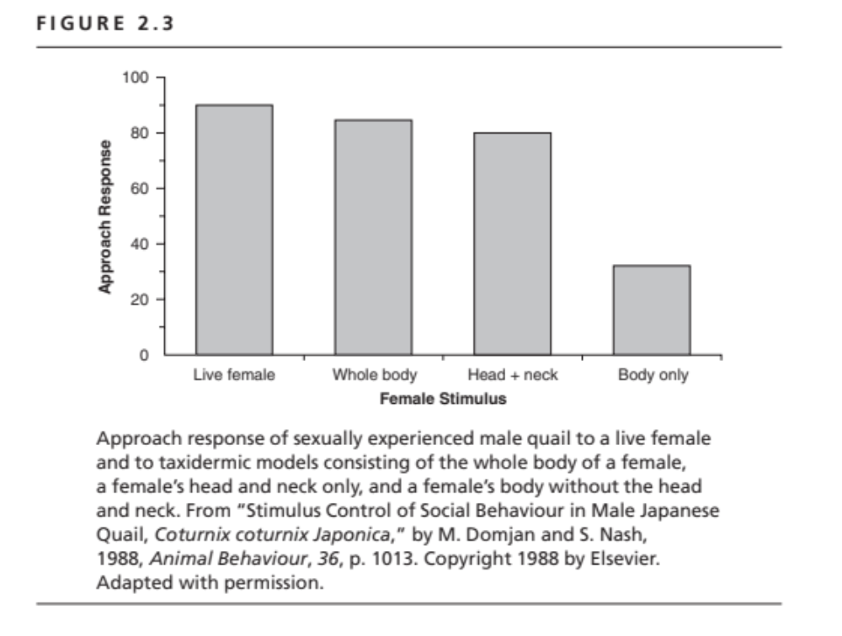

Slide 5
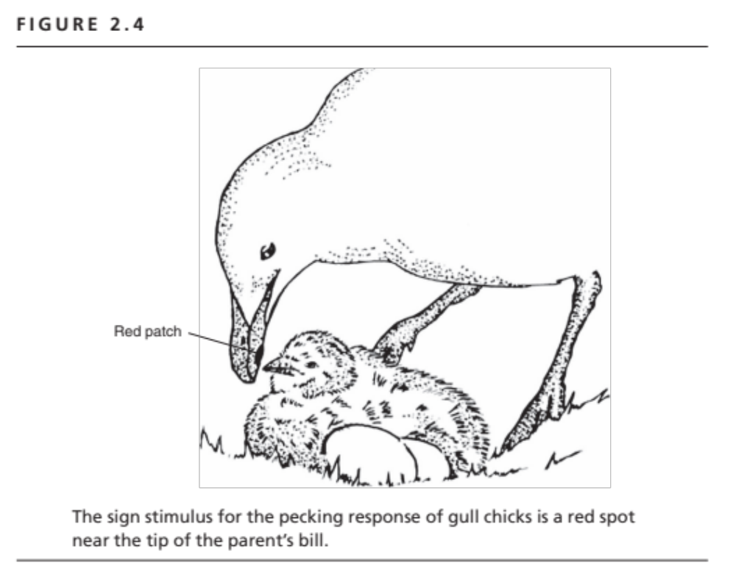

Slide 6


Books by Deirdre Barrett on supernormal stimuli
in human affairs
2007
2010

Slide 7
