Slide 1
Chapter 14
Memory Mechanisms
Stages of Information Processing
The Matching-to-Sample Procedure
Types of Memory
Sources of Memory Failure
Consolidation, Reconsolidation, and Memory Updating

Slide 2
Stages of Information Processing
Acquisition
Retention
Retrieval

Slide 3
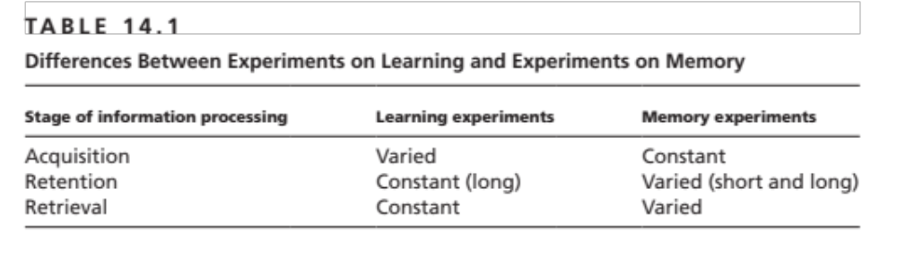

Slide 4
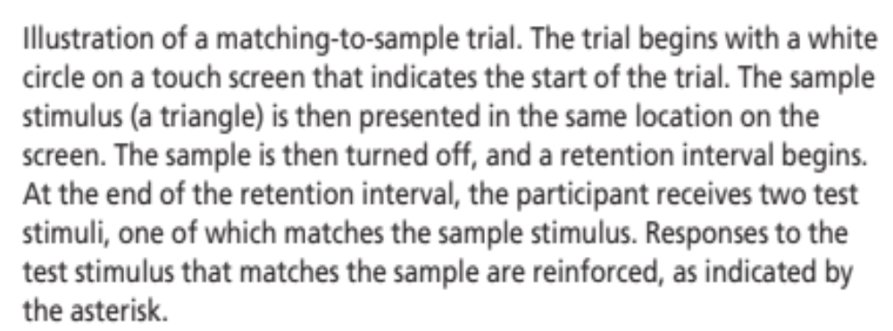
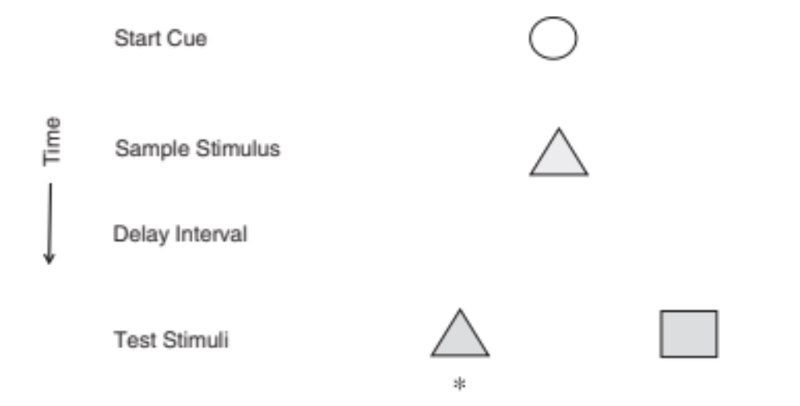
The Matching to Sample Procedure

Slide 5
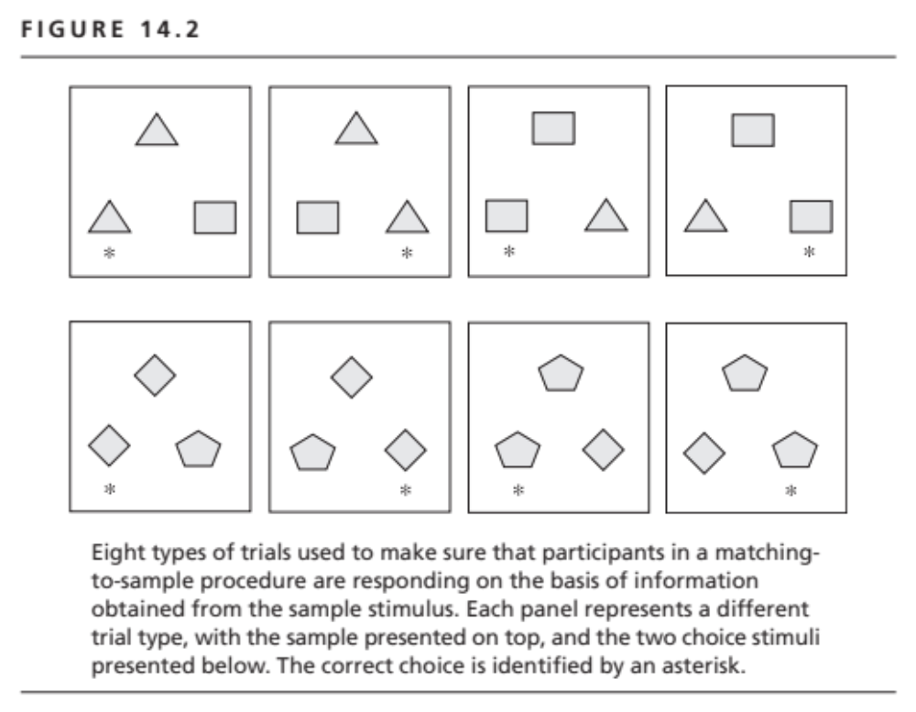

Slide 6
Types of Memory
Declarative memory
Procedural memory
Reference memory
Working memory
Retrospective memory
Prospective memory

Slide 7
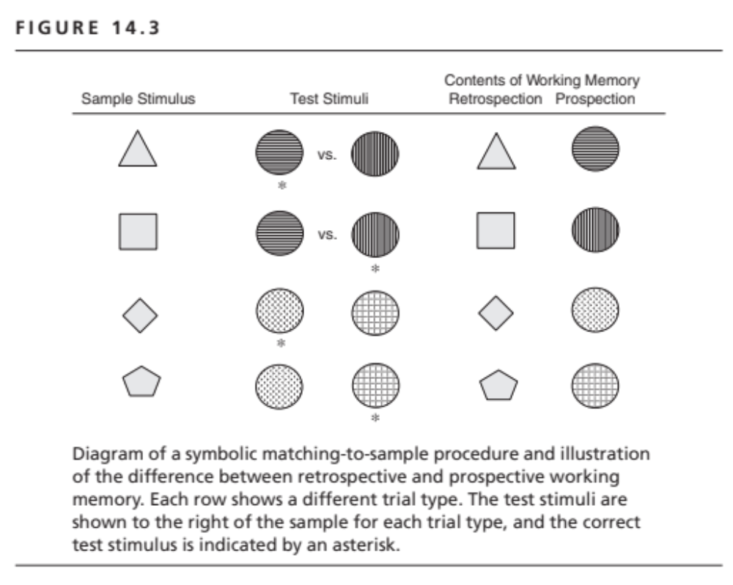

Slide 8
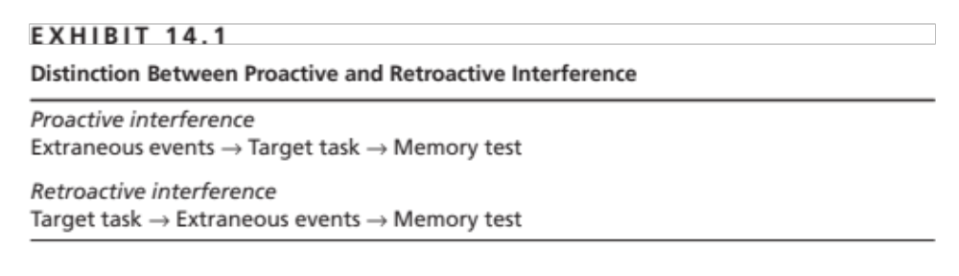

Slide 9
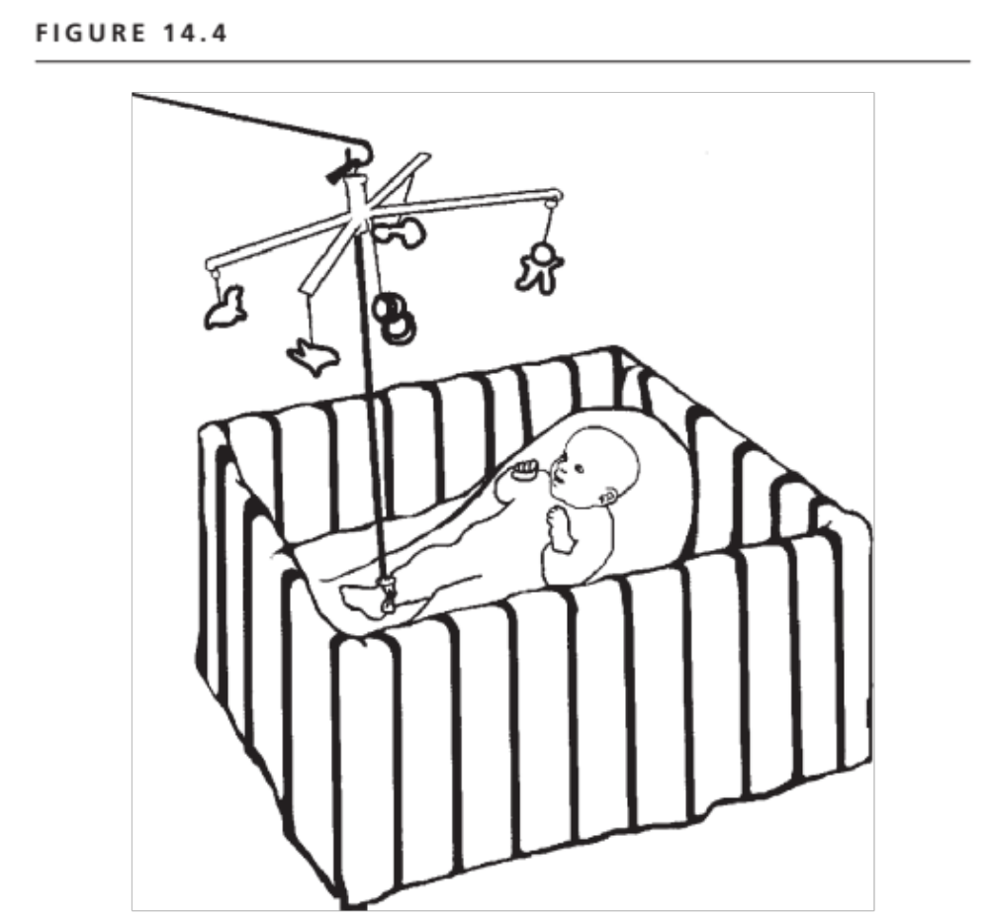
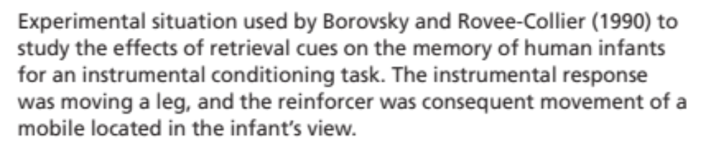

Slide 10
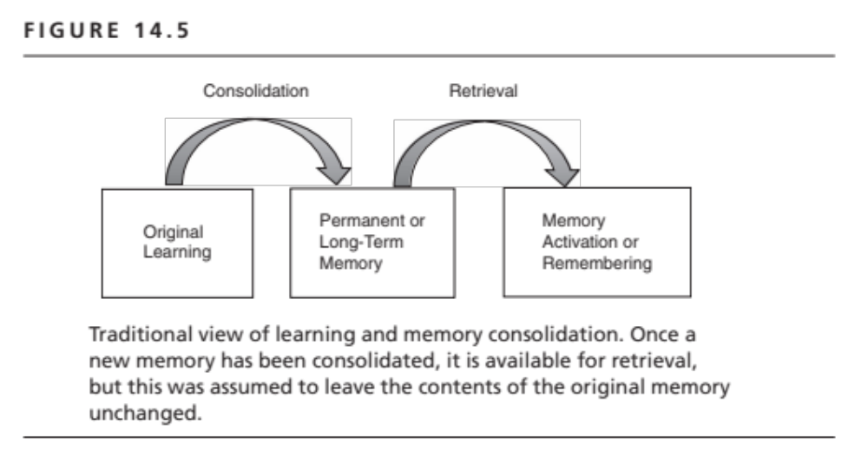

Slide 11
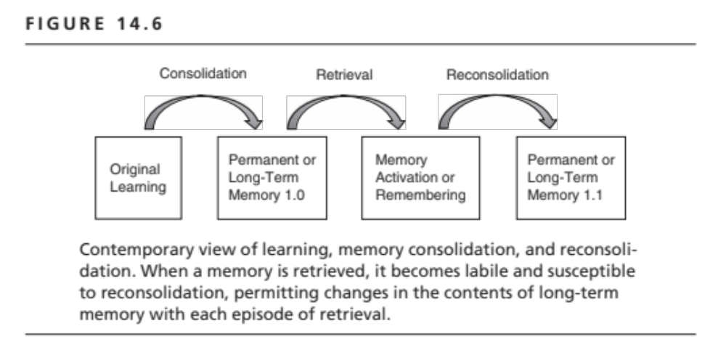

Slide 12
Consolidation and Reconsolidation
The activation of a memory makes the memory malleable.
Memory has to be reconsolidated to enable further storage and retrieval.
This makes memories that have been retrieved several times subjects to substantial modification, leading to false memories

