Slide 1
Chapter 13
Stimulus Control of Behavior
Measurement of Stimulus Control
Sensory and Motivational Variables in Stimulus Control
Learning Factors in Stimulus Control
Interdimensional and Intradimensional Discrimination Training
Stimulus Equivalence Training

Slide 2
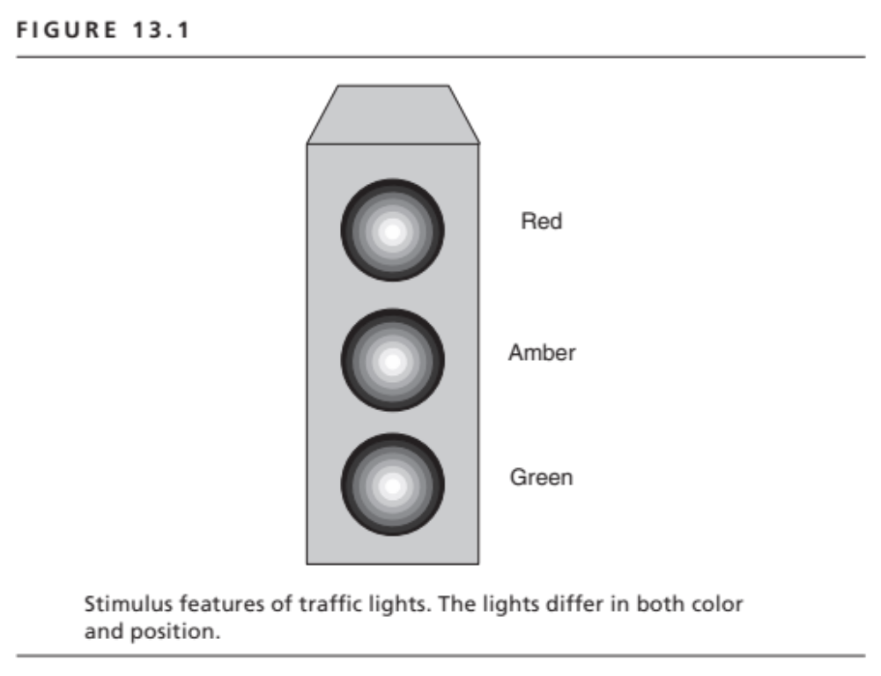

Slide 3
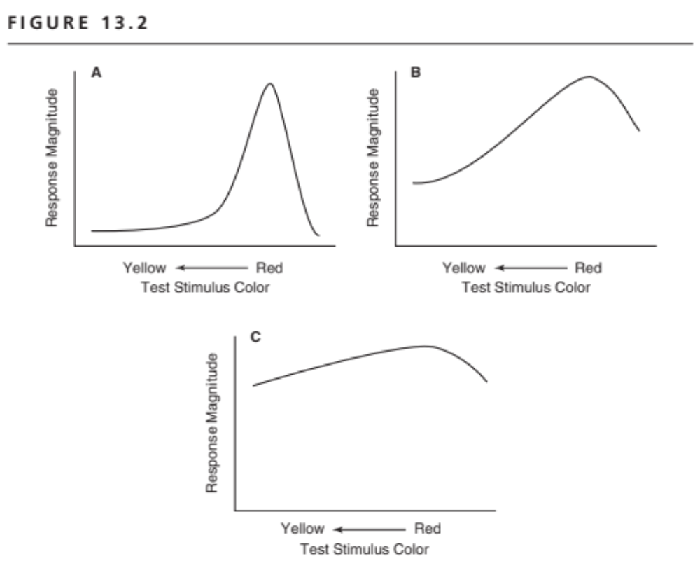
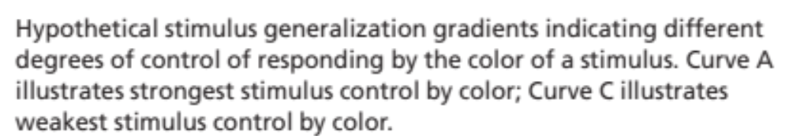

Slide 4
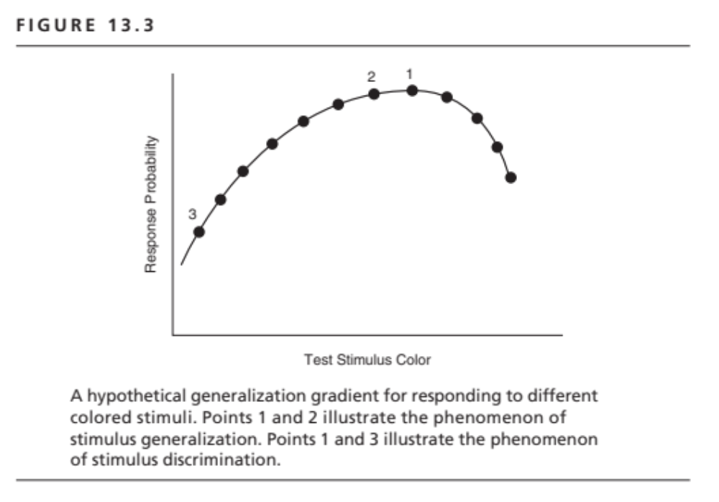

Slide 5
Discrimination Training
Simple Discrimination Training
Presence of S+ : R → reinforcement
Presence of S– : R → no reinforcement
Multiple Schedule of Reinforcement:
Presence of S1: one schedule of reinforcement
Presence of S2: a different schedule of reinforcement

Slide 6
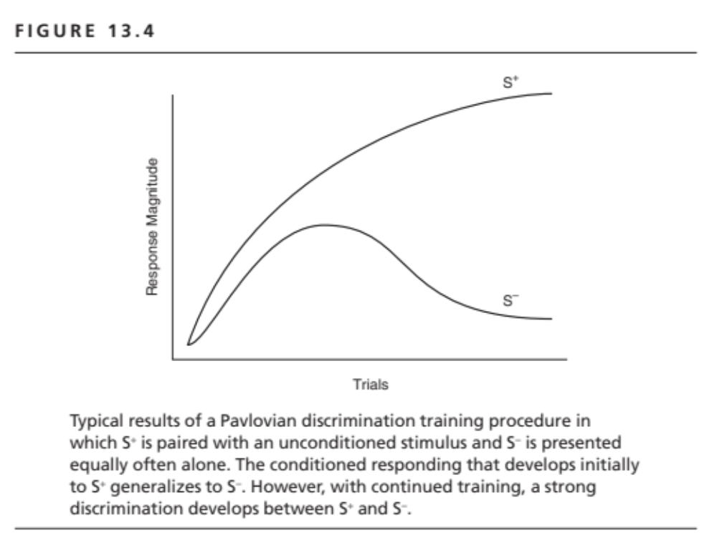

Slide 7
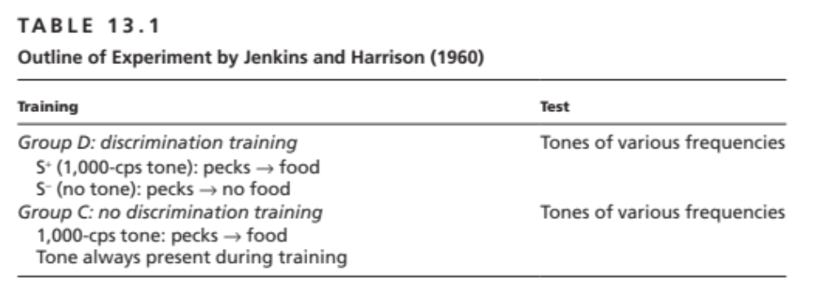

Slide 8
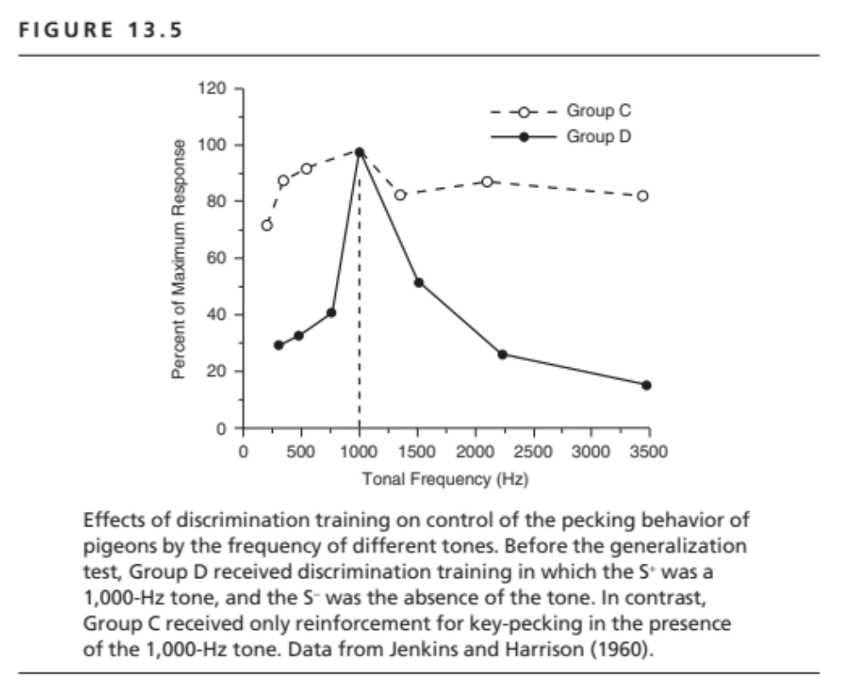

Slide 9
Interdimensional Discriminations
S+ and S– differ in numerous respects
Orange vs. Banana
Car vs. Bus
Violin vs. Piano
Vertical line vs. White pecking key
1000 cps tone vs. No tone

Slide 10
Intradimensional Discriminations
S+ and S– differ only in one (or small) respect
Orange vs. Tangerine
Honda Civic 4-door vs. Honda Civic 2-door
Stradivarius Violin vs. Guarneri Violin
1000 cps tone vs 950 cps tone

Slide 11
Stimulus Equivalence Training
Common Outcome Training
S¹, S², S³ . . . all paired with food
Sª, S^{b}, S^{c} . . . all paired with no food
Common Response Training
R1 is reinforced with S¹, S², S³ . . .
R2 is reinforced with Sª, S^{b}, S^{c} . . .

