Slide 1
Chapter 12
Avoidance Learning
Dominant Questions in the Analysis of Avoidance Learning
Origins of the Study of Avoidance Learning
Contemporary Avoidance Conditioning Procedures
Two-Factor Theory of Avoidance
Conditioned Temporal Cues in Avoidance Learning
Safety Signals and Avoidance Learning
Extinction of Avoidance Behavior
Avoidance Learning and Unconditioned Defensive Behavior

Slide 2
The Fundamental Avoidance Problem
A successful avoidance response is followed by nothing.
How can nothing serve as a reinforcer?

Slide 3
Basic Types of Avoidance Procedures
Signaled or Discriminated Avoidance
Nonsignaled or Free Operant Avoidance

Slide 4
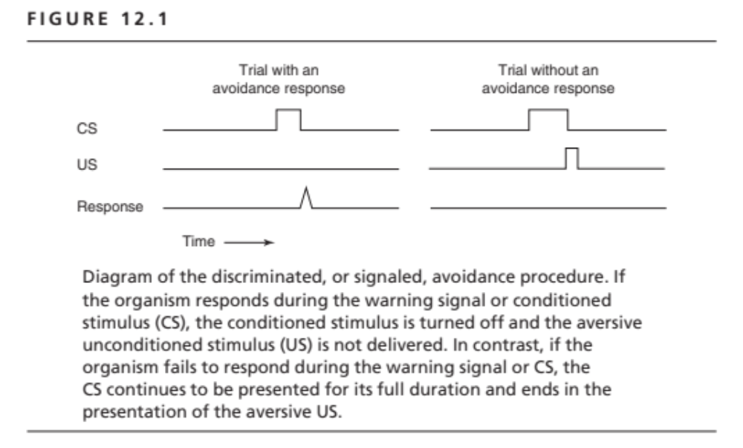

Slide 5
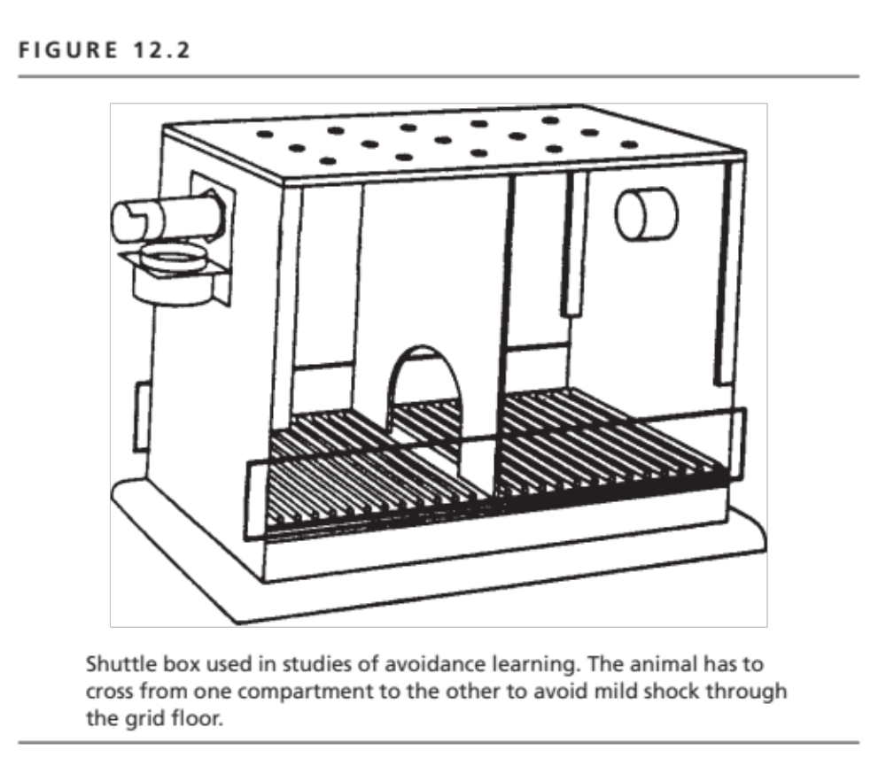

Slide 6
Two-Factor Theory of Avoidance
Escape Trials: Classical conditioning
  Conditioning of fear to the CS or warning stimulus.
Avoidance Trials: Instrumental Conditioning
  Response terminates CS and conditioned fear
  Response reinforced by fear reduction
  Form of negative reinforcement

Slide 7
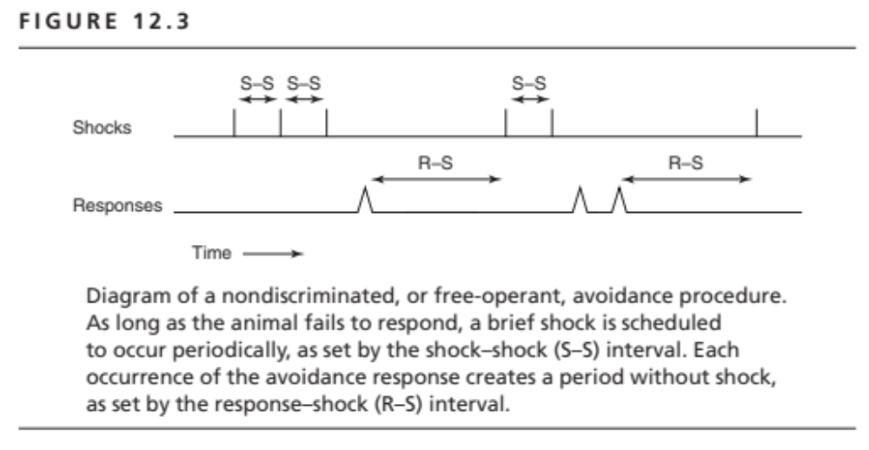

Slide 8
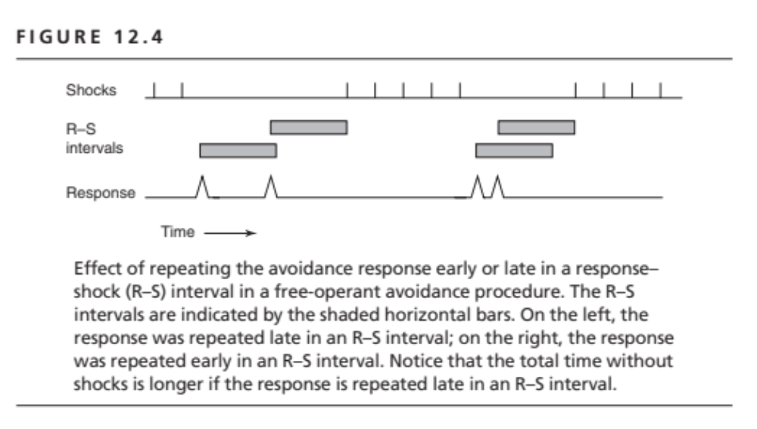

Slide 9
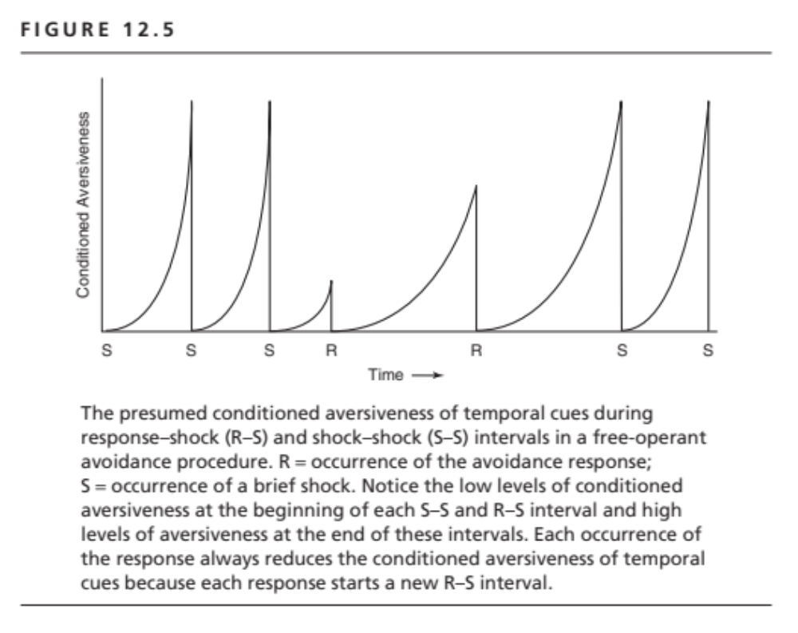

Slide 10
Nondiscriminated or
Free-Operant Avoidance
What reinforces the avoidance response?
Fear reduction through resetting temporal cues.
Response feedback cues as safety signals or conditioned inhibitors of fear.

Slide 11
Avoidance Learning Mechanisms
Classical conditioning of fear to the CS.
Negative reinforcement of the avoidance response through fear reduction.
Positive reinforcement of the avoidance response by response feedback cues as safety signals or conditioned inhibitors of fear.

Slide 12
Avoiding Predatory Attack on the First Trial: What if you cannot afford the luxury of avoidance learning?
Innate responses to fear
Species Specific Defense Reactions or SSDRs
Fear or freezing,
Fighting,
Flight or fleeing
The Predatory Imminence Continuum

Slide 13
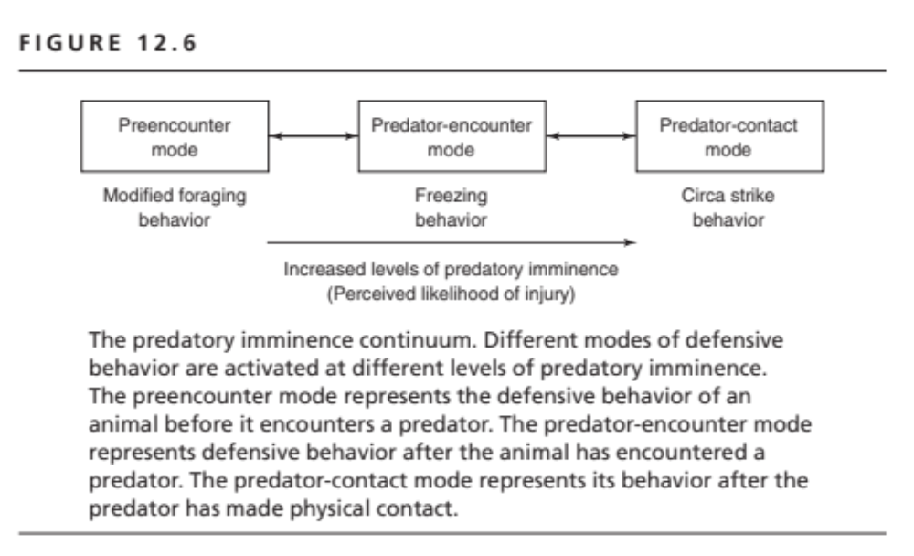

Slide 14
Avoidance Mechanisms:
Summary
Early trials--
  SSDR’s and Predatory Imminence
Later trials--
  Classical conditioning of fear
  Negative reinforcement through fear reduction
  Positive reinforcement by safety signal feedback cues

