Slide 1
Chapter 11
Punishment
Effective and ineffective punishment
Research evidence on punishment
Can and should we create a society free of punishment?
Alternatives to abusive punishment

Slide 2
Punishment
Thorndike: Not effective.
Skinner: Not effective, undesirable.
Azrin: Works fine, if applied properly.

Slide 3
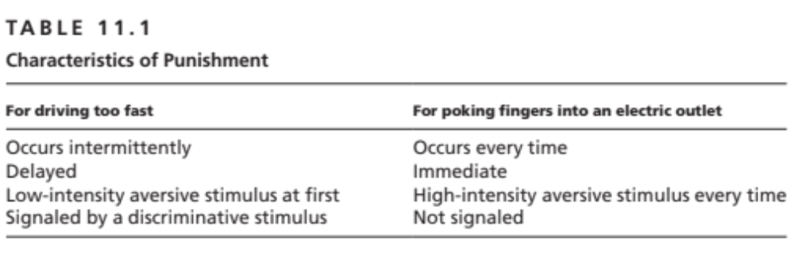

Slide 4
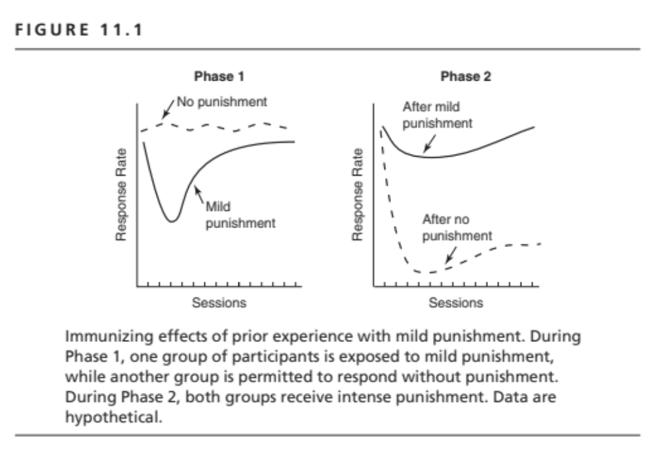

Slide 5
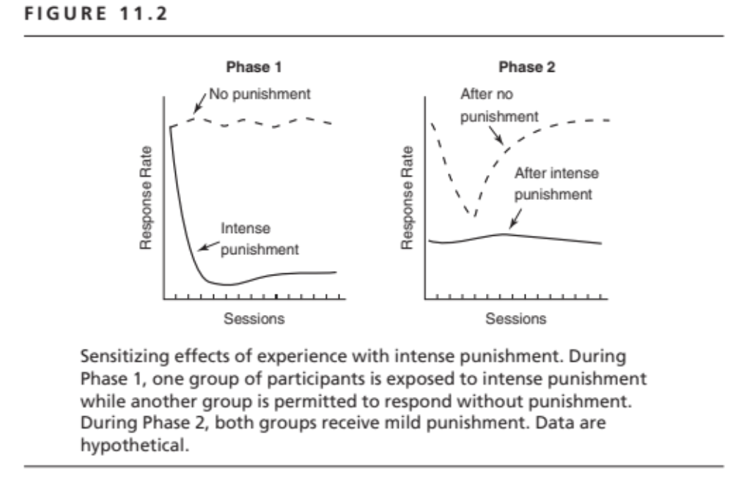

Slide 6
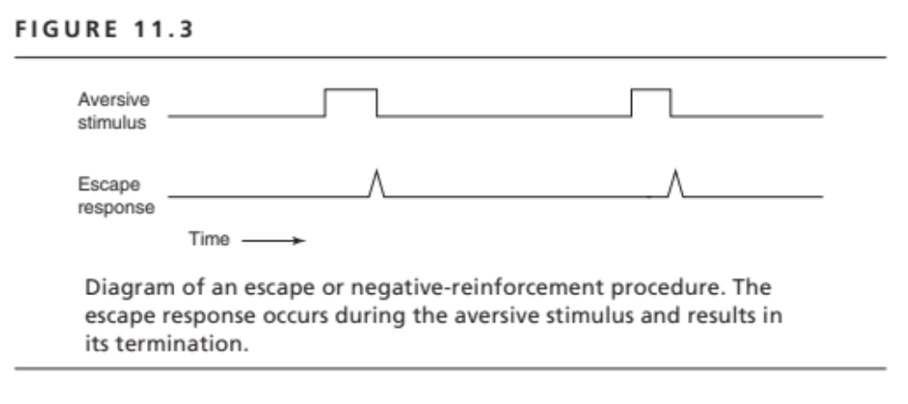

Slide 7
Other Factors that Determine the
Efficacy of Punishment
Delay of punishment
Schedule of positive reinforcement
Availability of a discriminative stimulus for punishment
Punishment as a cue for reinforcement

Slide 8
Alternatives to Abusive Punishment
Time out
Differential reinforcement of other behavior (DRO)

