Slide 1
Chapter 10
Extinction of Conditioned Behavior
Effects of Extinction Procedures
Response Recovery after Extinction
Enhancing Extinction Performance
“Paradoxical” Reward Effects in Extinction

Slide 2
Extinction Procedures
Classical Conditioning:
Repeated CS alone presentations
Instrumental Conditioning:
Responding without reinforcement

Slide 3
Extinction Effects
Decline in responding
Frustration
Increase in response variability

Slide 4
Does the response decline in extinction reflect the loss or reversal of what was previously learned?
Test for response recovery.
Borrow procedures from habituation.

Slide 5
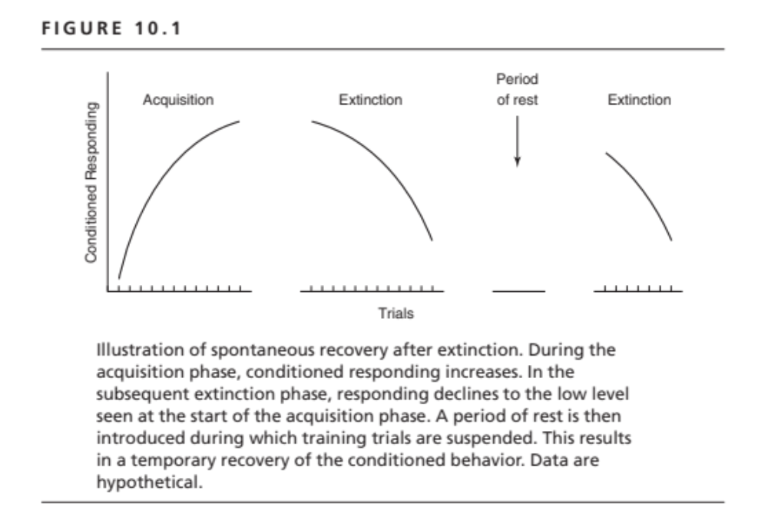

Slide 6
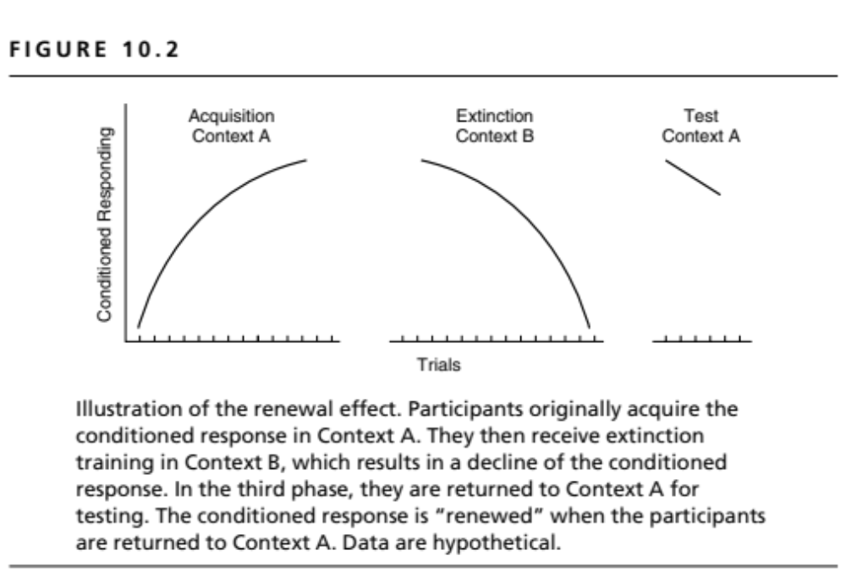

Slide 7
Mechanisms of Renewal
Acquisition generalizes across contexts
Extinction is context specific
Acquisition and extinction create conflicting memories, making the CS ambiguous
Context serves to disambiguate the significance of the CS

Slide 8
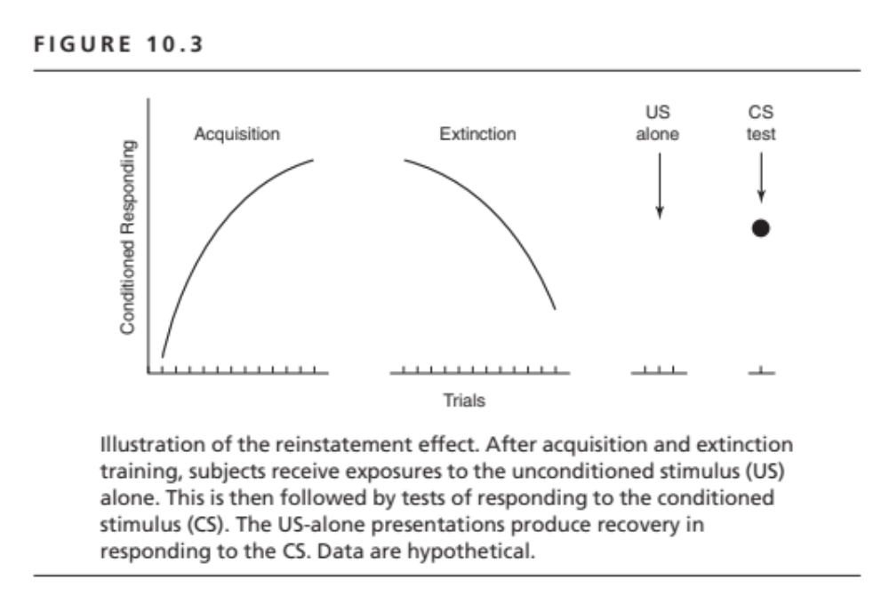

Slide 9
Enhancing Extinction
Increase number of extinction trials
Increase the interval between extinction trials
Conduct extinction in multiple contexts
Provide reminder cues for extinction
Prime extinction with a CS-alone trial to facilitate incorporating extinction in reconsolidation

Slide 10
Persistence in Extinction
(Instrumental Conditioning)
Paradoxical Reward Effects–
  More responding in extinction after less reinforcement during initial the reinforcement phase

Slide 11
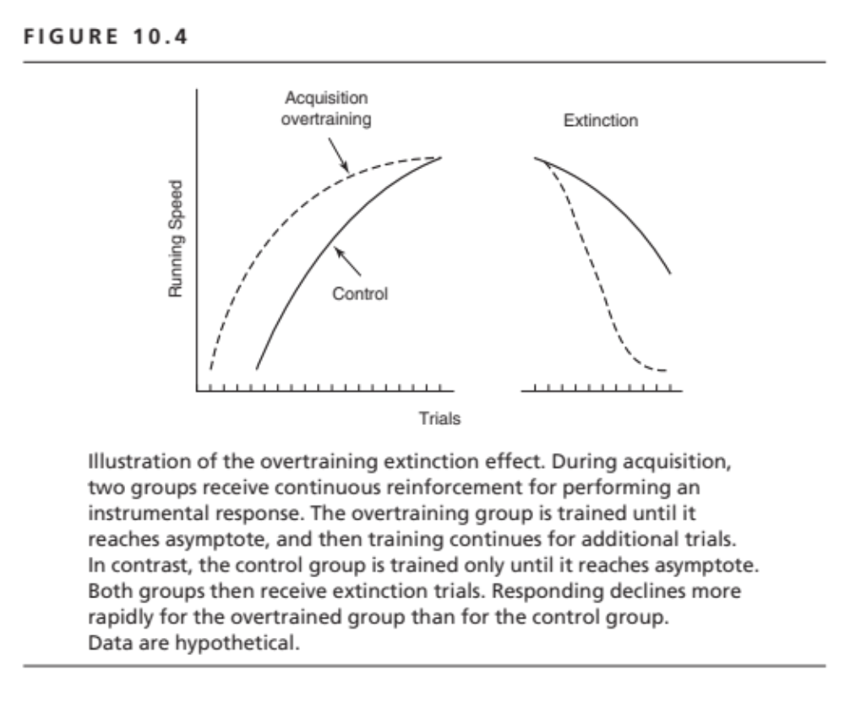

Slide 12
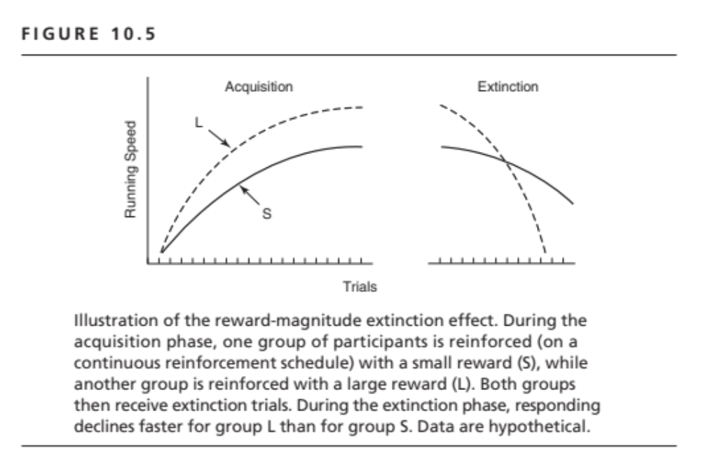

Slide 13
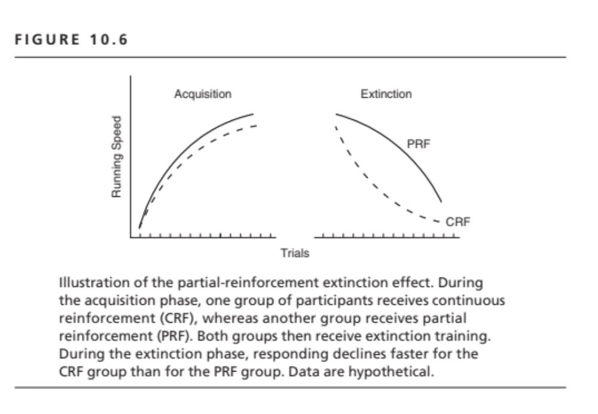

Slide 14
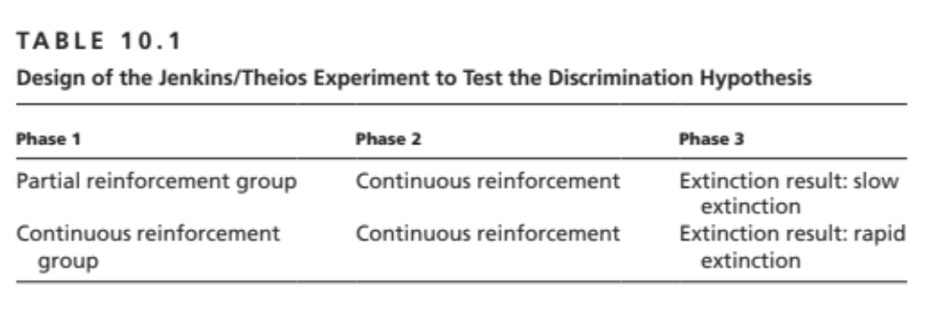

Slide 15
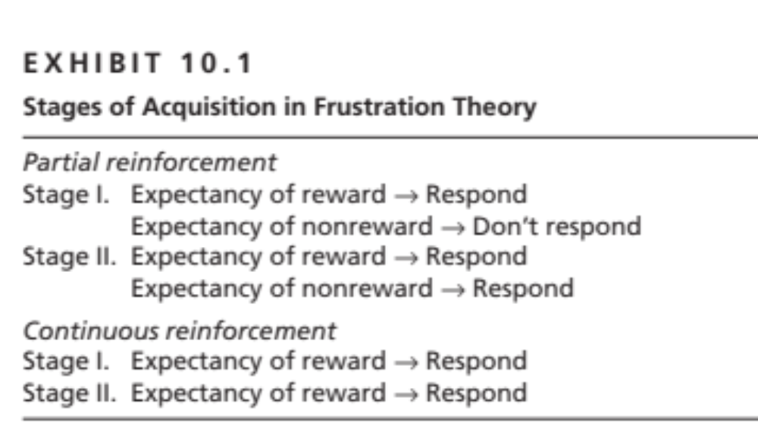

Slide 16
Frustration Theory
Reward expectancy learned on reinforced trials.
Frustration occurs when a trial ends in nonreward in the face of the expectation of reward.
Subjects learn to respond in the face of the anticipation of frustration or the anticipation of nonreward.
This learning leads to persistence in extinction.

Slide 17
Sequential Theory
Emphasis on trial sequence: RNNRRNR
On reinforced trials following nonreward, the response becomes conditioned to the memory of nonreward. The memory of nonreward serves as S in S-R, S-O, and S-(R-O) associations.
Responding in the face of the memory of nonreward causes response persistence.
Critical factors:
  Number of N-R transitions
  N-length (number of N’s prior to R)

