Slide 1
Chapter 1
Basic Concepts and Definitions
Fundamental Features of Learning
Learning and other forms of behavior change
Learning, performance, and levels of analysis
Definition of learning
Naturalistic versus Experimental Observations
The Fundamental Learning Experiment
The control problem in studies of learning
The general-process approach to the study of learning
The use of nonhuman participants in research

Slide 2
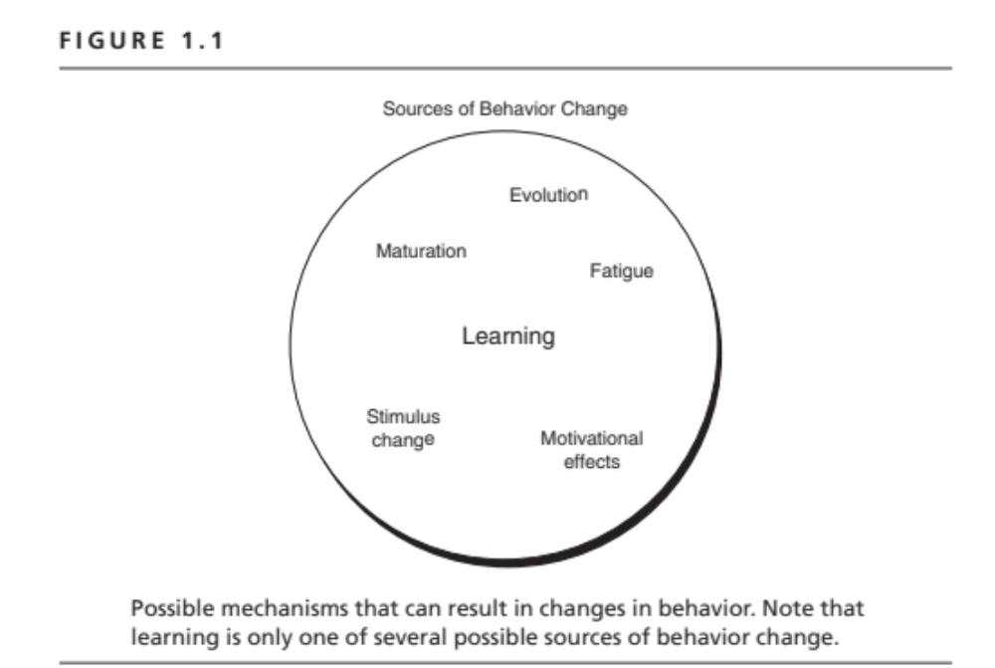

Slide 3
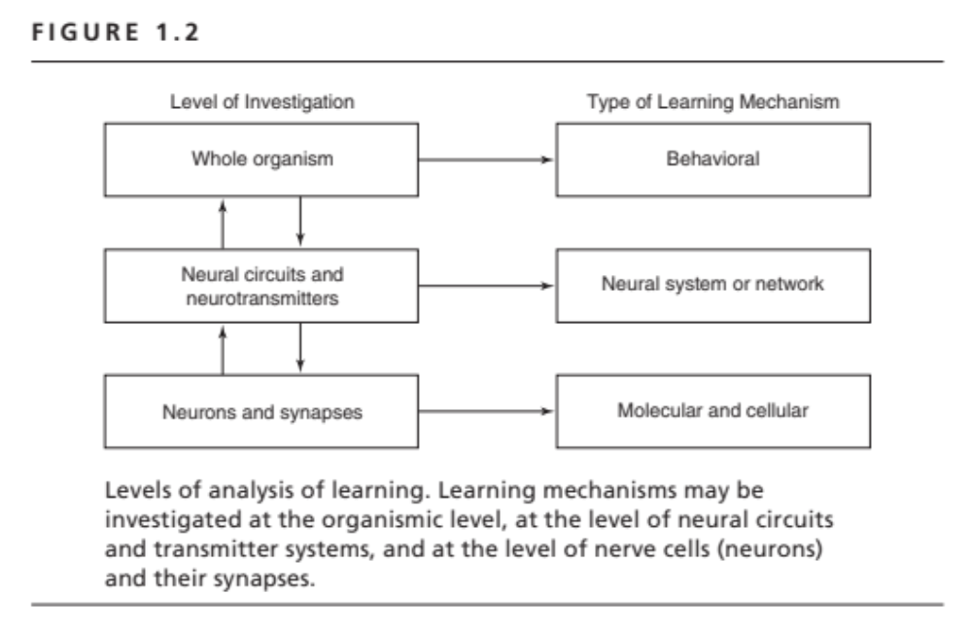

Slide 4
Definition of Learning
Enduring change in the mechanisms of behavior involving specific stimuli and/or responses that results from prior experience with those or similar stimuli and responses.

Slide 5
Definition of Learning
Enduring change in the mechanisms of behavior involving specific stimuli and/or responses that results from prior experience with those or similar stimuli and responses.
Learning vs. Stimulus change
Fatigue
Motivational change

Slide 6
Definition of Learning
Enduring change in the mechanisms of behavior involving specific stimuli and/or responses that results from prior experience with those or similar stimuli and responses.
Learning vs. Performance

Slide 7
Definition of Learning
Enduring change in the mechanisms of behavior involving specific stimuli and/or responses that results from prior experience with those or similar stimuli and responses.
Learning vs. Maturation

Slide 8
Definition of Learning
Enduring change in the mechanisms of behavior involving specific stimuli and/or responses that results from prior experience with those or similar stimuli and responses.
Observational vs. Experimental Methodology
©M. Domjan

Slide 9
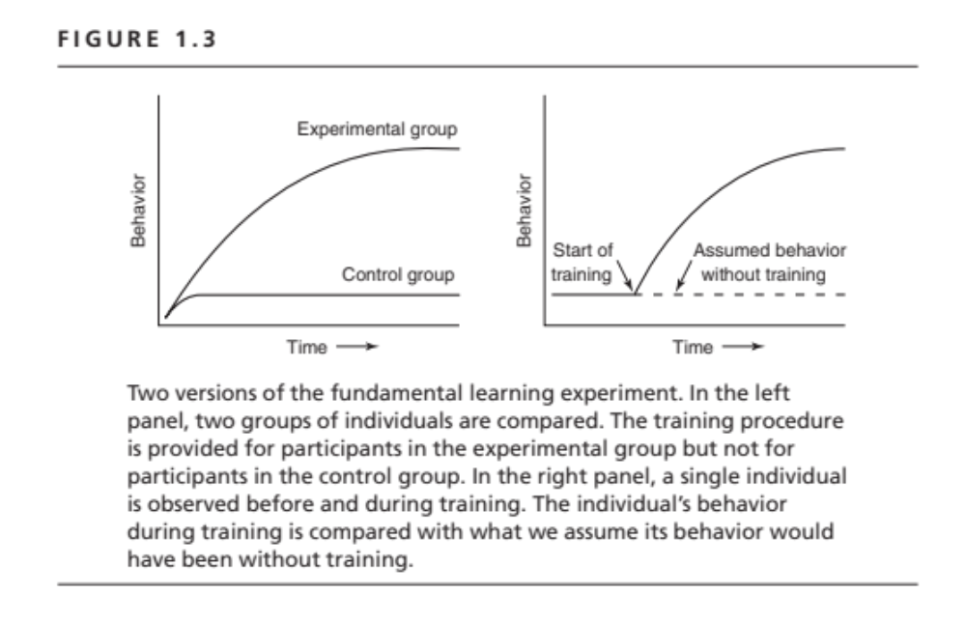

Slide 10
Rationale for Nonhuman
Animal Research
Better experimental control
  Knowledge and control of past experience
  Greater control over learning environment and procedures
  Easier repeated observation of the same individual under the same circumstances
  Knowledge of and control of the genetics of the participants
  Easier control of motivational variables
Processes may be simpler
  No verbal mediation
  No demand characteristics
Facilitates study of the evolution of intelligence or learning
Facilitates study of the biological bases of learning

Slide 11
Inadequate Alternatives to Animal Research
Naturalistic observations
Plants
Tissue cultures
Computer simulation

