Slide 1
Minority-related Chronic Stress in Adolescents: Implications for Student Learning and Mental Health Outcomes
April Thames, Ph.D. (Division 40 –Society for Clinical Neuropsychology)
Scott L. Graves Jr., Ph.D. (Division 16 - School Psychology)

Slide 2
Race-related stress vs. stressors linked to race
Race-related stress is defined as “stress that is characterized by both social ostracism and blocked economic opportunity (Brondolo, Gallo, & Myers, 2009)
  (e.g., discrimination, racism)
Race-related stress is a significant contributor in minority health disparities (Brondolo, Gallo, & Myers, 2009; Geronimus, Hicken, Keene, & Bound, 2006; Myers, 2009; Utsey & Hook, 2007).
Stressors linked to racial identity are not synonymous with race-related stress
  Poverty
  Incarceration
  Food insecurity
  Neighborhood safety
  Interpersonal violence
  Family conflict

Slide 3
Why Do Educator’s Need to Understand Chronic Stress
One out of every 4 children attending school has been exposed to chronic and traumatic events that can affect learning and/or behavior
These events can impact school performance (Lower GPA, higher absence rate, decreased reading ability, increased behavior problems)
These events can impair learning. (Chronic exposure can adversely affect attention, memory, and cognition
These children may experience physical and emotional distress

Slide 4
Stress impacts neurodevelopment
Early life stress can affect the developing brain in a way that leads to poorly controlled stress response systems (Loman & Gunnar, 2010).
  Overly reactive
  Slow to return to homeostasis
Over time this can result in mental health problems and cognitive problems

Slide 5
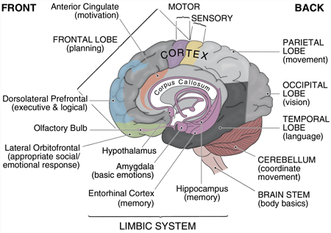
Normal Brain Development

Slide 6
The Adolescent Brain
During puberty there is a dramatic increase in neuron connectivity and growth throughout many parts of the brain
During adolescence, many neural pathways will be pruned away because the pathways are not used
Maturation and development of cognitive functioning and higher-level thinking skills

Slide 7
The Adolescent Brain
Heavy involvement of the limbic system (particularly the amygdala). Teenagers do more of their thinking and decision-making in this part of the brain.
Greater need for proper nutrition, rest and sleep
Its development depends largely upon the kinds and quality of experiences it receives.
Sensitive to chronic stress
Last part to mature – part in which higher-level thinking and more rational decision-making occurs

Slide 8
Stress Response
Operates via two interrelated systems:
SAM (Sympathetic-adrenomedullary)
HPA (hypothalamic-pituitary-adrenocortical).
These balance each other
Both are triggered by the hypothalamus

Slide 9
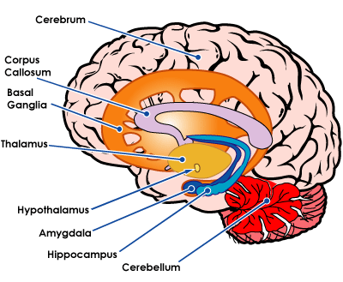
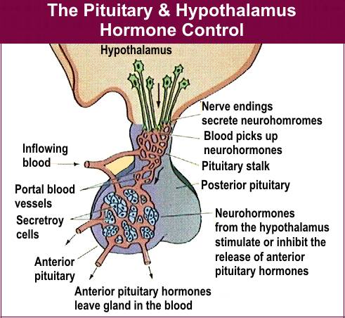
The brain system for appraising threats
Limbic system:
  Adds emotional dimensions to stress perception: fear, anger, anxiety
  Especially centered in the hypothalamus

Slide 10
Stress Response - Brain
Prolonged exposure to adversity is associated with impairments in emotional regulation and learning and memory (Richards & Wadsworth, 2004; Shonkoff et al., 2012; Tottenham et al., 2010).
Adverse events, and its resultant stress, engender such changes particularly in brain regions such as the hippocampus and amygdala (Lupien, McEwen, Gunnar & Heim, 2009; Sapolsky, 1996).
Disruption of the HPA-axis has been associated with loss of neuronal connections and smaller hippocampal volume (Rao, Chen, Bidesi, Shad, Thomas & Hammen, 2010; Sapolsky, 1996; Woon & Hedges, 2008) and altered amygdala connectivity (Thomason, Marusak, Tocco, Vila, McGarragle & Rosenberg, 2015).
Functional (Dannlowski et al., 2012; Hart & Rubia, 2012, McCrory et al., 2013; Teicher et al., 2002, 2010)
  Amygdala- hyper-responsivity (limbic irritability)
  Diminished right-left intrahemispheric communication
  Alterations in frontal-cingulate-limbic circuitry (Bluhm et al., 2009, Daniels et al., 2013, Dean et al., 2014, Krause et al., 2014, Phillip et al., 2013a, 2013b, van der Werff et al., 2013, Wang et al., 2014)

Slide 11
Memory and learning in the teenage brain can be significantly affected by emotion
Too much or too little will derail learning
The brain is wired to pay attention first to sensory information that has a strong emotional content
Strong emotional responses like anger, fear and intense anxiety can override conscious thought processing

Slide 12
Meta-analysis of school-based trauma interventions
Sareska Tamayo, Scott Graves & Research Group
14 studies met our criteria
Effects
  PSTD (0.592)
  Depression (0.443)
  Anxiety (0.456)
13 in urban schools
Mostly African American, Hispanic and Indian American children attending middle school
Framework Cognitive Behavioral Therapy
Interventions are responsive to multiple/cumulative trauma
10 sessions, mostly delivered in a group format

Slide 13
Framework for Schools
School wide infrastructure and culture
Staff training
Linking with Community Partners
Academic instruction for traumatized children
Nonacademic strategies
School policies, procedures, and protocols
Notes:
Follow your school's reporting procedures if there is suspected abuse
If the child is not eligible for special education, consider making individualized modifications to academic work until the trauma has been sufficiently addressed (might consider including these in a 504 plan).

Slide 14
What can protect against the negative effects of stress?

Slide 15
Teacher’s Role
School staff should be trained regarding salient aspects of youth development, school climate, and the importance of positive adult-child relationships in promoting healthy and meaningful relationships
Be a part of established routines (i.e. welcome students as they enter school each morning)
Identifying a weekly school-wide topic (i.e. respect) and reinforcing this in a variety of ways to promote a positive school climate
Teach children how to ask for help when needed
Listen and model effective problem-solving skills
Help build an internal locus of control
Teach children how to identify and appropriately express feelings from an early age

Slide 16
Additional Strategies
Provide unconditional regard in a safe and caring environment
Always empower, never disempower
  Be assertive when addressing inappropriate conduct but avoid controlling methods
Set up situations for students to help themselves by helping others
  It can provide insight and lessen isolation
Maintain high expectations, routines and reasonable limits
  It sends message that student is worthy of continued love and attention
Increase connections with any pro-social person
Embed instruction with both the effective and affective
  Check assumptions, observe and question. Teacher needs to model that life makes sense despite inevitable adversities.

Slide 17
Physical activity and movement greatly enhance learning for the teenage brain
Regulates energy and attention levels in the brain and affects the release of hormones
Can actually build brain cells
Optimizes development of key areas of the brain
Builds strong memory pathways
Learners become more receptive to and engaged in the learning experience

Slide 18
Supportive caregiving
Children who receive supportive care appear to have reduced stress responses "that may buffer or protect the developing brain and result in a more stress-resilient child." (Gunnar & Quevedo, p 156)
"Responsive caregiving allows children to elicit help by expressing negative emotions, without triggering the endocrine component of the stress response": plausibly a modified limbic system reaction.

Slide 19
Acknowledgments
Special thanks to APA Committee on Division/APA Relations for their support in this project

