Slide 1

Promoting Parent Engagement in Schools to Prevent HIV/STDs among Teens
Riley Steiner, MPH
Health Scientist
Division of Adolescent and School Health
APA webinar
September 3, 2015
National Center for HIV/AIDS, Viral Hepatitis, STD and TB Prevention
Division of Adolescent and School Health

Slide 2
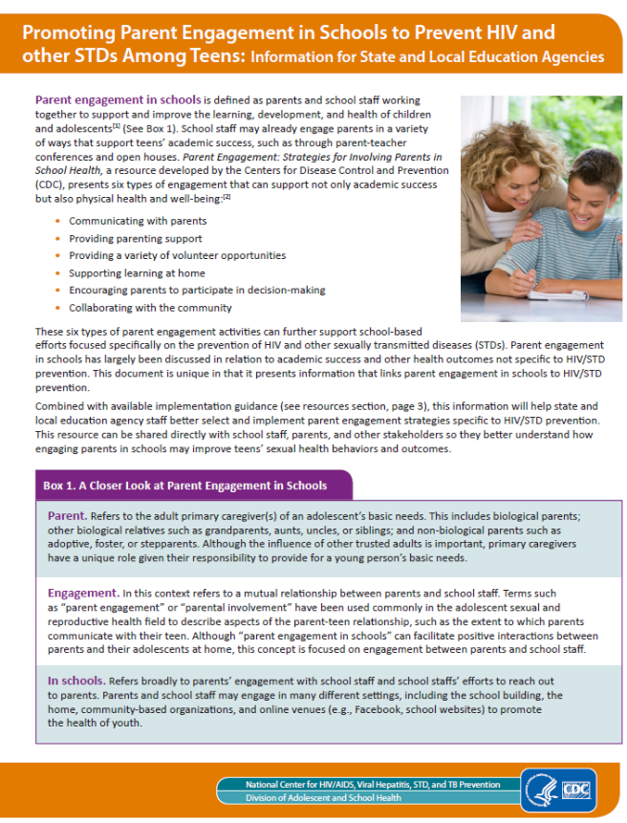
A New Resource
Provides the rationale for promoting parent engagement in HIV/STD prevention
Released August 2015
Available at: http://www.cdc.gov/healthyyouth/protective/pdf/PE-HIV_prevention_rationale.pdf

Slide 3
Why was this document developed?
The link between parent engagement in schools and academic success is fairly intuitive
The rationale for promoting parent engagement in schools for HIV/STD prevention requires a bit more explanation
Understanding this rationale can help guide the implementation of parent engagement activities that contribute to HIV/STD prevention

Slide 4
Parent Engagement in Schools
…is defined as parents and school staff working together to support and improve the learning, development, and health of children and adolescents

Slide 5
What do we mean by ‘parent’?
Those adults who serve as the primary caregivers of a child’s basic needs, which may include:
  Biological parents
  Biological relatives such as grandparents, aunts, uncles, and siblings
  Non-biologically related adults such as adoptive, foster, or step parents
http://www.cdc.gov/healthyyouth/adolescenthealth/parent_engagement.htm

Slide 6
What do we mean by ‘parent engagement’?
Mutual relationship between…
Parents School staff
vs.
Parents Teens

Slide 7

What do we mean by ‘in schools’?
Engagement may occur in the school building
But may also happen in…
  Community-based organizations
  Online venues (e.g., Facebook, school websites)
  Home

Slide 8
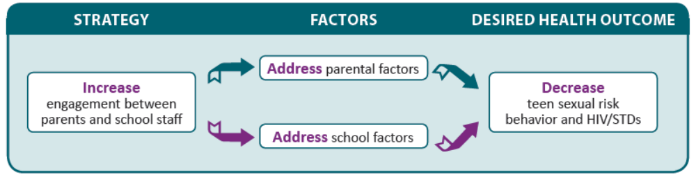
Links between parent engagement and HIV/STD prevention

Slide 9
Links between parent engagement and HIV/STD prevention

Slide 10

What parental factors can be addressed?
Parental monitoring
Parent-adolescent communication
Family connectedness

Slide 11
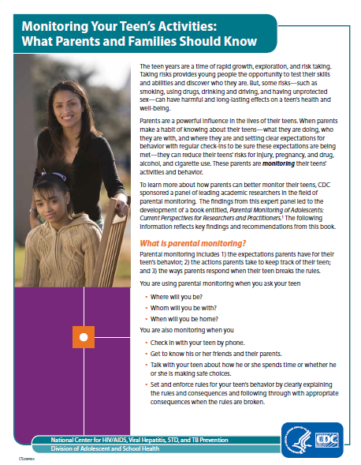
Schools can help parents
Communicating with parents
  School staff can share resources
Providing parenting support
  School staff can implement parent-based programs
Supporting learning at home
  School staff can assign homework assignment about HIV/STD that involve parents

Slide 12
Links between parent engagement and HIV/STD prevention
Notes:
So now I want to explain the bottom pathway highlighted in yellow here, which involves school factors related to HIV/STD prevention and how parent engagement activities can address these factors.

Slide 13
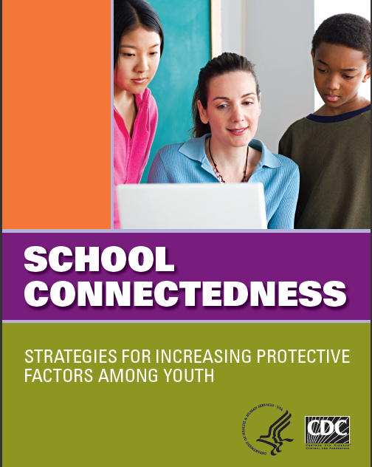
What school factors can be addressed?
Sexual health education policies and curricula
Access to sexual health services
Supportive school climate
School connectedness

Slide 14
Parents can help schools
Encourage parents to participate in decision-making
    Parents can serve on school health advisory councils that select sexual health education materials
Communicate with parents
  Parents can be made aware of bullying prevention policies/practices to enhance bullying prevention efforts
Provide parenting support
  Parent workshops that teach academic support skills can promote school connectedness
  *What about sexual health services?

Slide 15
The Ultimate Goal
Address parental and school-level factors that influence adolescent sexual and reproductive so as to improve the health and well-being of young people

Slide 16

Types of Engagement
Provide parenting support
Communicate with parents
Provide a variety of volunteer opportunities
Support learning at home
Encourage parents to be part of decision making
Collaborate with the community
Epstein JL. School, Family, and Community Partnerships: Preparing Educators and Improving Schools Second Edition. Boulder, CO: Westview Press; 2011.

Slide 17

What next?
Share this resource
Review CDC’s strategy guide on parent engagement
Consider how types of engagement can be implemented for HIV/STD prevention
Seek out and tailor other parent engagement resources

