Slide 1
Mutual Support
TEACH Teamwork
Module 4

Slide 2
Contributors
University of Central
Florida (UCF)
Eduardo Salas, PhD
Lauren E Benishek, PhD
Megan Gregory, MS
Ashley Hughes, MS
Shannon Marlow, BS
Christina Lacerenza, BS
Stephanie Zajac, MS
The Coalition for Psychology in Schools and Education, especially to
Sylvia Rosenfield, Ph.D.
Markeda Newell, Ph.D.
Karin Hodges, Psy.D.
Peter Sheras, Ph.D.
George DuPaul, Ph.D.
The Center for Psychology in Schools and Education (CPSE) Staff
Rena Subotnik, Ph.D., Director
Geesoo Maie Lee, BA, Program Officer

Slide 3
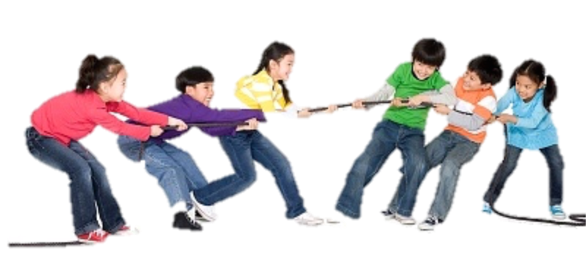
A Real Vignette
It was Field Day at Cherry Valley Elementary School. Unexpectedly, the P.E. teacher coordinating the event woke up with an awful sinus infection and was forced to call in sick. The principal was faced with a hard choice: cancel Field Day or not? Rather than disappoint the students, she decided to take control of the event. With the help of many committed teachers, the principal began executing the P.E. teacher’s Field Day plans. In the end, the day was a great success.

Slide 4
This Module Will Help You:
Understand the importance of mutual
support
Know the components of mutual support
Be able to provide support constructively
Use the Two-Challenge Rule to advocate for yourself and your teammates
Understand the appropriateness and use of the DESC template
Manage conflict effectively

Slide 5
Part 1:
Mutual Support for what and when?

Slide 6

The Benefits of Mutual Support
Teams that engage in mutual support:
  Are more effective
  Make fewer errors
  Can self-correct
  Distribute and assign responsibilities appropriately
  Reallocate work assignments when
  needed
  Are more resilient
Relevant Citation: Salas, Sims, & Burke (2005)

Slide 7

What Mutual Support Entails
Back-up behavior given to one or more team members as needed and can manifest as:
  Task assistance
  Social support
  Feedback
Intended for the benefit of an individual or the greater good of the team.
    Feeling comfortable taking
    interpersonal risks with your team mates will help you set the stage for better support
Relevant Citations: Marks, Mathieu, & Zaccaro (2000); McIntyre & Salas (1995)

Slide 8
When to Engage Mutual Support
Seek support when you are:
  Overburdened
  Stressed
  Lacking skills for performing a task
  Making errors (e.g., technical or judgment)
Offer support when:
  When you notice another teammate is struggling
  You are able to contribute more to the team
Don’t wait to be asked for help but
be gracious if your offer of support is declined
Relevant Citations: Porter, Hollenbeck, Ilgen, Ellis, West, & Moon, 2003; McIntyre & Salas (1995)

Slide 9
Part 2:
Developing Skills for Effective Mutual Support

Slide 10

1. Offer Task Assistance
Lend a hand: Actively help team members manage their responsibilities to the team
Includes:
  Working with team members on their assignments
  Rerouting some or all work
  to other members
  Filling in for a team member,
  as needed
Relevant Citation: Salas, Sims, & Burke, 2005

Slide 11
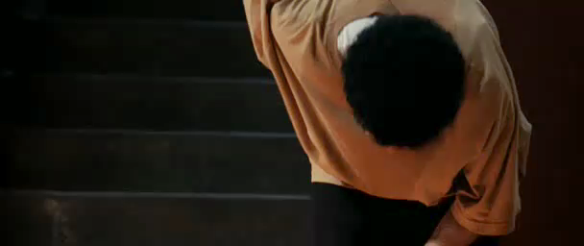
Effective Task Assistance

Slide 12

Providing Task Assistance
Be clear about your available time and assistance capability
Consider experience and competence
  Is the task within yours and your colleagues’ ability?
Close the loop: ensure the task was completed correctly
Reiterate expectations and support
consistency whenever possible!
Relevant Citation: Salas, Sims, & Burke, 2005

Slide 13

2. Provide Social Support
Be a friend: Human connection can go a long way in creating commitment to the team and lessening the stress and burnout that school staff may experience.
Includes:
  Being an ally
  Reassuring teammates’ worth
  Listening to problems
  Offering guidance (if it is wanted)
Relevant Citation: Pearce & Herbik, 2004

Slide 14
Keep It Helpful & Productive
Vent to an Extent: Too much venting can speed up burnout.
  Use your peers to brainstorm solutions, rather than being your pity party
Value their Involvement: People want to feel their thoughts are important
  Encourage participation from your teammates, ask them their thoughts, and actively listen to their ideas
Back them Up: Sometimes people need an ally to convince an audience or defend their interests
  Advocate for teammates and support assertions you agree with
Relevant Citation: Woodcock, 1989

Slide 15
Speak Up for Your Teammates
(and Yourself)
Two-Challenge Rule:
  Voice initial concern with a question
    “I do not feel comfortable with that approach. Can we talk about doing it another way?”
When teammates are unresponsive…
  Restate and explain the concern
    “Marcus said he was uncomfortable with the approach. I think he is worried about the ethical considerations. Can we talk about those?”
Always show respect. Use non-threatening language and check your temper.
Relevant Citation: Salas, Sims, & Burke, 2005

Slide 16

3. Provide Feedback
Develop one another: Provide information with the intention of improving individual and/or team performance
Includes:
  Reinforcing good performance
  Increasing members’ awareness of their weaknesses
  Suggesting solutions to overcome limitations
  Cautioning team members about potential pitfalls or consequences
Relevant Citation: Marks & Panzer (2004)

Slide 17

Feedback Should be Constructive
Add value and build team members up, do not use feedback to break them down
If you can’t think of a constructive purpose for giving feedback, don’t give it at all
Relevant Citation: Ovando (1994)

Slide 18
Giving Constructive Feedback
Be timely in feedback delivery
Be specific
Focus on description instead of judgment
Focus on observation rather than inference
Focus on behavior instead of personal traits
Provide a balance of positive and negative feedback
Avoid overload
Relevant Citation: Ovando (1994)

Slide 19

DESC’ribe Your Feedback!
In administering feedback, you could adopt the DESC template:
  Describe what you observed
  Explain how your observations
  differed from your expectations
  Support your expectations with
  rationale
  Collaborate to define an action plan or solution
Relevant Citation: Ovando (1994)

Slide 20

Handling Constructive Feedback

Slide 21

Every Rose Has its Thorns
All teams experience some sort of conflict at some point in time. It is inevitable no matter how cohesive and friendly your team may be.
Learning how to handle conflict as it arises makes the difference between a strong team and a fractured team
Relevant Citation: De Dreu & Weingart (2003)

Slide 22
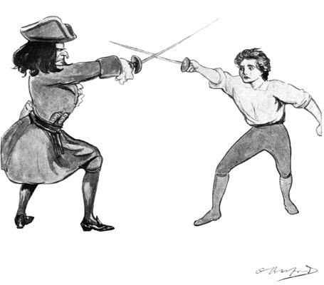

Make conflict a thing of the past
Butting heads: Tension and disagreements are common workplace obstacles that can delay the achievement of team goals and
productivity.
Caused by contrasts in:
  Opinions about tasks themselves
  Ideas about how to approach a task
  Personal characteristics (e.g., personality clashes, religious beliefs)
Relevant Citation: Andersson & Pearson (1999)

Slide 23
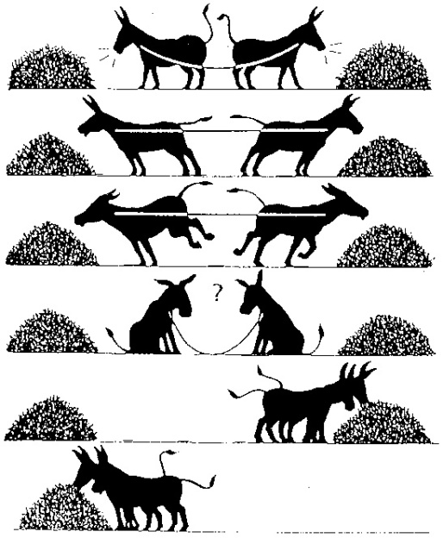
The good, the Bad, & the Win-Win!
Parties involved could:
  Compromise,
  Avoid confrontation
  Accommodate for the time-being
An ideal WIN-WIN :
  Achieves a mutually satisfying solution
  Meets goals without compromising relationships
Relevant Citation: Thomas (1992)

Slide 24


DESC’ription Isn’t Just for Feedback
You can also use the DESC script to manage conflict!
D
  Minimize defensiveness
  See both perspectives
  Find the source of the tension
  Focus on the future
  instead of the past
E
S
C
Relevant Citation: Ovando (1994)

Slide 25
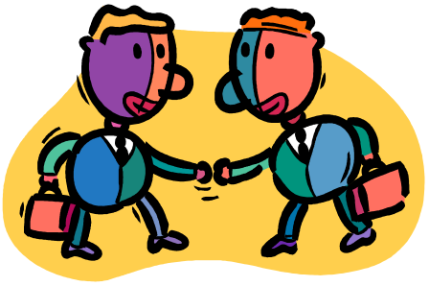
When in Conflict,
CUS at Your Teammates
Yes, you read that correctly.
But no, it’s not what you think.
CUS is a way to convey that you are uncomfortable with a situation
  I am Concerned
  I am Uncomfortable
  Let’s Solve this
Use CUS with DESC to share your perspective.

Slide 26
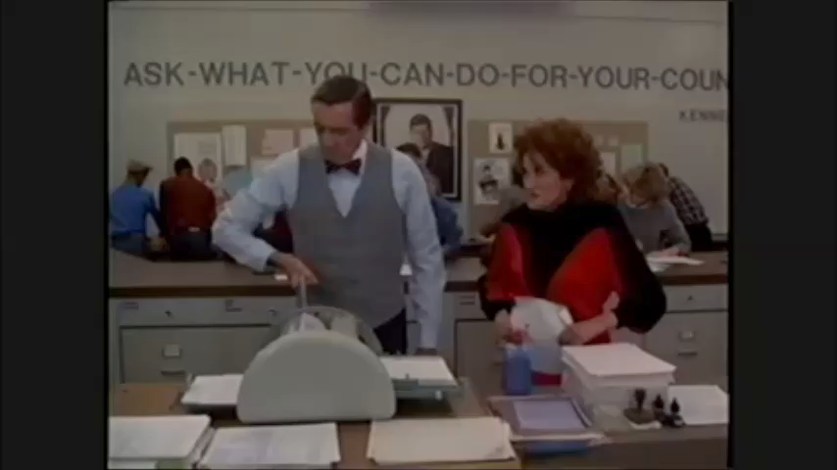
Dealing with Conflict

Slide 27
Think-Pair-Share: Conflict
What type of conflict was demonstrated in the previous video?
Write a DESC script for how the School Psychologist could have articulated her grievances using the CUS strategy (but without actually cussing).
Bonus: incorporate the Two-Challenge Rule

Slide 28
An Opportunity for Mutual Support
Imagine in your school…
Trained to implement state-mandated Response-to-Intervention model
A newly formed team has been appointed
No additional resources provided to implement this model.
Some feel that neither they nor the staff have the time to commit to this new endeavor.

Slide 29
Think-Pair-Share: Mutual Support
What barriers to mutual support are present in the hypothetical situation? What additional barriers might you face in your school?
How could task assistance, social support, and feedback alleviate the struggles faced by the professionals in this scenario?
How can you make these types of support sustainable and ongoing?

Slide 30
Brainstorm: Promoting Mutual Support in your Team
What does our team(s) do well?
What doesn’t our team(s) do well?
What would we most like to improve?
How can we improve in that area(s)?
How can we implement our strategies and make them sustainable?
How will we know whether we have made progress?

Slide 31
References
Andersson, L. M., & Pearson, C. M. (1999). Tit for tat? The spiraling effect of incivility in the workplace. Academy of Management Review, 24(3), 452-471.
De Dreu, C. K., & Weingart, L. R. (2003). Task versus relationship conflict, team performance, and team member satisfaction: a meta-analysis. Journal of Applied Psychology, 88(4), 741-749.
Dickinson, T. L., & McIntyre, R. M. (1997). A conceptual framework for teamwork measurement. In M. T. Brannick, E. Salas, & C. Prince (Eds.), Team performance assessment and measurement (pp. 19-43). Mahwah, NJ: Erlbaum.
Marks, M. A., & Panzer, F. J. (2004). The influence of team monitoring on team processes and performance. Human Performance, 17(1), 25-41.
Marks, M. A., Zaccaro, S. J., & Mathieu, J. E. (2000). Performance implications of leader briefings and team-interaction training for team adaptation to novel environments. Journal of Applied Psychology, 85(6), 971-986.
McIntyre, R. M., & Salas, E. (1995). Measuring and managing for team performance: Emerging principles from complex environments. In R. Guzzo & E. Salas (Eds.), Team effectiveness and decision making in organizations (pp. 149-203). San Francisco: Jossey-Bass.
Ovando, M. N. (1994). Constructive feedback: A key to successful teaching and learning. International Journal of Educational Management, 8(6), 19-22.
Pearce, C. L., & Herbik, P. A. (2004). Citizenship behavior at the team level of analysis: The effects of team leadership, team commitment, perceived team support, and team size. The Journal of Social Psychology, 144(3), 293-310.
Porter, C. O., Hollenbeck, J. R., Ilgen, D. R., Ellis, A. P., West, B. J., & Moon, H. (2003). Backing up behaviors in teams: the role of personality and legitimacy of need. Journal of Applied Psychology, 88(3), 391-403.
Salas, E., Sims, D. E., & Burke, C. S. (2005). Is there a “Big Five” in teamwork?. Small group research, 36(5), 555-599.
Smith-Jentsch, K. A., Zeisig, R. L., Acton, B., & McPherson, J. A. (1998). Team dimensional training: A strategy for guided team self-correction. In J. A. Cannon-Bowers & E. Salas (Eds.), Making decisions under stress: Implications for individual and team training (pp. 271-297). Washington, DC: American Psychological Association.
TeamSTEPPS® Fundamentals Course: Module 5. Mutual Support: Instructor’s Materials. Agency for Healthcare Research and Quality, Rockville, MD. gov/teamsteppstools/instructor/fundamentals/module5/igmutualsupp.htm
TeamSTEPPS Fundamentals Course: Module 5. Mutual Support. Evidence-Base: Mutual Support. Agency for Healthcare Research and Quality, Rockville, MD. http://www.ahrq.gov/teamsteppstools/instructor/fundamentals/module5/ebmutualsupport.htm
Thomas, K. W. (1992). Conflict and conflict management: Reflections and update. Journal of Organizational Behavior, 13(3), 265-274.
Woodcock, M. (1989). Team Development Manual. Gower, Aldershot.

Slide 32
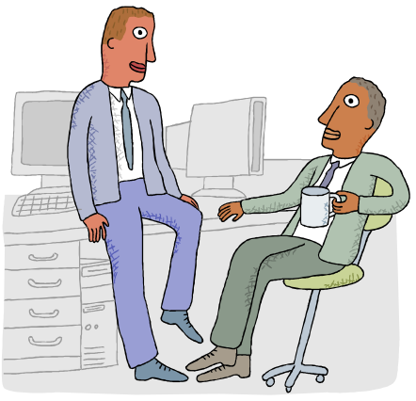
Bonus Example:
Constructive Feedback
The 4th grade team met to discuss the upcoming semester’s curriculum. Mr. Smith, a first-year teacher, provided the group with his ideas for a new math program. After the meeting, Mr. Green– a teacher who has been at the school for over 20 years and his mentor-- approaches Mr. Smith privately, and tells him that he did a great job communicating his ideas for the new math program in a detailed manner. However, he explained, in the future, a hand-out may help people in understanding his vision.

Slide 33
Bonus Example:
Using CUS to Resolve Conflict
A student is displaying severely aggressive behavior. His teacher, Ms. J, expresses concerns regarding his behavior to Ms. B, the school counselor, and asks for the student to wait in detention until he can be sent home. Ms. B refuses, however, and tells Ms. J it is not her job to babysit.
Astonished, Ms. J says, “Ms. B, I am concerned about the safety of myself and my students. I am uncomfortable with this student’s behavior, and I do not think it is safe to continue to allow him to remain here.”

Slide 34
Bonus Example:
Using the Two-Challenge Rule
“Mrs. Matthews, do you think it’s safe to allow this unauthorized individual into the assembly?”
“Mrs. Matthews, it’s a little loud in here and I just want to make sure I wasn’t drowned out with all the noise. This student has not signed in at the office and I am concerned that it may not be safe to allow him to attend this assembly. What do you think we should do?”

Slide 35
Bonus Example:
Using the DESC Script
Mr. Johansen, I’d like to talk about what happened earlier during the IEP meeting. I was upset because the information you provided about Thomas Smith seemed incomplete. I am concerned we don’t have the full picture of what is going on with Thomas and, in my experience, it is difficult to formulate a plan for a student without all relevant information. Next time, I think it would be helpful if you provided all of a student’s disability information so we can make the best decisions for the student’s education.

