Slide 1
B.A.M.
BODY. ACTION. MIND.

Slide 2
RESILIENCE
the ability to move forward from tough times

Slide 3
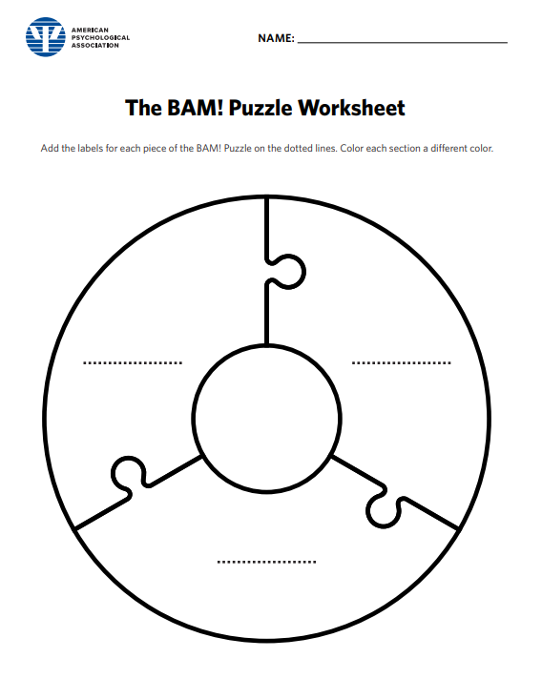
BAM!
Body
Actions
Mind

Slide 4
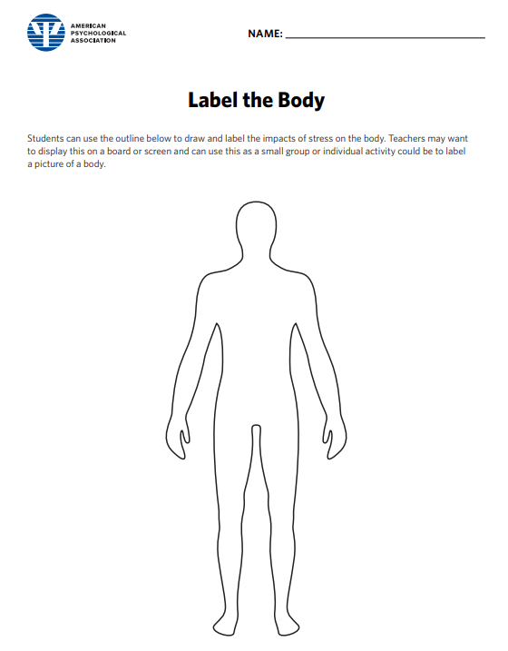
HOW DOES STRESS AFFECT YOUR BODY?
When you feel nervous or worried, what do you feel in your body?
Where do you feel stress in your body?
How would you know when there is stress in your body?

Slide 5
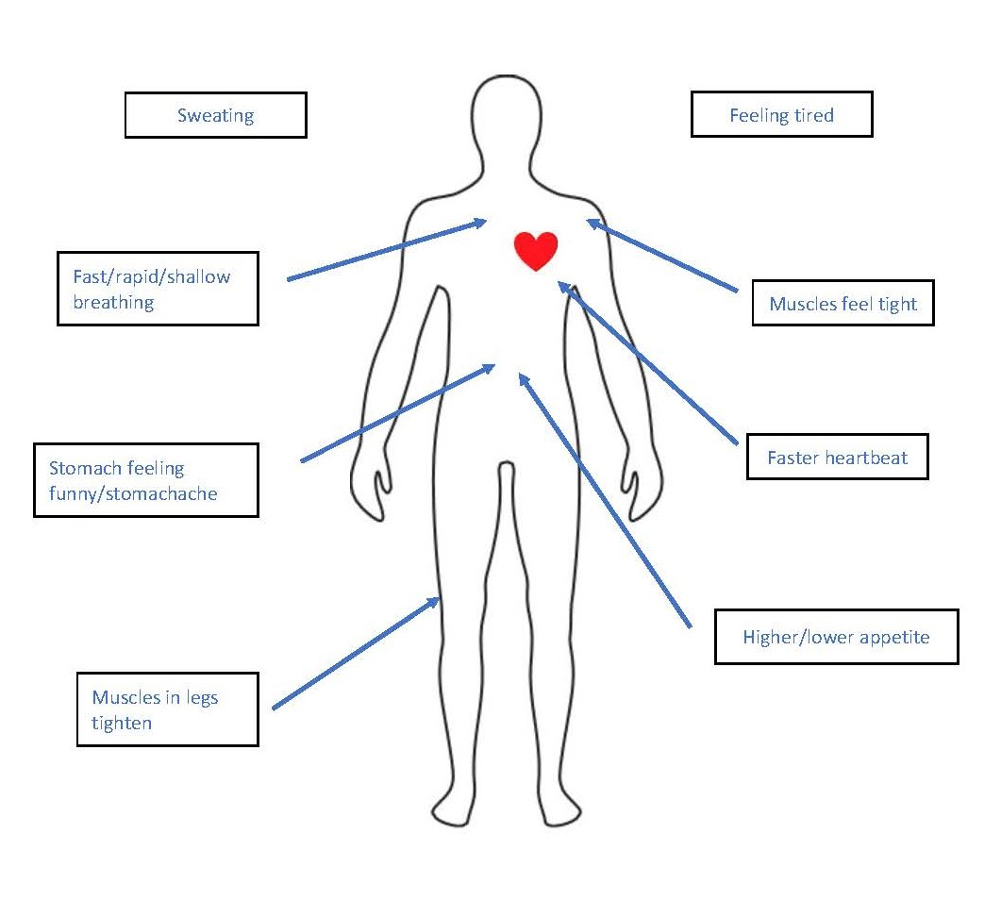
HOW DOES STRESS AFFECT YOUR BODY?
When you feel nervous or worried, what do you feel in your body?
Where do you feel stress in your body?
How would you know when there is stress in your body?

Slide 6
STRESS AND THE BODY
  Positive (help you)
  Negative (hurt you)
  Add ideas here
  Add ideas here

Slide 7
STRESS AND THE BODY
  Positive (helpful)
  Negative (hurtful)
Talking to trusted friends or adults
Sleeping well, healthy food, & exercise
Positive thinking
Mindfulness
Try not to think about it
Criticize ourselves
Blame other people
Thinking about all the negative things
Procrastinate
Pretend it’s not true

Slide 8
JUST BREATHE
Often, without even realizing it, when we are stressed or anxious, we hold our breath or breathe quick, shallow breaths. Unfortunately, when we do that, we actually make our bodies even more anxious—we might find ourselves tensing more or our heart rate increasing.
Video link: https://youtu.be/L_qO0RFmpRk
This Photo by Unknown Author is licensed under CC BY-ND

