Slide 1
Situation Monitoring
TEACH Teamwork
Module 3

Slide 2
Contributors
University of Central
Florida (UCF)
Eduardo Salas, PhD
Lauren E Benishek, PhD
Megan Gregory, MS
Ashley Hughes, MS
Shannon Marlow, BS
Christina Lacerenza, BS
Stephanie Zajac, MS
The Coalition for Psychology in Schools and Education, especially to
Sylvia Rosenfield, Ph.D.
Markeda Newell, Ph.D.
Karin Hodges, Psy.D.
Peter Sheras, Ph.D.
George DuPaul, Ph.D.
The Center for Psychology in Schools and Education (CPSE) Staff
Rena Subotnik, Ph.D., Director
Geesoo Maie Lee, BA, Program Officer

Slide 3

Recognizing Change “Blindness”
Failing to notice visual, tactile, oratory, or olfactory changes in your surroundings

Slide 4
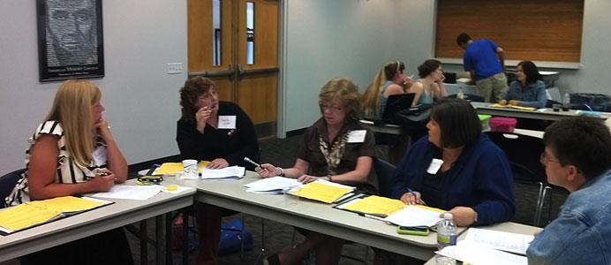
A Real Vignette
During a meeting with teachers and administration, the principal requests that Karen, the school psychologist, pull a certain student’s file. Imagine you are in this meeting and you notice that Karen did not hear the student’s name so you quietly tell Karen whose file should be pulled while the meeting progresses.

Slide 5
This Module Will Help You:
Understand the importance of situation monitoring
Understand the importance of cross monitoring
Identify barriers to both situation and cross-monitoring
Use the STEP mnemonic to anticipate and predict team needs

Slide 6
Part 1:
Situational Monitoring:
What, How, For what purpose, & What gets in the way?

Slide 7
Setting the Groundwork
Situation
Monitoring
Situation Awareness
Shared Situation Awareness
Situational Changes
Integrate
Communication
Relevant Citations: Endsley (2000; 2004)

Slide 8
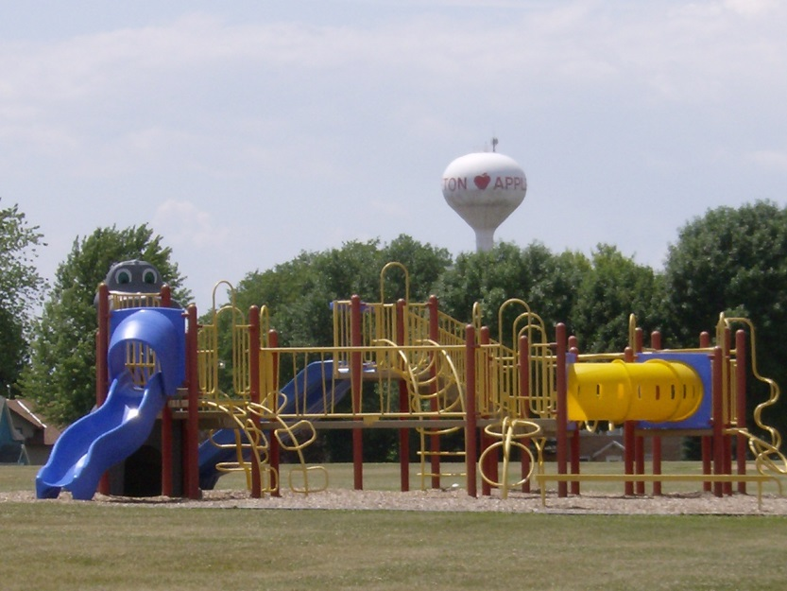
Situation Monitoring
Individual scanning of the environment to seeking out important information
People and things to monitor:
  Students
  Teammates
  Environment
  Progress towards goals
Situation Monitoring
Relevant Citations: Endsley (2000; 2004)

Slide 9
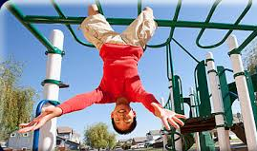
Situation Awareness
is the state of being aware of the status of yourself, teammates, environment, and responsibilities.
Situation Awareness
Stay in the loop:
  Characteristics change
  Your SA needs to be updated!
Think of the team
  Communicate updates to
  keep team members in the
  loop and aware
Integrate Information
Communicate
Relevant Citations: Endsley (2000; 2004)

Slide 10
Shared Situation Awareness
Two or more people with the same or similar understanding of their surroundings
Individual team members differ on how they perceive events and surroundings
Communication is key
Necessary for:
  Coordination
  Trust
  Performance
Shared Situation Awareness
Situational Changes
Integrate Information
Communicate
Relevant Citations: Endsley (2000; 2004)

Slide 11

Shared Situation Awareness
Situation Awareness
Shared Situation Awareness
Relevant Citations: Endsley (2000; 2004)

Slide 12



Process Summary in an IEP Meeting
Situation Monitoring
Shared Situation
Awareness
Situation Awareness
Relevant Citations: Endsley (2000; 2004)

Slide 13

Continuously Monitoring the Situation Creates Awareness
Why do you think situation monitoring and awareness are so important?
What benefits do you think it has for teamwork?
Allows teams to:
  Anticipate and respond to changes
  Adjust the team strategy
  Avoid and rectify issues
  Develop an accurate shared understanding
  Accommodate students
  Ensure student and staff welfare
Relevant Citations: Endsley (2000; 2004)

Slide 14






Barriers to Situation Monitoring
Stress
Chaotic Environment
Hunger
Fatigue
Illness
Team Member Workload

Slide 15
Part 2:
Using the STEP Mnemonic

Slide 16
Part 1 Review & Discussion
What are the three phases in the situation monitoring process?
What are the benefits of continuous monitoring?
What are examples of barriers to situation monitoring and awareness?
How can you avoid some of these common barriers?

Slide 17
STEP: A Monitoring Strategy
A mnemonic to help direct monitoring behavior
Focuses one’s monitoring on four aspects:
  Self
  Team Members
  Environment
  Progress of the team (i.e., temperature
  taking)
Progress
Environment
Team Members
Self

Slide 18
STEP: Self
What have I done to contribute to the team?
What do I need to do to contribute to the team?
Can I do what I need to do for the team?
Now knowing all of this, what would I
recommend to the team?
E
P
S
  T

Slide 19
STEP: Team Member Status
Cross-Monitoring: deliberately checking on and watching colleagues for signs that assistance is needed
What verbal and non-verbal cues are my teammates displaying?
Why might they be displaying these cues?
How might the underlying cause affect the
team?
What should I do about this?
E
P
S
T

Slide 20
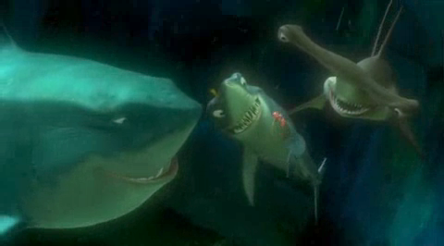
Cross-Monitoring: What it Looks Like

Slide 21
STEP: Environmental Conditions
What are the current circumstances surrounding our team?
What tools and materials are (un)available?
How might the team be affected?
What can and should we do about them?
E
P
S
T

Slide 22
STEP: Progress Towards Goals
What is the goal?
Are we on track to meet our goal(s)?
How has our goal progress been affected by what is going on with me, my teammates, and the environment?
What course of action would I recommend?
E
P
S
T

Slide 23

Activity: Practice STEPing

Slide 24
Implementation Discussion
What makes it difficult to maintain situation awareness?
What can we do at our school to help each other remember to continually scan the environment?
What policies and procedures would you recommend to the administration to help facilitate situation monitoring?
How can we remember to share what we observe?
What practices can we implement during and between meetings to ensure everyone is updated and in-the-loop?

Slide 25
References
Endsley, M. R. (2004). Situation awareness: Progress and directions. A cognitive approach to situation awareness: Theory, measurement and application, 317-341.
Endsley, M.R. (2000). Theoretical underpinnings of situation awareness: a critical review. In M.R. Endsley & D.J. Garland (Eds.), Situation Awareness Analysis and Measurement (pp 1-24). Mahwah, NJ: Lawrence Erlbaum Associates.

