Slide 1
Leadership In Schools
TEACH Teamwork
Module 5

Slide 2
Contributors
University of Central
Florida (UCF)
Eduardo Salas, PhD
Lauren E Benishek, PhD
Megan Gregory, MS
Ashley Hughes, MS
Shannon Marlow, BS
Christina Lacerenza, BS
Stephanie Zajac, MS
The Coalition for Psychology in Schools and Education, especially to
Sylvia Rosenfield, Ph.D.
Markeda Newell, Ph.D.
Karin Hodges, Psy.D.
Peter Sheras, Ph.D.
George DuPaul, Ph.D.
The Center for Psychology in Schools and Education (CPSE) Staff
Rena Subotnik, Ph.D., Director
Geesoo Maie Lee, BA, Program Officer

Slide 3

A Real Vignette
In a K-5 school, a teacher noticed there was no sense of leadership on the curriculum team. Many staff members had great ideas and interests about how to modernize lesson plans, but nobody stepped up to the plate to devise a cohesive plan. Therefore, meetings were spent with individuals vying for their personal agenda rather than understanding the bigger picture. Due to these issues, the school struggled with innovating, making plans, and accomplishing goals.

Slide 4
This Module Will Help You:
Understand the importance of leadership
Recognize that anyone can be a leader
Understand effective and ineffective leadership behaviors
Use strategies to facilitate effective leadership behaviors: STEP, SWIM, BIKE, and RACE

Slide 5
Part 1:
Valuing, understanding, and noticing help and hindrances towards leadership

Slide 6

Activity: Who Is A Good Leader?
Take a moment to think about someone you know whom you consider to be a good team leader in schools.
  What are the behaviors that make him/her a strong leader?
  What are his/her best qualities?

Slide 7

Importance of Learning Leadership
Leadership serves many functions and supports positive outcomes within organizations, teams, and classrooms
  Productivity
  Learning
  Job satisfaction
  Performance
Relevant Citations: Barling, Christie, & Hoption (2011); Burke et al. (2006)

Slide 8
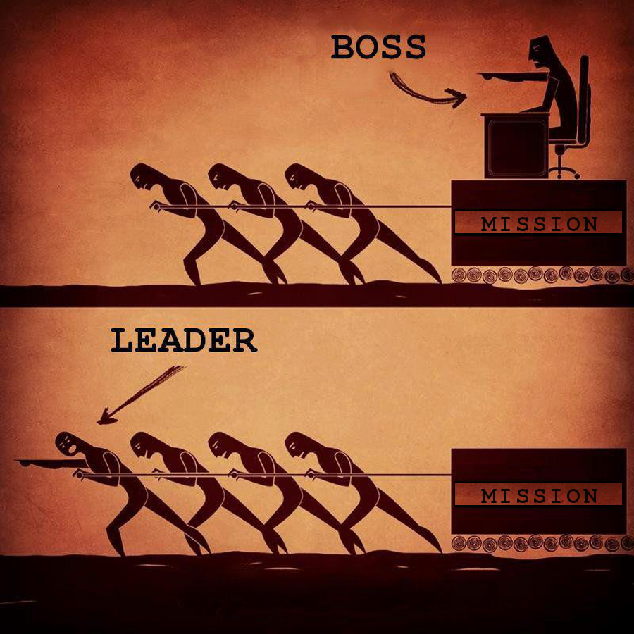
What is Leadership?
Leadership is carrying out necessary behaviors in order to help the team accomplish their goals.
Anybody can be a leader!
Relevant Citations: Fleishman, Zaccaro, & Mumford (1991)

Slide 9

Leadership Types
Designated
Shared
Relevant Citations: Carson, Tesluk, & Marrone (2007); Morgeson, DeRue, & Karam (2010)

Slide 10

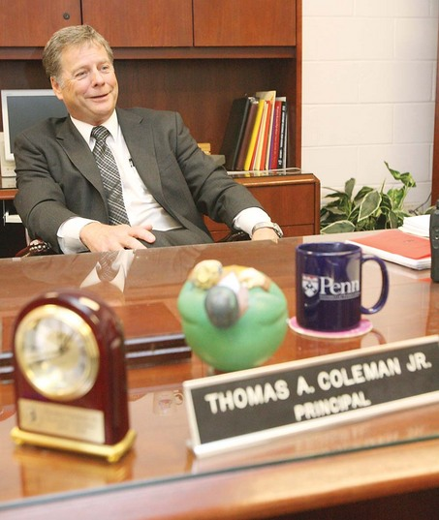
Designated Leader
  Formally appointed leader

Slide 11
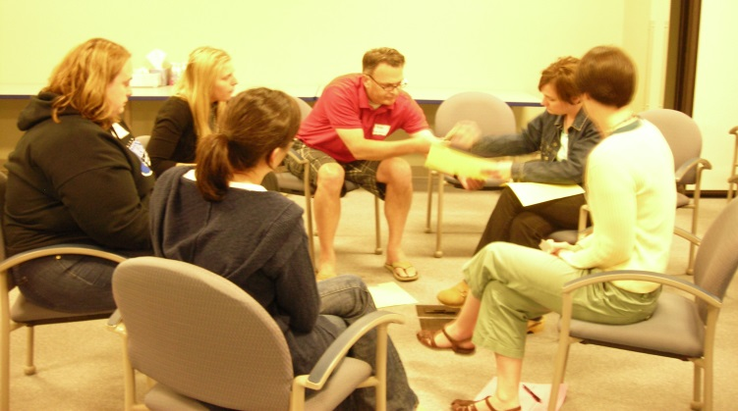
Shared leadership
Leadership depends on the situation and team needs
  ANY team member can enact leadership
Team members lead one another
    Context and flexibility matter
In shared leadership, any team member is empowered to take initiative
Example:
  A Teacher may be the leader of an IEP team when the current team task is to design a curriculum for a special needs student. However, when the IEP team’s focus turns to addressing the students social emotional needs, a Psychologist may adopt the role of team leader because of his/her expertise.
Relevant Citations: Carson, Tesluk, & Marrone (2007); Pearce, Manz, & Sims (2009)

Slide 12
Think-Pair-Share: Types of Leaders
Think about where there is a need for leadership in your school.
  What type of leadership would be helpful here?
  How could this be beneficial?
Discuss your ideas and examples within your small group.
Finally, each group can share with the whole group.

Slide 13
Part 2:
Developing Skills for Effective Leadership

Slide 14
Part 1 Review & Discussion
Define leadership.
What are the two types of leadership?
Who can be a leader?

Slide 15

Video: Shared leadership

Slide 16
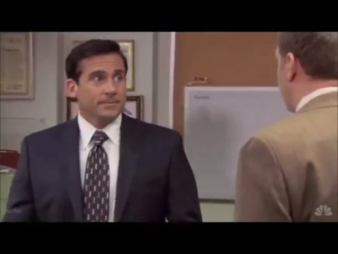
ineffective leadership
What sorts of things have you seen colleagues in leadership positions do that were ineffective?
(no names please)

Slide 17


Ineffective Shared Leadership Behaviors
Acting unreliably/volatilely
  Changing mind
  Expressing arbitrary expectations
Treating team members inappropriately
  Unwilling to listen to others
  Refusing to compromise
Mismanaging team progress
  Using passive behavior
  Mismanaging resources
  Micromanaging
  Failing to delegate

Slide 18

Examples of Leadership in Schools
What sorts of things have you seen colleagues in leadership positions do that were effective?
(no names please)

Slide 19

Effective Leadership Behaviors
Leaders develop skills to conduct the following responsibilities:
  Monitor the team
  Establish shared
  expectations and goals
  Pool resources
  Embrace team members’
  perspectives
Relevant Citations: Barling, Christie, & Hoption (2011); Hughes & Pickeral (2013); Morgeson, DeRue, & Karam (2010); Salas, Burke, & Stagl (2004); Zaccaro, Rittman, & Marks (2001)

Slide 20

Monitor the Team
  Make sure everyone is checking themselves, their team members, the environment, and progress towards the goal.
  For more information, refer back to the Situation Monitoring module.

Slide 21

Establish Shared Expectations And Goals
Clarify team responsibilities
Set team standards and regulations
Establish challenging yet attainable team goals

Slide 22

Pool Resources
Under a shared leadership system, everyone should work together to ensure the team has what is needed. This can include:
Equipment
  Office supplies
  Classroom supplies
  Media equipment
Knowledge
  Expertise
  Information

Slide 23

  Embrace all team members’ perspectives
Demonstrate respect and concern for team members
  Respect diverse opinions
Address team needs and concerns
  Answer any questions on the task or assigned responsibilities
  When possible, offer
  support and
  task assistance

Slide 24

Brief Review
Monitor the team
Establish shared expectations and goals
Pool resources
Embrace all team members’ perspectives
Assess yourself:
Which of these skills is your strongest?
Where could you improve the most?

Slide 25
Part 3:
Leadership Strategies

Slide 26

Leadership Strategies
Leadership is a journey
STEP
SWIM
BIKE
RACE
Remember: STEP up to your leadership triathlon!

Slide 27



Monitor the Team: Use STEP
Remember STEP from situation monitoring?
  Self
    Monitor your contributions
  Team Members
    Cross-monitor
  Environment
    Consider what is going on around you
  Progress
    Consider your team’s progress towards goals
USE IT!
Progress
Environment
Team Members
Self

Slide 28

Establish Shared Expectations And Goals: SWIM
S
Start
W
With
I
Intent and
M
Meaning
By SWIM-ming, you can establish shared expectations and goals
  Know what you Intend to discuss
  Be able to tie the Meaning of the discussion to the larger goal
SWIM before beginning a brief, debrief, or creating an agenda

Slide 29
Establishing Shared Expectations and Goals: Agendas
Meeting agendas are also a helpful tool for SWIM-ming
Benefits of agendas:
  Save time
  Stay on topic
Send out your agenda to meeting participants at least 24 hours in advance
Items on agendas should be in the order in which they will be discussed
Close the agenda with follow up information (e.g., “Next meeting is Friday at 5pm in room 214”).

Slide 30
Agendas
Helpful for:
  “SWIM”MING
  Saving Time
  Staying on Topic
How is one constructed?
  Make items in order in which they will be discussed
  Close with follow-up information (e.g., next meeting 5pm in room 214)
  Send it out 24 hours in advance

Slide 31
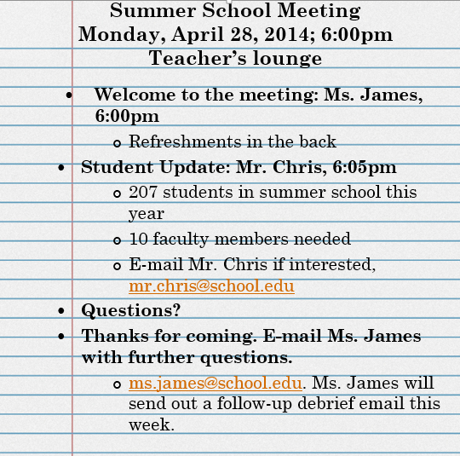
An example
Title of Meeting
Date & Time
Location
Discussion Items
Q & A
Closing Remarks
Follow-up Info

Slide 32

Pool Resources: BIKE
B
I
E
Equipment
K
Knowledge, and
In
Bring

Slide 33

Example of Bike-ing
While creating the agenda for her next upcoming meeting, Ms. James realized that she was not trained on how to use the presentation equipment for her presentation. The room that the meeting was scheduled in had a SMART Board™, while she had been trained on a different device, the projector.
Ms. James knew that Mr. Chris was not in her projector training class, and had received training on the SMART Board™.
Before the meeting, Ms. James contacted Mr. Chris and asked him to teach her how to use the new equipment.

Slide 34

Embrace Team Members’ Perspectives: RACE
Encourage all team members to speak up during meetings by RACE-ing:
Benefits:
  Allows concerns to be voiced
  Everyone gets to contribute
  Everyone takes ownership of work
R
Respect all viewpoints
A
Address questions & concerns
C
Consider all perspectives
E
Eye contact with each team member

Slide 35

Think-Pair-Share: Brainstorming
Think about how you can use these strategies on a team that you are a part of.
  Which of these strategies does your team already do well?
  Which of these strategies can your team use the most?
    How will this benefit the team?
Discuss your ideas and examples within your small group.
Finally, each group can share with the whole group.

Slide 36
References
Barling, J., Christie, A., & Hoption, C. (2011). Leadership. In S. Zedeck (Ed.), Handbook of industrial and organizational psychology (Vol 1., pp. 183-240). Washington, DC: American Psychological Association.
Burke, C. S, Stagl, K. C., Klein, C., Goodwin, G. F., Salas, E., & Halpin, S. M. (2006). What type of leadership behaviors are functional in teams?: A meta-analysis. The Leadership Quarterly, 17, 288-307.
Carson, J. B., Tesluk, P. E., & Marrone, J. A. (2007). Shared leadership in teams: An investigation of antecedent conditions and performance. The Academy of Management Journal, 50(5), 1217-1234.
Fleishman, E. A., Zaccaro, S. J., Mumford, M.D. (1991). Individual differences and leadership: An overview. The Leadership Quarterly, 2(4), 237-243
Hughes, W., & Pickeral, T. (2013, February). School climate and shared leadership. Retrieved from http://www.schoolclimate.org/publications/documents/sc-brief-leadership.pdf
Morgeson, F.P., DeRue, D. S., Karam, E. P. (2010). Leadership in teams: A functional approach to understanding leadership structures and processes. Journal of Management, 36(1), 5-39.
Pearce, C. L., Manz, C. C., & Sims, H. P. (2009). Where do we go from here?: Is shared leadership the key to team success? Organizational Dynamics, 38, 234-238.
Salas, E., Burke, C. S., & Stagl, K. C. (2004). Developing teams and team leaders: strategies and principles. In D. V. Day, S. J. Zaccaro, & S. M. Halpin (Eds.), Leader development for transforming organizations: Growing leaders for tomorrow (pp. 325−355). Mahwah, NJ: Lawnrence Erlbaum.
Zaccaro, S.J., Rittman, A.L., & Marks, M.A. (2001). Team leadership. The Leadership Quarterly, 12, 451–483.

