Slide 1
Introduction to TEACH Teamwork
TEACH Teamwork
Module 1

Slide 2
Contributors
University of Central
Florida (UCF)
Eduardo Salas, PhD
Lauren E Benishek, PhD
Megan Gregory, MS
Ashley Hughes, MS
Shannon Marlow, BS
Christina Lacerenza, BS
Stephanie Zajac, MS
The Coalition for Psychology in Schools and Education, especially to
Sylvia Rosenfield, Ph.D.
Markeda Newell, Ph.D.
Karin Hodges, Psy.D.
Peter Sheras, Ph.D.
George DuPaul, Ph.D.
The Center for Psychology in Schools and Education (CPSE) Staff
Rena Subotnik, Ph.D., Director
Geesoo Maie Lee, BA, Program Officer

Slide 3
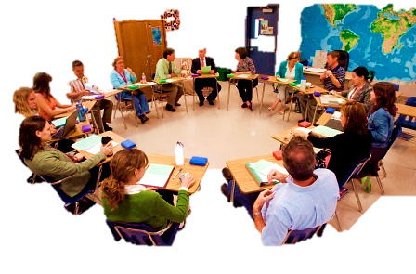
A Real Vignette:
Wei is seeking feedback from his colleagues during his grade level team meeting regarding an unruly student. He suspects something is going on at home that sparked the sudden misbehavior and would like advice on how to handle the student during school hours and approach the student’s parents without causing offense or seeming judgmental.
Though well meaning, many of Wei’s colleagues eagerly begin talking about their own experiences with troubled students. Very quickly the focus of the discussion moves away from helping Wei. Wei, who is naturally agreeable and reserved in nature, is at a loss for how to bring the topic back to his concerns.
Notes:
situations. Make sure the discussion doesn’t go on for too long but that most people engage.

Slide 4
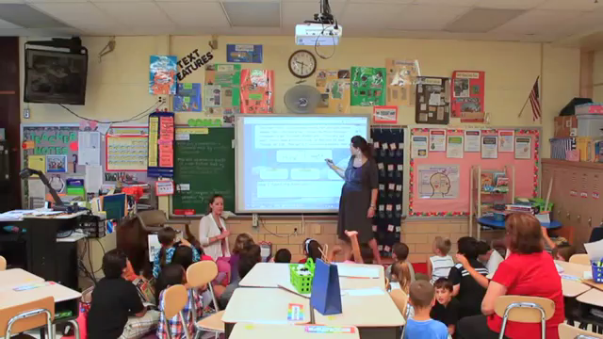
Teamwork in Schools

Slide 5
Yes, TEACH Teamwork Can Help
Successfully used in other high-stress, high-stakes environments
Evidence- and experience-based
Teaches transportable skills for any school team, such as:
  Individualized Education Program (IEP) Teams
  School Improvement Teams
  Grade Level Teams
  Instructional Support Teams
Relevant Citation: Baker, Day, & Salas (2006)

Slide 6
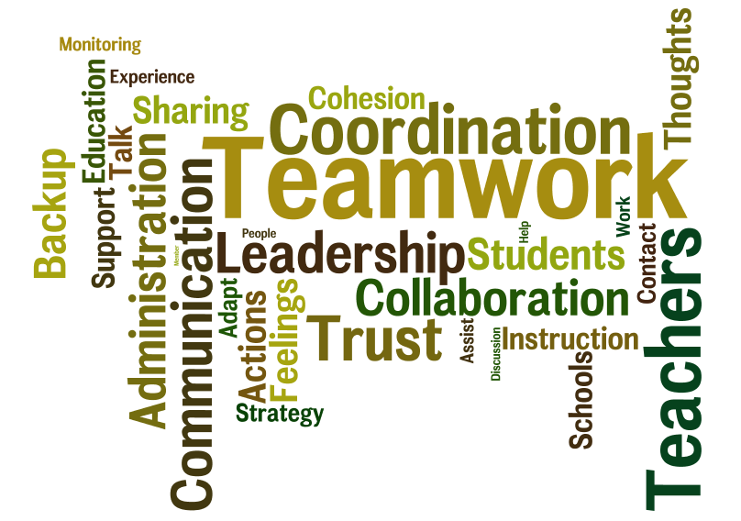
This Training is Most Beneficial When You:
Understand why teamwork is important in schools
Appreciate why learning about teamwork is relevant to you
Understand the advantages of teamwork

Slide 7
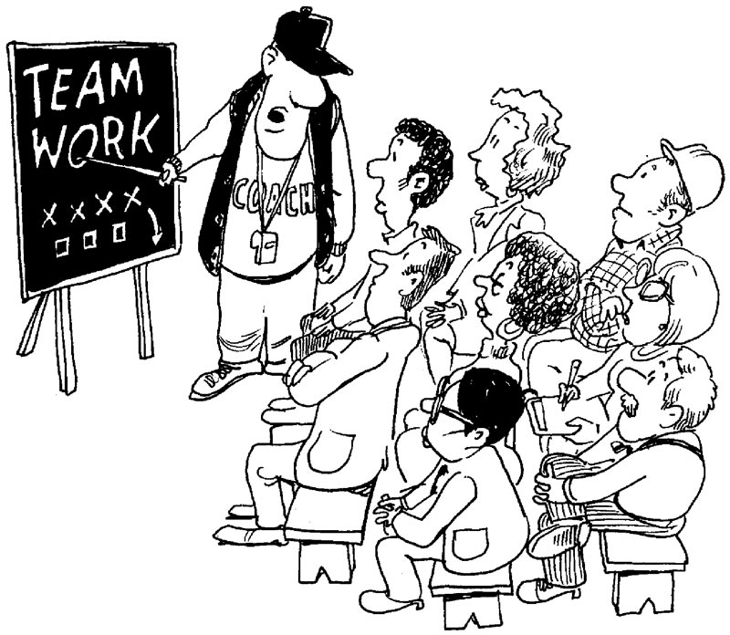
YOUR Experiences with Teamwork
Do you frequently work collaboratively with others on a shared goal?
How much of what you do at work is dependent on others?
What sort of challenges have you experienced when working with others?

Slide 8

Recall Wei…
How might learning about teamwork help Wei?
How might learning about teamwork benefit Wei’s colleagues?
How is Wei’s situation similar to your experiences?
How might learning about teamwork benefit you and/or your colleagues?

Slide 9




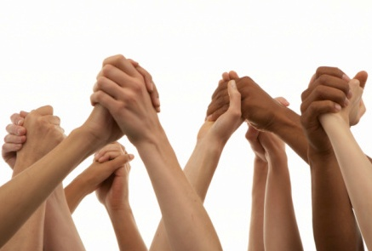
Improving Teamwork Has Benefits for You
Smoother, more efficient meetings
Easier Interactions
Robust Professional Support System
Stronger Relationships
Improved Management

Slide 10


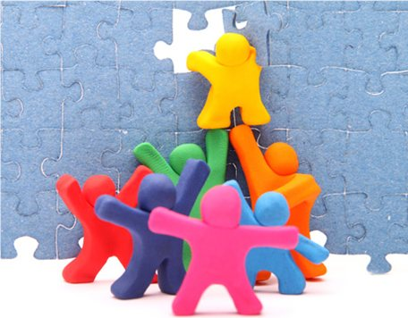
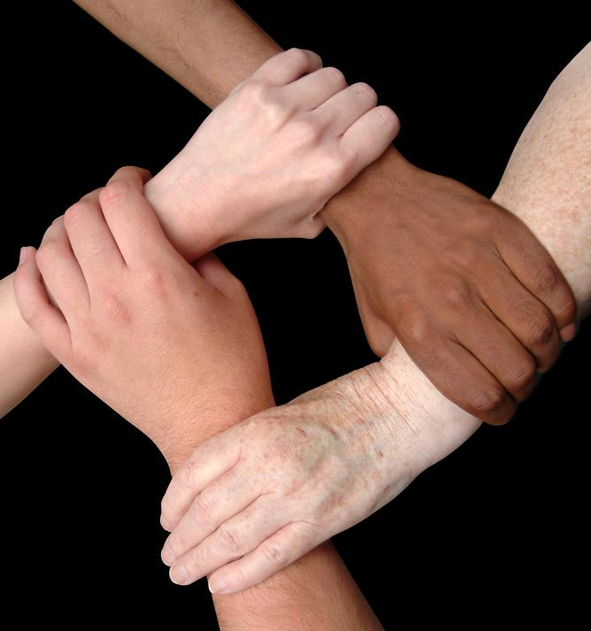
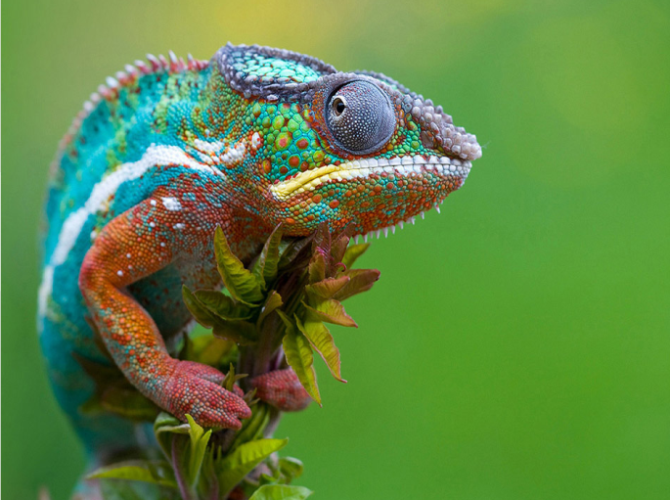
Teams are…
2+ Individuals
Dynamic
Goal-Oriented
Interdependent
Adaptive
Relevant Citation: Salas, Burke, & Cannon-Bowers (2000)

Slide 11
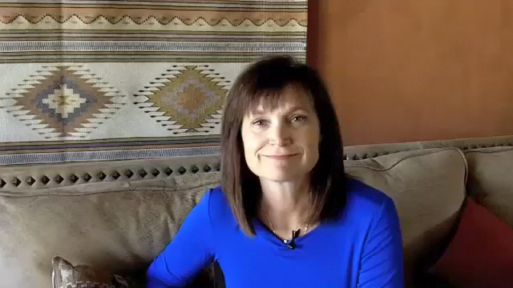
Kristen Arnold on the Difference Between Groups and Teams

Slide 12
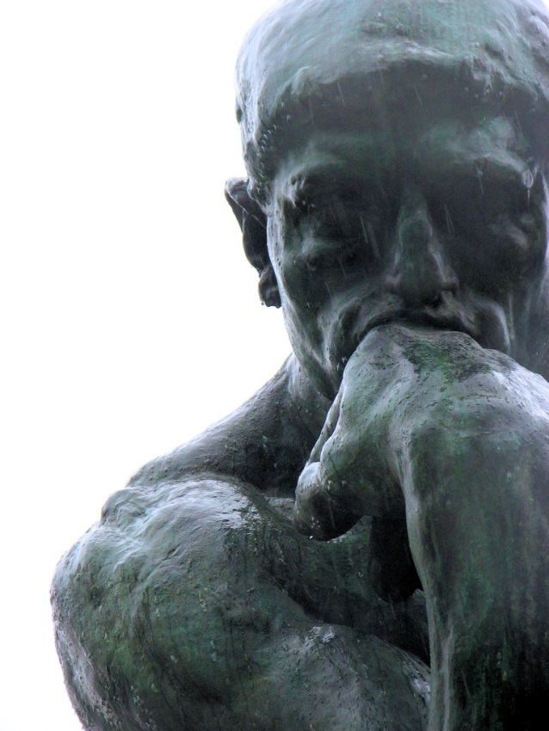


What is Teamwork?
FEELINGS
THOUGHTS
Relevant Citation: Kozlowski & Bell (2003)

Slide 13

Course Nuts and Bolts
Informative
  Teamwork strategies
  Various perspectives on teamwork
Interactive
  Demonstrations
  Discussion
  Practice
Informal
  Self-paced

Slide 14




Focused on Four Teamwork Skills
LEADERSHIP
COMMUNICATION
SITUATION
MONITORING

Slide 15
References
Baker, D. P., Day, R., & Salas, E. (2006). Teamwork as an essential component of high‐reliability organizations. Health Services Research, 41(4p2), 1576-1598.
Cannon-Bowers, J. A., & Bowers, C. (2011). Team development and functioning. In S. Zedeck (Ed.), APA handbook of industrial and organizational psychology (Vol. 1, pp. 597-650). Washington, DC: American Psychological Association.
DeChurch, L. A. & Mesmer-Magnus, J. R. (2010). The cognitive underpinnings of effective teamwork: A meta-analysis. Journal of Applied Psychology, 95, 32-53.
Kozlowski, S. W. J., & Bell, B. S. (2003). Work groups and teams in organizations. In W. C. Borman, D. R. Ilgen, & R. J. Klimoski (Eds.), Handbook of Psychology: Industrial and organizational psychology, (Vol 12, pp. 333-375). New York, NY: Wiley-Blackwell.
Mathieu, J. E., Maynard, M. T., Rapp, T. & Gilson, L. (2008). Team effectiveness 1997-2007: A review of recent advancements and a glimpse into the future.
Salas, E., Dickinson, T. L., Converse, S. A., & Tannenbaum, S. I. (1992). Toward an understanding of team performance and training. In R. W. Swezey, & E. Salas (Eds.), Teams: Their training and performance (pp. 3-29). Westport, CT: Ablex Publishing
Salas, E., Burke, C. S., & Cannon-Bowers, J. A. (2000). Teamwork: Emerging Principles. International Journal of Management Reviews, 2(4), 339-357.
Salas, E. Shuffler, M. L., Thayer, A. Bedwell, W. L., & Lazzara, E. H. (Under Review).
Salas, E., Sims, D. E., & Burke, C. S. (2005). Is there a “Big Five” in teamwork? Small Group Research, 36, 555-599.

