Slide 1
Communication
TEACH Teamwork
Module 2

Slide 2
Contributors
University of Central
Florida (UCF)
Eduardo Salas, PhD
Lauren E Benishek, PhD
Megan Gregory, MS
Ashley Hughes, MS
Shannon Marlow, BS
Christina Lacerenza, BS
Stephanie Zajac, MS
The Coalition for Psychology in Schools and Education, especially to
Sylvia Rosenfield, Ph.D.
Markeda Newell, Ph.D.
Karin Hodges, Psy.D.
Peter Sheras, Ph.D.
George DuPaul, Ph.D.
The Center for Psychology in Schools and Education (CPSE) Staff
Rena Subotnik, Ph.D., Director
Geesoo Maie Lee, BA, Program Officer

Slide 3
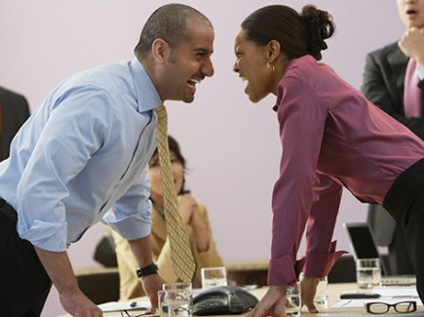
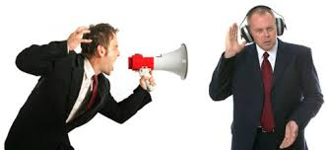
A Vignette
The principal of McKenna Elementary held a meeting during which the teachers were to design a schedule for the children regarding time spent with their primary teacher and specialized teachers (like art and music). Once the meeting began, the principal quickly opened the floor for discussion. The Physical Education teacher shouted, “The students should spend more time each week in PE than they do in music!” The music teacher barked back, “Absolutely not! There should be equal time devoted to PE and music!” From there, all of the teachers began raising their voices and arguing about whose time was more valuable to the students.

Slide 4
Thoughts on Communication
You can have brilliant ideas, but if you can’t get them across, your ideas won’t get you anywhere.
-Lee Iacocca
Communication does not always occur naturally, even among a tight-knit group of individuals. Communication must be taught and practiced in order to bring everyone together as one.
-Mike Krzyzewski
The most important thing in communication is to hear what isn’t being said.
-Peter Drucker

Slide 5
This Module Will Help You:
Understand that communication is critical
Identify barriers to effective communication
Learn what clear, brief, timely, and complete messages are like
Communicate critical information through structured communication techniques

Slide 6
Part 1:
Communication: What, Why, Why Not, and How?

Slide 7




What is Communication?
And why do we Communicate?
For Shared
Perspective
Sender
Receiver
The creation of a dialogue between two or more individuals
For Talent
Integration
For Information
Exchange
  Relevant Citations: McIntyre & Salas (1995) Cannon-Bowers, Tannenbaum, Salas, & Volpe (1995)

Slide 8

Communication is the Foundation for Teamwork
Enables leaders to provide feedback, clarify team roles and define team norms
Enhances the delivery and effectiveness of mutual support
Relays information obtained through situation monitoring
LEADERSHIP
MUTUAL
SUPPORT
SITUATION MONITORING
COMMUNICATION
  Relevant Citations: Burke, Stagl, Klein, Goodwin, Salas and Halpin (2006) Cannon-Bowers, Tannenbaum, Salas, & Volpe, (1995) Salas, Sims & Burke (2004)

Slide 9
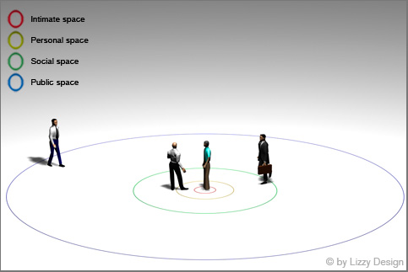




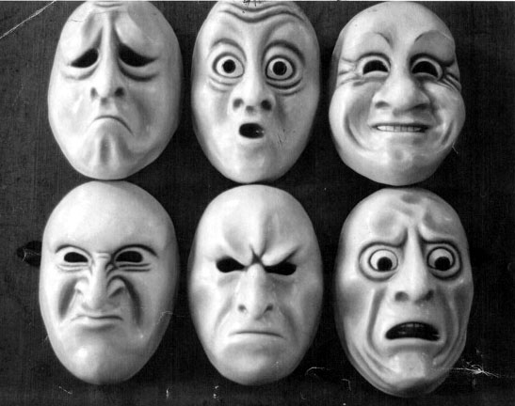

Communication Barriers
Physical Distance
Unverified
Information
Language Differences
Communication Style
Competing Priorities
Emotion

Slide 10
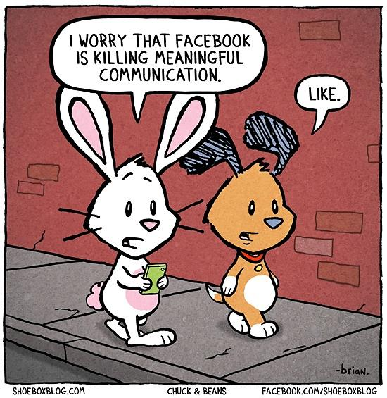
How We Communicate
Relaying information non-verbally
  Body language
  Written messages
Speaking
  In person
  Telephone
  Virtual conferences
Listening
  Receiving the message
  Interpreting the message
  Relevant Citation: Cannon-Bowers, Tannenbaum, Salas, & Volpe, (1995)

Slide 11
Part 2:
Communication Strategies

Slide 12
Part 1 Review
What is communication?
How do we communicate?
Why do we communicate?
What is the purpose of good communication in teams?
What are examples of barriers to productive communication?

Slide 13
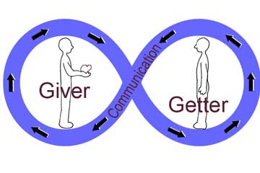
Best Practices and Communication Strategies
Best Practices
Strategies
Closing the loop
SBAR: Situation, Background, Assessment, Recommendation
Clear
Brief
Timely
Complete
Paraphrasing
Perception checking
Clarifying questions
Sender
Receiver
  Relevant Citations: Herschel, Nemati & Steiger (2003) King et al. (1995) McIntyre & Salas (1995)

Slide 14
Closed-Loop Communication
Initiation of a message by a Sender
Receipt and acknowledgement of the message by the Receiver
  Paraphrase and perception check
Verification of the message by the Sender
Sender
Receiver
Sender
  Relevant Citations: King et al. (1995) McIntyre & Salas (1995)

Slide 15
Sending and Receiving Content Using
Closed-Loop Communication
SENDER
RECEIVER
RECEIVER
SENDER
Asks Clarifying Question
Perception checks
Initiates clear, brief, timely, and complete message
Paraphrases
Quietly and attentively accepts message
Confirms, Simplifies, or Clarifies
Listens
  Relevant Citations: King et al. (1995) McIntyre & Salas (1995)

Slide 16
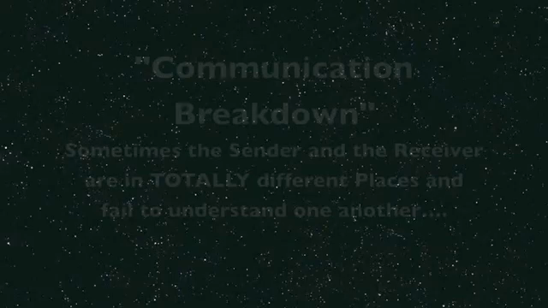
Communication Breakdown

Slide 17
Characteristics of
Effective Communication
EFFECTIVE COMMUNICATION
Complete
Clear
Brief
Timely
  Relevant Citations: Kripalani & Weiss (2006) Wilson, Burke, Priest & Salas (2005) Leonard, Graham, & Bonacum (2004)

Slide 18
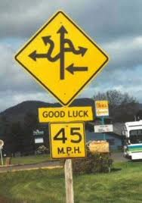
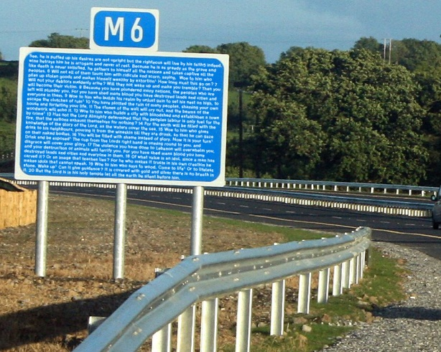
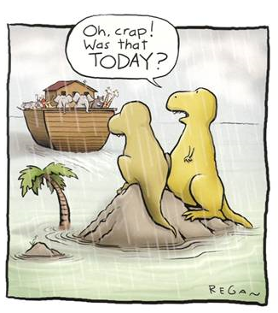
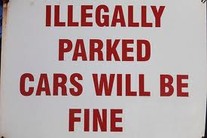
Effective Communication Is…
CLEAR
BRIEF
COMPLETE
TIMELY
  Relevant Citations: Kripalani & Weiss (2006) Wilson, Burke, Priest & Salas (2005) Leonard, Graham, & Bonacum (2004)

Slide 19
Exercise: Peer Feedback
Partner up
Explain a problem you are having with a student to your partner
Have your partner provide feedback on the effectiveness of your message (make sure they focus on clear, brief, and complete communication)
Switch roles
Group discussion will follow

Slide 20



Seeking Comprehension:
Listening Skills of Effective Communicators
Paraphrasing
Perception checking
Asking clarifying questions

Slide 21
The POWER of Listening
    Signals you value others’ thoughts and feelings
    Builds trust and self-esteem
TIPS for Listening
    Pause for a few seconds before speaking to:
      Avoid the risk of interrupting
      Show you are carefully considering the message
      Better understand what is being shared
    Get clarification
      E.g., “How do you mean?”
    Paraphrase
      E.g., “What you are saying is…”
  Relevant Citation: Mishra & Morrissey (1990)

Slide 22
Paraphrasing
LISTEN
Restate MEANING in your own words
CONFIRM understanding
Example:
“So, you’re concerned the curriculum does not have enough repetition for some of the students in your class. Have I understood your concern?”
  Relevant Citations: Kripalani & Weiss (2006)

Slide 23
Exercise: Paraphrasing
Aim: Paraphrase the Sender’s message.
Sender
(after arriving for a meeting):
I am worried we do not have time to address all of my concerns this week. So, I am hoping to spend the first 30 minutes of this meeting focused on a conversation that I had with Josh’s parents. I want to spend the second 30 minutes discussing the ways in which my students seem to be overly impulsive and energized since they returned from Spring break. I’d like to curb the energy level in my class and I am looking for some tips from you.

Slide 24

Perception Checking
A statement which communicates to the Sender that, in addition to the content, the Receiver has heard or perceived an emotion in the message.
Example:
  “You look and sound overwhelmed and rushed. I also sensed frustration in you when you mentioned Josh’s parents. Are you feeling frustrated with something?”

Slide 25

Closing the Loop
Receiver (a) confirms that the message was received and (b) paraphrases the understood meaning
  Example: “Thank you for the note. I will add new basketballs to our next equipment order.”
If the Receiver does not confirm that the message was both received and understood, then the Sender should check back with the Receiver
  EXAMPLE: “Did you receive my e-mail message to you about adding basketballs to the next equipment order?”
  Relevant Citation: Henriksen et al. (2008)

Slide 26

Asking Clarifying Questions
Receivers should ask questions of the Sender to better understand the information being shared

Slide 27
Exercise: Clarifying The Message
  Sender: “I am pressed for time and frustrated about our time constraints. I am not upset with Josh’s parents at all – the meeting was actually informative and hopeful and I understand much more about Josh’s academic history…”

Slide 28
Example: Clarifying Question
“Could you tell me more about the productive meeting with Josh’s parents? How was the meeting helpful?”
“I know the schedule has been packed. Beyond feeling pressured and frustrated, I’d like to learn more about how time constraints are affecting your experience on the student support team.”

Slide 29
SBAR Communication Technique
To be used when 2 or more people share responsibility for a student
SBAR:
  Situation: What is happening at present?
  Background: What is the history leading to the present situation?
  Assessment: What are my thoughts about the situation?
  Recommendation: How do I think the situation should be handled?
  Relevant Citation: Henriksen et al. (2008)

Slide 30
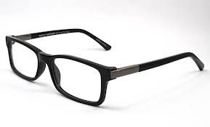
Example: SBAR
Mr. Johansen, I’d like to talk about your third period student, Thomas Smith. Thomas arrived in my office today complaining of problems completing the classwork because he was not able to see the board [Situation]. In this past year, Thomas has had multiple instances of not being able to complete his classwork [Background]. It seems to me that he might have some vision problems [Assessment], and I recommend that he see an optometrist [Recommendation] so that he is able to get treated and complete his schoolwork in the future.

Slide 31
Teamwork Actions
Be aware of communication barriers
Communicate completely, clearly, briefly and timely with your team members
Focus as much on listening as sharing
Verify and share information frequently with your team members

Slide 32
Activity
Please address the following.
  Identify one important concept that you learned while completing this activity. Why do you believe that this concept is important?
  Apply what you have learned from this activity to some aspect of your professional life.
  What question(s) has the activity raised for you? What are you still wondering about?
Now discuss your answers with a partner.
  Did you come up with the same concept?
  How can you learn from what they mentioned?
Notes:
to communication, ways in which we communicate, closed-loop communication, and SBAR.

Slide 33
References
Baker, D. P., Salas, E., King, H., Battles, J. and Barach, P. (2005). The role of teamwork in the professional education of physicians: Current status and assessment recommendations. Journal on Quality and Patient Safety, 31, 185 – 202.
Burke, C. S., Stagl, K. C., Klein, C., Goodwin, G. F., Salas, E., and Halpin, S. M. (2006). What type of leadership behaviors are functional in teams? A meta-analysis. The Leadership Quality, 17, 288-307.
Cannon-Bowers, J. A., Tannenbaum, S. I., Salas, E., & Volpe, C. E. (1995). Defining competencies and establishing team training requirements. In R. Guzzo & Salas (Eds.), Team effectiveness and decision making in organizations (p. 333-380). San Francisco, CA: Jossey-Bass.
de Vries, R. E., van den Hooff, B., & de Ridder, J. A. (2006). Explaining knowledge sharing: The role of team communication styles, job satisfaction, and performance beliefs. Communication Research, 33(2), 115–135.
Dickinson, T. L. and McIntyre, R. M. (1997). A conceptual framework for team measurement. In M. T. Brannick, E. Salas, & C. Prince (Eds.), Team performance and measurement: Theory, methods and applications: 19-43. Mahwah, NJ: Lawrence Erlbarum Associates.
Edmondson, A. C. (2003). Speaking up in the operating room: How team leaders promote learning in interdisciplinary action teams. Journal of Management Studies, 40(6), 1419–1452.
Haskard Zolnierek, K. B., and DiMatteo, M. R. (2009). Physician communication and patient adherence to treatment: A Meta-analysis. Med Care, 47, 826-834.
Herschel, R. T., Nemati, H. and Steiger, D. (2001). Tacit to explicit knowledge conversion: knowledge exchange protocols. Journal of Knowledge Management, 5,107 – 116.
McIntyre, R. M. and Salas, E. (1995). Measuring and managing for team performance: Emerging principles from complex environments. In R. Guzzo & Salas (Eds.), Team effectiveness and decision making in organizations (p. 333-380). San Francisco, CA: Jossey-Bass.
Mehrabian, A. (1971). Silent Messages. Oxford, England: Wadsworth.
Mesmer-Magnus, J.R., & DeChurch L.A. (2009). Information sharing and team performance: A meta-analysis. Journal of Applied Psychology, 94(2): 535-546.
Orasanu, J. and Salas, E. (1993). Team decision making in complex environments. In Klein, G. A., Orasanu, J., Calderwood, R., and Zsambok, C. E. (Eds.), Decision Making in Action: Models and Methods (p. 327-345). Norwood, NJ: Ablex.
Oser, R. L., Prince, C., and Morgan, B. B. (1990, October). Difference in aircrew communication content as a function of flight requirement: Implications for operational aircrew training. Poster presented at the 34th Annual Meeting of the Human Factors Society, Orlando, FL.
Salas, E., Sims, D. E., & Burke, C. S. (2005). Is there a “Big Five” in teamwork? Small Group Research, 36, 555-599.
Henriksen, K., Battles, J. B., Keyes, M. A., Grady, M. L., King, H. B., Battles, J., ... & Salisbury, M. (2008). TeamSTEPPS™: team strategies and tools to enhance performance and patient safety.
Mishra, J., & Morrissey, M. A. (1990). Trust in employee/employer relationships: A survey of West Michigan managers. Public Personnel Management.
LePine, J. A., Piccolo, R. F., Jackson, C. L., Mathieu, J. E., & Saul, J. R. (2008). A meta-analysis of teamwork processes: Tests of a multidimensional model and relationships with team effectiveness criteria. Personnel Psychology, 61, 273-307.

